Slide 1
2022/2023 Practicum Supervisor Overview

Slide 2
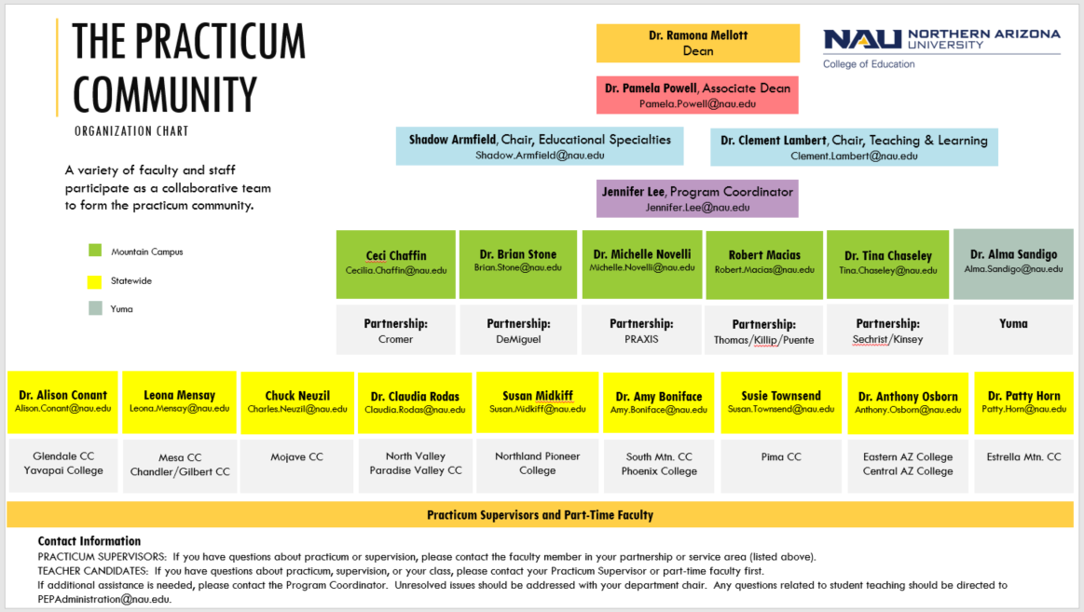
Organization Chart
Notes:
THIS DOCUMENT IS ALSO FOUND IN THE BBLEARN PRACTICUM RESOURCE COURSE. IT CAN BE DOWNLOADED FROM THERE FOR A MORE VIEWABLE AND CLEAR VERSION (this is only a screenshot and difficult to see).
This organizational chart identifies those involved in practicum working together to support Teacher Candidates. If you have questions or concerns, first contact the faculty member in your partnership or service area, noted above in the green and yellow boxes. If you need additional assistance, please contact the Program Coordinator, Jennifer Lee. Unresolved issues should be addressed with the appropriate department chair.
This is not meant to be hierarchal, but to demonstrate proper channels for questions and concerns, and to highlight all involved that support our Teacher Candidates. Statewide faculty that oversee Practicum Supervisors in a particular area are referred to as Anchor Faculty. Faculty on the mountain campus that coordinate a partnership are referred to as Partnership Leads or Lead Faculty.

Slide 3
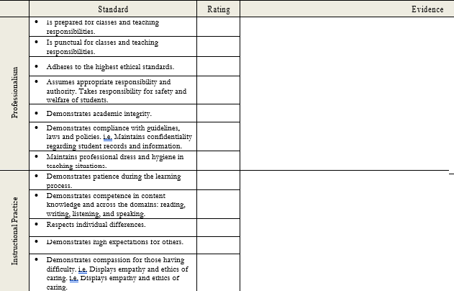
Guiding Documents
NAU Dispositions Tool
Notes:
These are guiding documents utilized during practicum. Each are explained in further detail in this presentation and/or in the handbook.

Slide 4
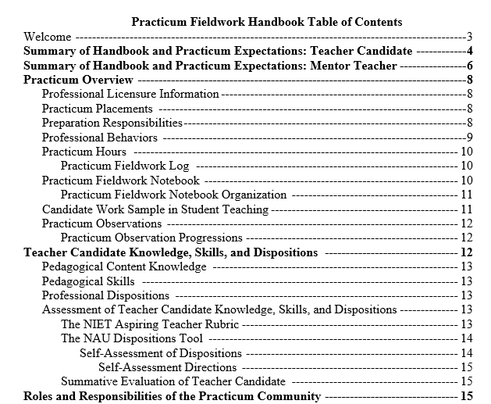
Practicum Syllabus & Handbook
Notes:
There is a separate handbook for ECI 608.
Please provide the handbook to all Teacher Candidates and their Mentors.
Practicum Supervisors may augment and expand upon the handbook by adding assignments and information which support the minimum course objectives and outcomes. Content should not be removed from the syllabus and handbook.
The items in red print in the syllabus should be populated with your information.

Slide 5
NAU Dispositions Tool
Professionalism
Instructional Practice
Critical Thinking
Reflective Practice
Communication
Personal Attributes
Cultural Competence
Collaboration
Instructional Skills
Notes:
The NAU Dispositions Tool (found in the handbook) details the dispositions that Teacher Candidates are expected to demonstrate during practicum, and should be used during observations. Teacher Candidates are required to self-assess their performance on the NAU Dispositions at the beginning of each practicum experience. At the end of the term, Practicum Supervisors and Mentor Teachers complete a summative evaluation, so proper documentation should be completed throughout the term to assist in this evaluation.

Slide 6
NIET Aspiring Teacher Rubric
Notes:
The NIET Aspiring Teacher Rubric (ATR) provides a streamlined set of performance indicators to be used with teacher candidates to define effective instruction. These 12 indicators, which are based on and aligned to NIET’s research-based Teaching Standards Rubric, describe the key skills and abilities that aspiring teachers must have to be prepared for the classroom. The descriptions within NIET’s Aspiring Teacher Rubric create common language for observation, feedback, and support as well as foster collaboration between an aspiring teacher and peers or faculty around instructional practices. The vision represented within the rubric maximizes instructional excellence and correlates with student achievement. Since the rubric is a proprietary tool, it cannot be provided in the handbook. You will receive a copy through email and BbLearn prior to the beginning of the semester. As a Practicum Supervisor, you also have access to the NIET PREP portal, where you can find the rubric and supporting materials.
We have created a set of progressions (shown above) for the ATR that are developmentally sequenced teaching skills that Teacher Candidates are expected to demonstrate throughout the 3 terms of practicum. Practicum Supervisors will work with Teacher Candidates to identify specific indicators to focus on as they progress through each practicum fieldwork experience. Practicum Supervisors of Terms 4 and 5 should also use the ATR, and select indicators their Teacher Candidates need to develop further.

Slide 7
Model Code of Ethics for Educators
Notes:
The PEP Alert system is based on the MCEE. Prior to student teaching, all Teacher Candidates must complete the following course in BbLearn: “Professional Dispositions Module: “Introducing the Model Code of Ethics for Educators”.
The dispositional concern process can be found on pg. 9 of the handbook, and the dispositional concern form on pg. 36. Step 2 of this process requires that a PEP Alert be completed. IF YOU NEED TO COMPLETE AN ALERT, PLEASE CONSULT WITH THE LEAD/ANCHOR FACULTY FIRST AND COMPLETE THE PROCESS TOGETHER.
Since our TC’s are evaluated on the NAU Dispositions, the alert form crosswalks the MCEE Principles with the NAU Dispositions. If you have concerns regarding content knowledge and teaching skills, follow the same process as found on pg. 9.

Slide 8
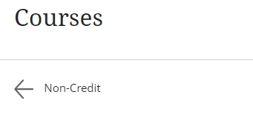
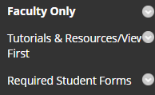
BbLearn: Practicum Resources
The “ECI-ESE Practicum” resource course is found in your “Non-Credit” courses (screenshots below). This is separate from your own practicum course that you will build. You may download any of the resources for your use. Contact ITS (928) 523-3335 if you need any assistance with BbLearn.
Notes:
This might be changed to Microsoft TEAMS for fall 2023 because of the conversion to Canvas. Non-credit courses might not be transferred to Canvas.

Slide 9
Expectations of Practicum Supervisors
Initial Meetings
Communication
Observations
Summative Evaluation
Notes:
Expectations of Practicum Supervisors: The Practicum Supervisor will schedule a meeting during the first few weeks of the semester with the Mentor Teacher and the Teacher Candidate. This may be in-person or virtually through Zoom or similar application. The purpose of this meeting is to review practicum expectations, forms, the end of term summative evaluation, and to answer any questions. It is suggested that you also have a meeting with your entire class at the beginning of the term to discuss the practicum course, expectations, etc.
The Practicum Supervisor should check in with the Mentor Teacher periodically (at least once monthly) to discuss the Teacher Candidate’s knowledge, skills, and dispositions, and to address any concerns. He or she will serve as a contact between the placement school and the University. Communicate at least monthly with the Anchor Faculty/Partnership Lead regarding the Teacher Candidate and the opportunities provided to them in the classroom.
Each Teacher Candidate will have at least two formal observations. The timing of the observations should fit the Mentor Teacher’s needs, and they should have the opportunity to approve the lesson plan according to their curricular goals and learning needs of their students.
Practicum Supervisors are responsible for completing a summative evaluation and assigning a final grade, based on the Mentor Teacher’s feedback and successful completion of other course assignments outside of the in-person hours in the placement classroom.

Slide 10
1st steps as a Practicum Supervisor
Finalize your syllabus (you may augment the syllabus, but not remove content or assignments in the syllabus as these are minimum expectations).
Contact TC’s in your practicum course through Louie.
TC’s should send an introductory email to their MT’s, and copy you.
Schedule the Initial Meeting between you, the MT, and the TC, preferably before TC enters classroom. Please distribute the handbook and observation materials to the MT and TC prior to the meeting.
Discuss expectations
Finalize TC schedule
Discuss observations
Answer questions
Schedule a mandatory meeting that includes all of your TC’s at the beginning of the term.
Communicate at least monthly with the Anchor Faculty/Partnership Lead and MT’s regarding the TC’s knowledge, skills, and dispositions. Address concerns as soon as they are noted to allow time for the TC to progress.
Follow the dispositional process in the handbook when concerns arise.

Slide 11
Suggested Observation Timelines
Send email to TC and MT 5 days in advance to confirm
Require lesson plan 3 days in advance from TC and pre-conference prior to the lesson
Post conference after the lesson
Observe TC
Send both the MT and TC a written summary of the post conference notes (within 1 week)
TC will write a reflection and submit to BbLearn
Notes:
This serves as a guide on what should take place before, during, and after an observation.
Suggested observation timeline:
1st observation within 7th - 8th week
2nd observation within 13th -14th week

Slide 12
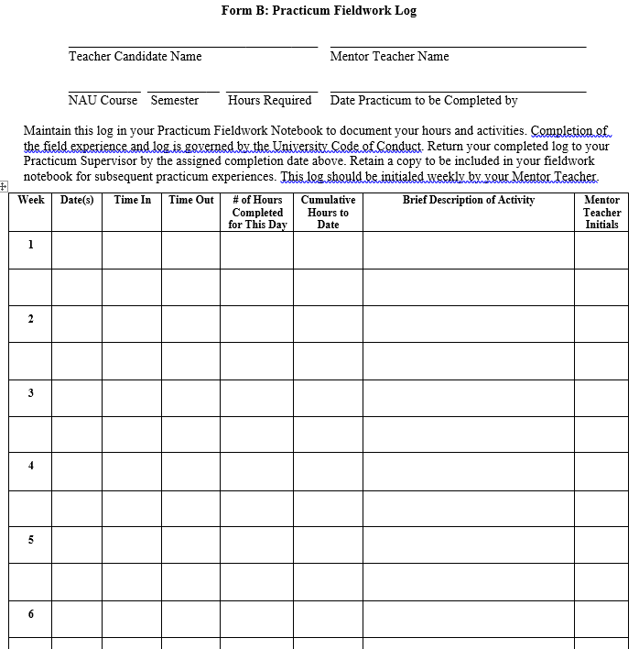
Student Documentation
Notes:
At the beginning of the semester, the Teacher Candidate should ask the mentor to sign their Contract and Statement of Understanding. This form should also be signed by the Teacher Candidate and the Practicum Supervisor (preferably during the 1st initial meeting). This form is their acknowledgement to fulfill all requirements of the practicum course and to adhere to the highest ethical standards.
During the semester, the Teacher Candidate should fill out the Fieldwork Log and have their mentor sign it, preferably weekly, to help document their completion of hours and activities performed.

Slide 13
Assignments
Required assignments:
Practicum Fieldwork Notebook with all elements (Handbook, pg. 6)
NAU Dispositions Self-Assessment (Handbook, pg. 12)
Letter to Mentor Teacher
Completion of hours, attending required meetings, and an overall satisfactory evaluation from the Practicum Supervisor, in conjunction with feedback from the Mentor Teacher and from formal observations
Optional assignments:
Reflections
Lessons and Practicum Experiences (forms located in BbLearn)
Classroom Procedure Form (form located in BbLearn)
ATR Modules and Videos (assignments and URL’s to access are in BbLearn)
Professional Development Workshops
AZ K12 Center
District Level

Slide 14
Practicum Fieldwork Notebook (required)
Teacher Candidates are expected to create a Practicum Fieldwork Notebook for each practicum experience, using a binder or digital format as instructed by the Practicum Supervisor.
The goal of this notebook is to be a ready tool of resources for each placement as well as a record of growth as the Teacher Candidate progresses through each practicum experience.
The Teacher Candidate builds their notebook during Practicum 1 through Practicum 3-5.
Several digital notebook options are Google Slides and the BbLearn Portfolio. You can choose whichever format/tool you prefer, if you choose the digital format.
Resources for digital options (paste the links in a browser to access):
Google Slides Template (do not have students edit this template; they should download to their own Google account first, then create their own):
https://docs.google.com/presentation/d/1QG6xjvkAFgUVcVkq7nAUQycqK_CxTm4JEAbvhIVCEiM/e dit?usp=sharing
Google Slides notebook example, from a first and second semester Teacher Candidate: https://docs.google.com/presentation/d/1_dRihU08lF7e0pgEtQ3EZRHR_6qIyAQC/edit#slide=id.p1
BbLearn Portfolio: There is a tutorial in the BbLearn shell for Teacher Candidates and Practicum Supervisors.
Notes:
More information on the Practicum Fieldwork requirements can be found in the handbook on pg. 6.
The Digital Portfolio Template is to be used as a guide only. The students can be creative in how they develop their own portfolio. You can require specific elements as well, but please refer to the handbook for the minimum requirements.
Thank you to Dr. Ali Conant for providing the Google Slides Template, and example portfolio from one of her Teacher Candidates!

Slide 15
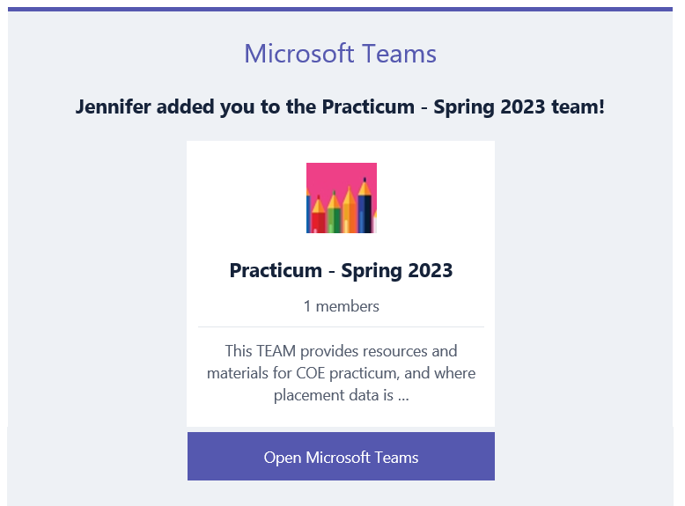
Placement Data
Each semester, Practicum Supervisors are asked to provide placement information for each practicum course they are assigned to.
This data is used to send the summative evaluations at the end of the term.
The method of collecting placement data is through Microsoft TEAMS.
You will receive the placement data request from the Practicum Coordinator, and an invitation email from Microsoft TEAMS to the “Practicum – Spring 2023” Team in late February or early March.
You will use your NAU email and password to login to TEAMS.
Notes:
Microsoft TEAMS is Microsoft Office application that you may already have on your computer as part of the Microsoft Office Suite, or it can be easily installed.
You will also need Microsoft Excel on your computer
Prior to the request for placement data, which will occur sometime in September or early October, please make sure you have Microsoft Teams and Excel installed on your computer
The email invite to the Team will be from Microsoft Teams (see above). You should receive this email the same day you receive the request for placement data from the Practicum Coordinator. If you do not receive this email, check your Spam folder, or simply login to Teams using your NAU credentials and the Practicum – Fall 2022 will be in your account. You will not see this Team until the request for placement data is sent in September or early October.

Slide 16
Mileage
Mileage Steps for Practicum Supervisors:
Complete travel training. Spring dates and sign up can be located here: https://in.nau.edu/rpsu/nau-travel-training/
Complete a Travel Funding Request Form each semester. THIS MUST BE COMPLETED PRIOR TO TRAVELING OR YOU MAY NOT BE REIMBURSED.
Estimate the number of trips you will take each semester.
Submit the form to Julie.Ellsworth@nau.edu prior to your first trip. She will review, complete the funding information on the bottom, and sign. Julie will use this form to create your travel ticket.
Keep a Mileage Log of your travel, and submit the log to Julie. She will upload it to your ticket. This is a mileage log specific to Practicum; don’t use the form on the COE website.
You may submit the mileage log to Julie monthly or at the end of the semester.
Complete your Annual Travel Certification Form prior to your first trip.
Be approved as an authorized driver by completing the Authorized Driver Training prior to your first trip.
Mileage is paid for statewide Practicum Supervisors only, or for those traveling a certain distance outside of Flagstaff.
Notes:
The revised Travel Funding Request form and the 2023 Mileage Log are also in BbLearn. Don’t utilize the mileage log on the COE website as we have one specifically for practicum.
To access the Annual Travel Certification Form: https://in.nau.edu/comptroller/forms/
To access the Authorized Driver Training: For those with NAU credentials, submit your Authorized Driver Requests online. Copy and paste this URL into your browser for driver information: https://news.nau.edu/nau-authorized-driver/?utm_medium=email&utm_source=7-13-22%20edition&utm_campaign=NAUNews&utm_term=internal&utm_content=authorized_driver

Slide 17
Covid-19 Information
Students will be expected to comply with requirements of internship, placement sites, and field work/trip sites. Settings where masks may be required will evolve as public health requires.
Faculty teaching and working at sites not operated by NAU should follow the guidance of the hosting partner (community college, or other facility owner).
Our private affiliates can require masks and/or vaccinations since the practicum takes place on their property.
You should honor any approved accommodations through Disability Resources, and will be notified by that department.
Work with students who are isolating, or are experiencing Covid-related in-person disruptions. Support them to continue to make progress in their practicum course.
For up-to-date Covid-19 policies and information, visit the Jacks are Back website.

Slide 18
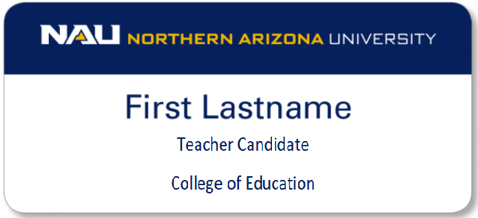
Name Badges
For Practicum Supervisor Name Badges:
Provide new supervisor information to the following contacts including name, complete title, and shipping address (if statewide).
For Teaching and Learning: Michele.Benedict@nau.edu
For Educational Specialties: Jude.Fulkerson@nau.edu
For Teacher Candidate Name Badges:
Requests should come from Leads and Anchors (or in some cases the Practicum Supervisor) and go through the department contact above.
If a student has a name change or loses a badge, have the student contact All Awards directly to arrange payment and shipping. We do not pay for additional badges.
https://awardstudio.com/
928-774-1997
Yuma - Requests for funds should go through the
Provost’s office. Route through John Georgas,
Vice Provost for Academic Operations.
Notes:
All practicum students should wear NAU name badges while in the field.
For remote students, the badges will be sent to the supervisor, who will provide them to each student during their first observation.
Yuma monies do not come to the COE, so they have a different process.

Slide 19
Practicum Supervisor Resources
Practicum page on the COE website: https://nau.edu/coe/practicum-resources/ (this is also a resource page for mentors and teacher candidates)
BbLearn Practicum Resource course: “ECI-ESE Practicum”
NIET Prep portal: www.nietprep.org
Tech Resources:
In Blackboard, on the bottom left, you will find “Help for Instructors” and “Video Tutorials”.
E-Learning Center – Here you will find information about recorded workshops and webinars for BbLearn, Collaborate Ultra, etc. E-Learning is also available by phone for individual support.
nau.edu/elearning/
(928) 523-3335
Affiliation Agreements: https://nau.edu/coe/practicum-resources/
Notes:
NIET PREP is a subscription-based interactive web tool that provides access to professional development, training, and certification resources to enhance instruction and observation of aspiring teachers. NIET PREP houses resources to extend aspiring teachers' understanding of effective instruction, as well as models of providing impactful instructional feedback to support supervisors and cooperating mentor teachers with their role in developing aspiring teachers. NIET PREP a wonderful repository of resources that support building a teacher’s capacity to execute best practices that will grow teachers and their students towards excellence. Should you have any questions related to the technology, access, or content within NIET PREP, please feel free to contact our support team at support@niet.org or call us at 1(800)575-NIET. Our support team responds to user requests Monday – Friday 8:30 am CST – 5:30 pm CST.

Slide 20
Contact Information
Your first point of contact should be the Lead or Anchor Faculty, if one is associated with your practicum course. If you need additional assistance, please contact the Program Coordinator, Jennifer Lee:
Jennifer.Lee@nau.edu
(928) 523-3678

Slide 21
Thank you

