Slide 1
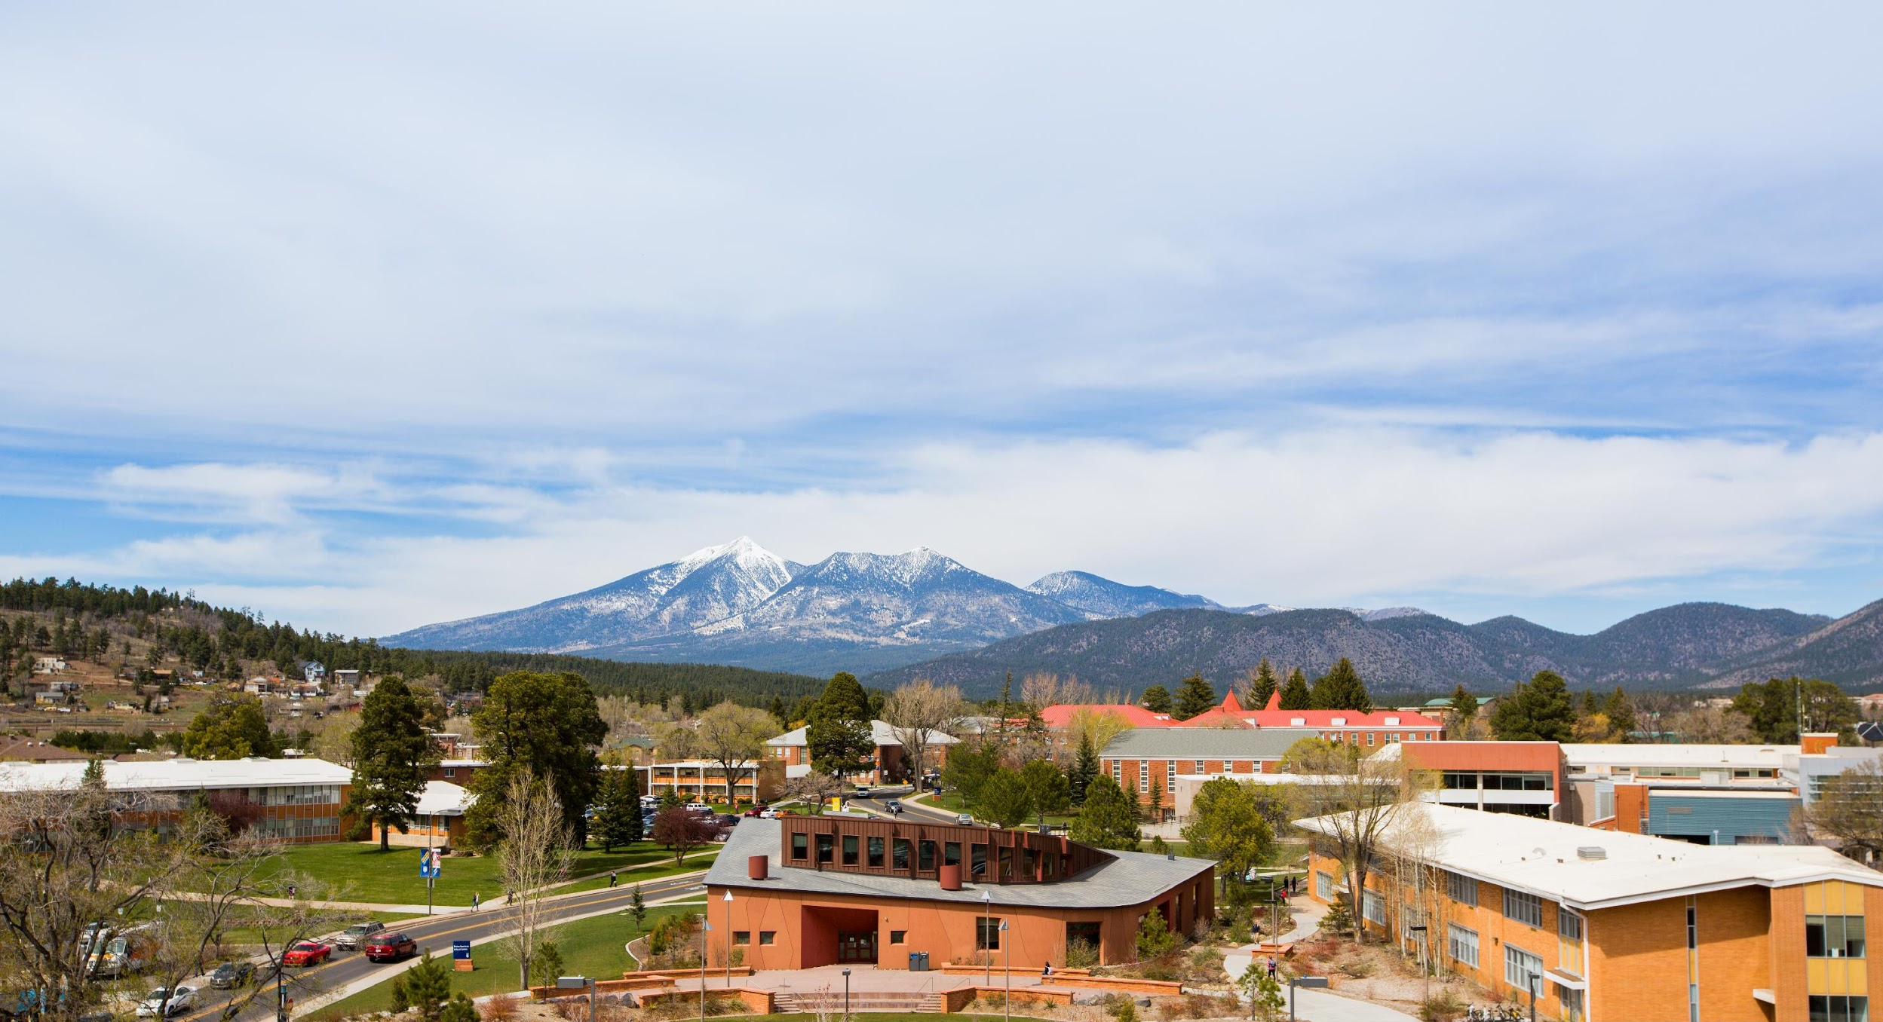
Arizona Teacher Licensure Exams:
Information & Preparation Resources
AY 2022-2023
Notes:
*** PUBLISH TO WEB AND ADD LINK!

Slide 2
Topics
Which licensure exam(s) do you need to take?
When should you take the licensure exam(s)?
How to best prepare for licensure exam(s)?
How to register for licensure exam(s)?
Other helpful information and resources
What if I do not plan on teaching in Arizona?
What exams do I need to take for Student Teaching Intern Certificate (STIC) opportunities?
Middle Grade Single-Subject Class Student Teaching Placement (BSED Elementary Education, MED Elementary Education with Certification, OR BSED Special & Elementary Education)
Test anxiety strategies
Please ask questions throughout and at the end of the presentation

Slide 3
Which licensure exam(s) do you need to take?
To teach in Arizona:
Professional Knowledge
Aligns to InTASC Standards and methods coursework
Subject Knowledge*
Aligns to discipline to standards
Foundations of Reading (Literacy Exam)
Required by all new kindergarten through grade 5 teachers by 2025
*Subject Knowledge exams are optional for some degree programs/teacher certification areas. See the AEPA/NES Resource Sheet for information regarding required and optional licensure exams aligned to NAU’s degree programs and teacher certification areas.

Slide 4
When should you take the licensure exam(s)?
Professional Knowledge and Foundations of Reading:
Recommend taking Professional Knowledge licensure exam(s) right before your student teaching semester or during student teaching
Subject Knowledge:
Subject knowledge can be taken once content knowledge coursework is completed.
Plan Ahead!
It takes approximately 4 weeks to get Professional Knowledge exam results due to scoring handwritten scenario items.

Slide 5
Don’t Stress!
NAU’s Licensure Exam Pass Rates
Pass Rates:
NES Professional Knowledge: Early Childhood (AZ093)
Average pass rate 92% (for AY18-19 thru AY20-21 graduates)
NES Professional Knowledge: Elementary (NT051)
Average pass rate 97% (for AY18-19 thru AY20-21 graduates)
NES Professional Knowledge: Special Education (NT601)
Average pass rate 93% (for AY18-19 thru AY20-21 graduates)
NES Professional Knowledge: Secondary (NT052)
Average pass rate 99% (for AY18-19 thru AY20-21 graduates)
Link to Anxiety Presentation/YouTube Video

Slide 6
Subject Knowledge Exams
Arizona Teacher Licensure Exams:
Preparation Resources
AY 2021- 2022

Slide 7
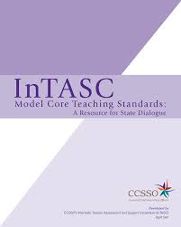
Preparation Step #1
Professional Knowledge Exam items are connected to the InTASC Model Core Teaching Standards.
Download the InTASC Model Core Teaching Standards
Read all 10 Standards
Performances = Be Able to Do
Essential Knowledge = Know
Critical Dispositions = Appropriate Ways to Act
Connect/crosswalk each of the 10 Standards to content from the methods classes you have or will take; make study notes
Link to Pearson AEPA website found here.

Slide 8
Preparation Step #2
Preparation Materials
Link to Pearson AEPA website found here.

Slide 9
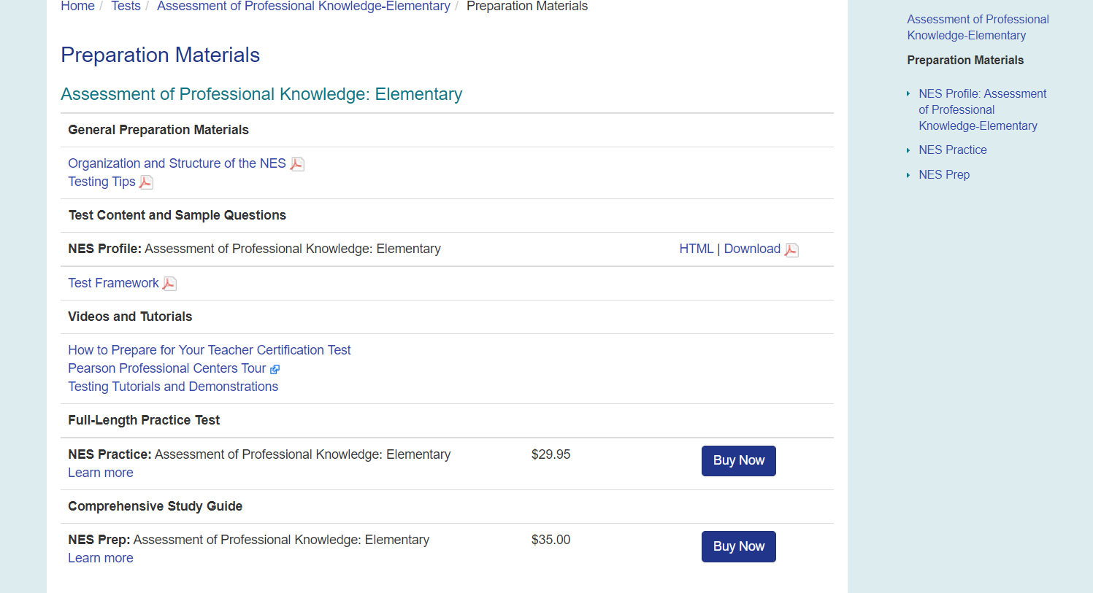
Preparation Materials: NES Profile
Lists structure and content addressed through licensure exam
Provides sample exam items
Examples: PK Elementary and PK Secondary
FREE
Notes:
Download PDF is better than the HTML version- Much easier to go through the materials!
Framework doesn’t have as much information.

Slide 10
Preparation Materials: NES Comprehensive Study Guide
If you are interested in purchasing test preparation materials, we recommend the NES Comprehensive Study Guide for the exam(s) you will be taking (costs range from $25-$35).
Full-length NES practice exams are also available for purchase, but be aware that the items on the practice tests will NOT appear on the actual test (costs range from $17.50-$30).
AVOID purchasing preparation materials from other vendors!
Notes:
Link- to google search

Slide 11
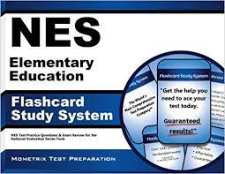
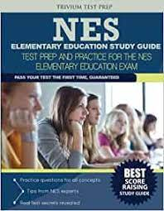
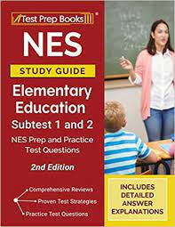
Preparation Materials: NES Profile
DO NOT GET DUPED
Study
Guide
2nd Choice
Study
Guide
1st Choice
Study
Guide
1st Choice
Study
Guide
1st Choice
Notes:
Download PDF is better than the HTML version- Much easier to go through the materials!
Framework doesn’t have as much information.

Slide 12
Subject Knowledge Exams (not required for certification but HIGHLY recommended)
The Subject/Content Knowledge Exam items are directly connected to discipline standards.
Example: Elementary Subject Knowledge aligned to K-5 discipline standards.
Example: Physical Education aligned to K-12 discipline standards
Follow the exact same preparation steps outlined for the Professional Knowledge Exam.
Access your content standards
Access preparation materials from testing website
Connect/Crosswalk each of the standards to your methods courses and material learned though your program of study.
Make study notes
Notes:
Change slide to be two columns- Draw attention to different content standards
Elementary example content example- Subtest I
Physical Education content example

Slide 13
So...tell me again which licensure exam(s) do I need to take?
For example, to teach in Arizona:
BSED Elementary Education NES Professional Knowledge: Elementary (NT051)
NES Foundations of Reading (NT103) (Recommended/Required by 2025)
BSED Special & Elementary Education NES Professional Knowledge: Elementary (NT051)
NES Professional Knowledge: Special Education (NT601)
NES Foundations of Reading (NT103) (Recommended/Required by 2025)
BSED Health Sciences - Physical Education
NES Professional Knowledge: Secondary (NT052)
Link to AEPA/NES Resource Sheet containing information regarding licensure exams aligned to NAU’s degree programs and teacher certification areas.
Link to Arizona Department of Education Arizona Educator Exams found here.
Notes:
Move

Slide 14
Arizona Teacher Licensure Exams:
Registration Steps
AY 2021- 2022

Slide 15
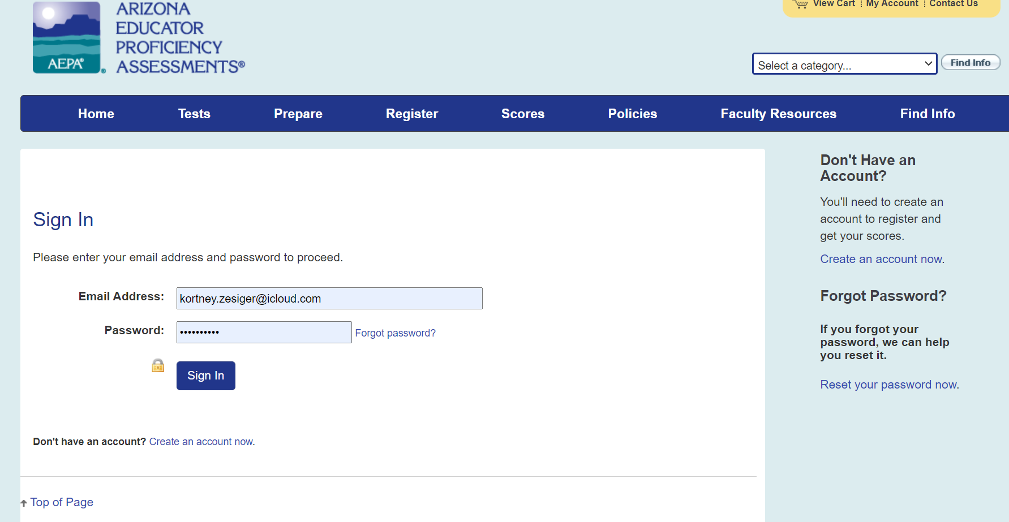
Registration Steps
www.aepa.nesinc.com
Click “My Account” tab and create an account by following all steps
MAKE sure to choose NAU as your reporting school
Let’s try it together now

Slide 16
Registration Steps
PLEASE mark that NAU can receive a copy of your licensure exam results. NAU ONLY uses these results for program evaluation and improvement.
KEEP a copy of your exam results (physical copy and pdf copy)!
Notes:
Cynthia

Slide 17
Cost of Exams
Exams range from $50 for one Elementary Education Subject Knowledge test to $139 for the Foundations of Reading Exam but . . .
AZ residents in an educator program are eligible for a one-time fee waiver for the Foundations of Reading exam
ATA participants receive a personalized voucher link to cover exam fees (voucher request emails are sent tot ATA students every 3 months). Don’t share the link! Contact PEP instead.
See the final page of the AEPA/NES Resource Sheet for more information.
Notes:
Cynthia

Slide 18
Arizona Teacher Licensure Exams:
Needed For Some Student Teaching Placements
AY 2021- 2022

Slide 19
Student Teaching Intern Certificate (STIC)
Licensure Exam Requirements:
A passing score on the required Arizona Professional Knowledge AND the Subject Knowledge exam(s) that correspond to the teaching certificate the applicant is pursuing
NAU’s Student Teaching Resources: https://nau.edu/pep/resources/

Slide 20
Student Teaching Intern Certificate (STIC)
For example, Professional Knowledge Licensure Exam Requirements:
BSED Elementary Education NES Professional Knowledge: Elementary (NT051)
BSED Health Sciences - Physical Education
NES Professional Knowledge: Secondary (NT052)
Plan Ahead! It takes approximately 4 weeks to get Professional Knowledge exam results due to scoring handwritten scenario items.

Slide 21
Student Teaching Intern Certificate (STIC)
For example, Subject Knowledge Licensure Exam Requirements:
BSED Elementary Education NES Subject Knowledge: Elementary Education
Sub-Tests I (NT102): 1) Reading and English Language Arts and 2) Social Studies
Sub-Tests II (NT103): 1) Mathematics, 2) Science, and 3) The Arts, Health and Fitness
BSED Health Sciences - Physical Education
NES Subject Knowledge: Physical Education (NT052)

Slide 22
Student Teaching: Single-Subject Middle School Classroom
BSED Elementary Education, MED Elementary Education with Certification, OR BSED Special & Elementary Education
Subject Knowledge Licensure Exam Requirement (one of the following):
Middle Grades Language Arts (NT201)
Middle Grades Social Studies (NT202)
Middle Grades Mathematics (NT203)
Middle Grades General Science (NT204)
Notes:
Is this still for the STIC? If so I think we should put that on the title like the slides before.

Slide 23
Arizona Teacher Licensure Exams: Planning to teach out-of-state?
AY 2021- 2022

Slide 24
Planning to teach out-of-state after graduation?
Resources
NASDTEC Interstate Agreements - Information for Out-of-State Applicants: https://www.nasdtec.net/page/InterstateAgreements
NAU’s Professional Licensure by State: https://nau.edu/compliance-and-authorization/professional-licensure-by-state/
Plan Ahead! AEPA tests were specifically developed for Arizona and may or may not be accepted by other states. Check out-of-state licensure exam rules in advance.
Notes:
Find graphic of states- NES vs Praxis states

Slide 25
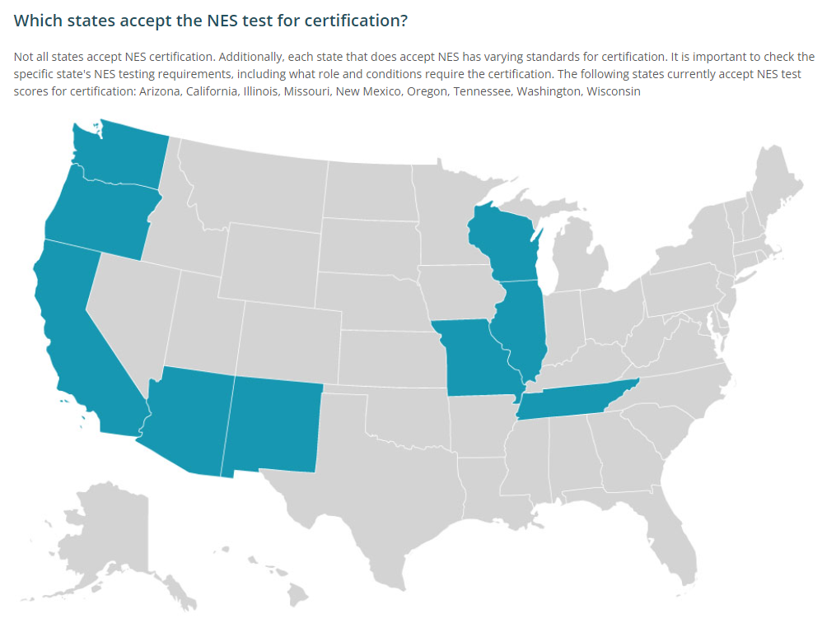
Planning on teaching in a state that requires Praxis instead of NES? Check out this link for state requirements
https://www.ets.org/praxis/states
Notes:
These states will be the easiest to reciprocate to with NES exams. Many other states will accept the NES exam, but may have additional requirements that the candidate will need to fulfill.

Slide 26
Arizona Teacher Licensure Exams: Additional Resources
AY 2021- 2022

Slide 27
Additional Resources
NAU College of Education Test Preparation Resources
Includes link to:
AEPA/NES Resource Sheet
this presentation and presentations related to Test Taking Strategies and Steps for Developing a Study Plan
Zoom recording of presentation
Web course and practice tests for Professional Knowledge Elementary, Special Education, and Secondary Exams as well as Elementary Subject Knowledge Tests I and II
Links to the Arizona Department of Education Testing Information web page
AEPA/NES web page
Notes:
Talk about anxiety presentation and COE/PEP Web page dedicated to test preparation

Slide 28
Questions?
Contact Information:
Email: TestPrepCenter@nau.edu
Email: PEPAdministration@nau.edu
Email: Kortney.Zesiger@nau.edu

