Slide 1
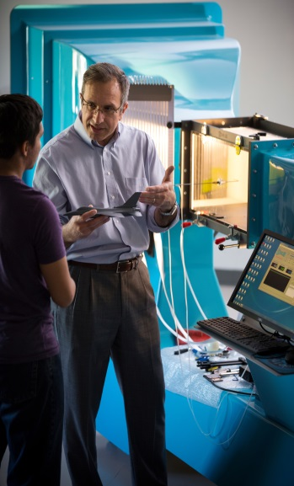
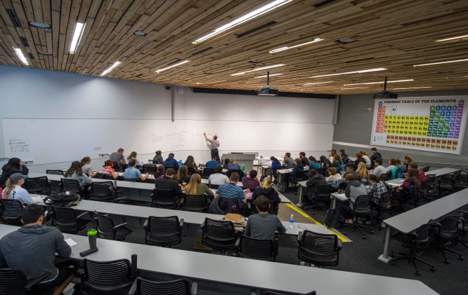
College of Engineering, Forestry & Natural Sciences Spring 2018 College Meeting May 4, 2018

Slide 2
Agenda
Tenure and/or Promotions
A Few Announcements
The History and Future of CEFNS

Slide 3
Tenure and/or promotions

Slide 4
Tenure and/or promotions
Biological Sciences
Dave Able – Senior Lecturer
Paul Dijkstra – Research Professor
Rick Holloway – Senior Lecturer
Nate Nieto – Associate Professor with tenure
Amy Whipple – Associate Professor with tenure
Jason Wilder – Professor
Civil Engineering, Construction Management & Environmental Engineering
Rob Bruner – Associate Professor of Practice
Jeff Heiderscheidt – Senior Lecturer
Ching-Hsing Ho – Associate Professor with tenure

Slide 5
Tenure and/or promotions
Earth Sciences & Environmental Sustainability
Diana Stuart – Associate Professor with tenure (joint with SBS)
Forestry
Matt Bowker – Associate Professor with tenure
Ching-Hsun Huang – Professor
Andrew Sánchez Meador - Associate Professor with tenure
Kristin Waring - Professor
Informatics, Computing & Cybersystems
Kiona Ogle - Professor
Temuulen Sankey – Associate Professor with tenure

Slide 6
Tenure and/or promotions
Mathematics & Statistics
Robert Daugherty – Senior Lecturer
Shannon Guerrero – Professor
Todd Wolford – Senior Lecturer
Physics & Astronomy
Ethan Dolle – Senior Lecturer
David Trilling - Professor
Science Teaching & Learning
Ron Gray – Associate Professor with tenure

Slide 7
Announcements
New President’s Distinguished Teaching Fellow
Ron Gray – CSTL
CEFNS College Teacher of the Year
Stephanie Hurst – Chemistry & Biochemistry
Barry Goldwater Scholars
Austin Dikeman (Biology); Mentors: Faith Walker, Carol Chamber, Daniel Sanchez
Shelby Hutton (Biology); Mentors: Dave Wagner, Joe Busch, Nathan Stone
Dan Rivera (Mech. Eng.); Mentors: Zach Lerner, Kiisa Nishikawa
Only 11 universities in the country had 3 Goldwater Scholars

Slide 8
Announcements
Two New Endowed Professorships
John & Pit Lucking Family Professor – Kitty Gehring (Biological Sciences)
Charles O. & Mary Minor Forestry Professor – TBD
Northern Arizona University/Chongqing University of Posts & Telecommunications (CQUPT) 3+1 B.S. Program in Electrical Engineering
First graduating class = 29 students
School of Earth Sciences & Environmental Sustainability (SESES)
will be renamed
School of Earth and Sustainability (SES)

Slide 9
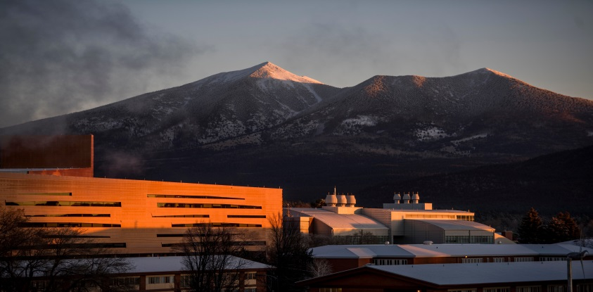
College of Engineering, Forestry & Natural Sciences

Slide 10
Origin of CEFNS
Formed in March 2008 when Forestry was merged with the
College of Engineering & Natural Sciences (CENS).
CEFNS AY09/10
Faculty & Staff = 196
Student majors = 4530 (Fall ‘09)
SCH’s = 122,774
Degrees Awarded = 590 (CY’09)
Ph.D. Programs = 2
CEFNS AY17/18
Faculty & Staff = 304
Student majors = 7,788 (Fall ‘17)
SCH’s = 202,236
Degrees Awarded = 1201 (CY’17)
Ph.D. Programs = 6

Slide 11
CEFNS
Implementation Task Force submitted
its report on May 1, 2018
CEFNS representation . . .
Diane Stearns, Chair
Cornel Ciocanel Paul Gremillion
Diana Elder Gabe Montaño
Paul Flikkema Jason Wilder
Two new colleges will be formed on July 1, 2018

Slide 12
Formation of two colleges
Some key recommendations . . .
Current staff in sciences and Dean’s Office stay with
the Science College
Current staff in engineering units move to the
Engineering College
One research center moves to the Engineering College
Advising remains centralized (current state)
Engineering College supports the shared services model

Slide 13
CEFNS
The present . . .

Slide 14
DEPARTMENTS ORGANIZATIONAL CHART
Biological Sciences
Chair:
Jason Wilder
Chem/Biochem
Interim Chair:
Marin Robinson
CSTL
Director:
Max Dass
CECMEE
Chair:
Paul Gremillion
Mech Eng
Chair:
John Tester
Manager
Jill Christensen
Business Mgr, Sr.
Kamala Masihlal
Business Manager
Lisa Cantor Ganey
Business Manager
Singne Slayton
Business Manager
Sarah Hunter
Admin Assoc: Lois Neff
Admin Asst: Judith Irons
Admin Assoc: Anita Burns
Admin Asst: Jeannette Thompson
Admin Assoc: Lillie Giffen
Admin Asst: Aspen Garcia
Admin Assoc: Gay Spivey
Admin Asst:
Lauren Badertscher
Forestry
Executive Director:
James Allen
Math & Stats
Chair:
Terry Crites
Physics & Astron
Chair:
Nadine Barlow
SESES
Director:
Nancy Johnson
SICCS
Director:
Paul Flikkema
Business Manager
Jamie Housholder
Business Manager, Sr.
Sarah Colby
Assoc. Director-Business Operations
Kay McConagha
Business Manager
Kristine Bellmore
Admin Assoc: Bea Gallegos
Admin Asst: Melinda Miller
Admin Asst: Judene McLane
Admin Assoc: Vacant
Admin Assoc: Tracy Tiedemann
Admin Assoc: Theresa Gustafson
Admin Asst: Vacant
Admin Assoc: Karen Blalock
CENTERS & INSTITUTES ORGANIZATIONAL CHART
Center for Bioengineering Innovation
Director: Kiisa Nishikawa
Colorado Plateau Cooperative Ecosystem Studies Unit
Director: James Allen
Colorado Plateau Research Station
Director: Buck Sanford
Ecosystem Science & Society Center
Director: Bruce Hungate
Ecological Restoration Institute
Director: Wally Covington
Landscape Conservation Initiative
Director: Thomas Sisk
Merriam Powell Ctr for Environmental Research
Director: Neill Cobb
Business Manager
Megan Coe
Program Coordinator
Lauri Thom
Business Manager, Sr.
Sarah Colby
Manager
Maria Galvez
Manager
Tiffany Woods
Business Manager, Sr.
Sarah Colby
Business Manager
Brenda Campbell
Admin Assoc: Allison Jourdan
Admin Asst: Linsey Baker

Slide 15
Science College & Engineering College
The future . . .

Slide 16
DEPARTMENTS ORGANIZATIONAL CHART
Biology
Chair:
Jason Wilder
Chem/Biochem
Interim Chair:
Marin Robinson
CSTL
Director:
Max Dass
CECMEE
Chair:
Paul Gremillion
Mech Eng Chair:
John Tester
Manager
Jill Christensen
Business Mgr, Sr.
Kamala Masihlal
Business Manager
Lisa Cantor Ganey
Business Manager
Singne Slayton
Business Manager
Sarah Hunter
Admin Assoc: Lois Neff
Admin Asst: Judith Irons
Admin Assoc: Anita Burns
Admin Asst: Jeannette Thompson
Admin Assoc: Lillie Giffen
Admin Asst: Aspen Garcia
Admin Assoc: Gay Spivey
Admin Asst:
Lauren Badertscher
Forestry
Executive Director:
James Allen
Math & Stats
Chair:
Terry Crites
Physics & Astr
Chair:
Nadine Barlow
SESES
Director:
Nancy Johnson
SICCS
Director:
Paul Flikkema
Business Manager
Kristine Bellmore
Business Manager
Jamie Housholder
Business Manager, Sr.
Sarah Colby
Assoc Director-Business Operations
Kay McConagha
Admin Assoc: Karen Blalock
Admin Assoc: Bea Gallegos
Admin Asst: Melinda Miller
Admin Asst: Judene McLane
Admin Assoc: Vacant
Admin Assoc: Tracy Tiedemann
Admin Assoc: Theresa Gustafson
Admin Asst: Vacant
CENTERS & INSTITUTES ORGANIZATIONAL CHART
Center for Bioengineering Innovation
Director: Kiisa Nishikawa
Colorado Plateau Cooperative Ecosystem Studies Unit
Director: James Allen
Colorado Plateau Research Station
Director: Buck Sanford
Ecosystem Science & Society Center
Director: Bruce Hungate
Ecological Restoration Institute
Director: Wally Covington
Landscape Conservation Initiative
Director: Thomas Sisk
Merriam Powell Ctr for Environmental Research
Director: Neill Cobb
Business Manager
Megan Coe
Program Coordinator
Lauri Thom
Business Manager, Sr.
Sarah Colby
Manager
Maria Galvez
Manager
Tiffany Woods
Business Manager, Sr.
Sarah Colby
Business Manager
Brenda Campbell
Admin Assoc: Allison Jourdan
Admin Asst: Linsey Baker
Center for Materials Interfaces in Research and Applications
¡MIRA!
Director: Gabe Montaño
“Natural Sciences College”
to be formed
“Engineering College”

Slide 17
Some needs
Science College
Need a proposed name (by May 10)
Need a Dean’s Office location
Need revised policies, procedures, etc.
Engineering College
Need a name (one proposed)
Need a Dean (Interim June 1)
Need a Dean’s Office staff
Need policies, procedures, etc.

Slide 18
Impact Across Campus
Breaking up is hard to do:
Advising
Budget Office
Development
Enrollment Management & Students Affairs
NAU Foundation
Human Resources
Marketing
Provost Office
Registrar
Really hard to do:
Alumni Engagement
Associated Students of NAU
Center for International Education
Financial Aid
Information Technology
Inventory Control
NAU Online
Sponsored Projects
V.P for Research

Slide 19
Questions/Comments
Will talk about names next

Slide 20
Names
Proposed name for Engineering College:
“College of Engineering, Informatics
& Applied Sciences
(CEIAS)
ABOR approval required

Slide 21
Names
Need a proposed name for Science College
by next Thursday
Biological Sciences Colorado Plateau CESU
Chemistry & Biochemistry Colorado Plateau Research Station
Earth & Sustainability Center for Ecosystem Science & Society
Forestry Ecological Restoration Institute
Mathematics & Statistics Landscape Conservation Initiative
Physics & Astronomy Merriam Powell Center for Env. Res.
Science Teaching & Learning

Slide 22
Names
ABOR approval required
Some possible names for Science College:
College of Forestry & Natural Sciences (FNS)
College of Natural Sciences & Forestry (NSF)
College of Natural Sciences (CNS)
College of Science (COS)
The College
Additional suggestions?
On Monday we’ll send you a request for your comments/preferred name

Slide 23
commencement
Friday, May 11
Commencement Reception
12:30pm – 2:00pm
HCCC
Commencement Ceremony
4:00pm – 5:30pm
Skydome

Slide 24
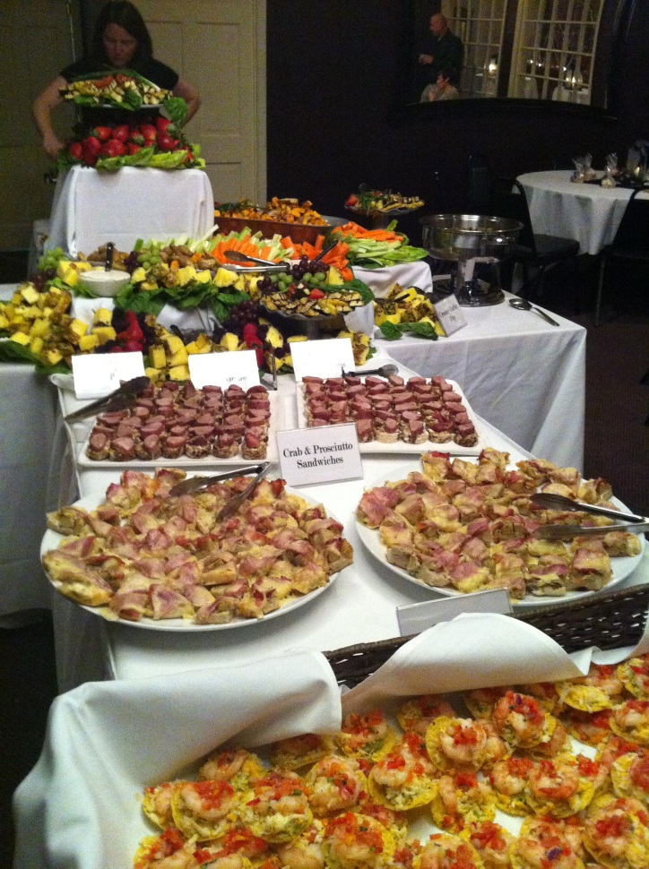
Refreshments are served!

Slide 25
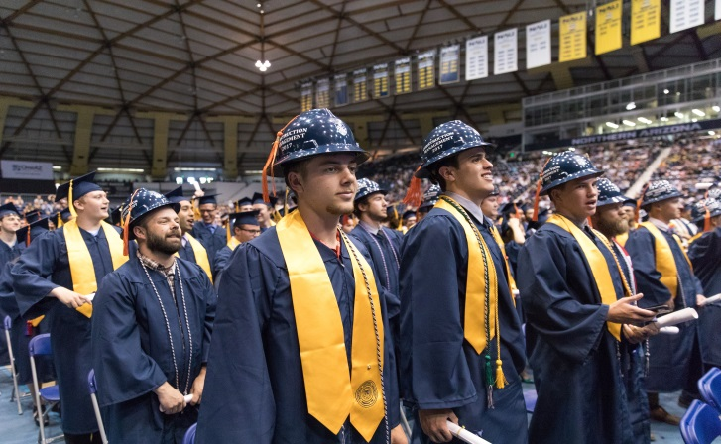
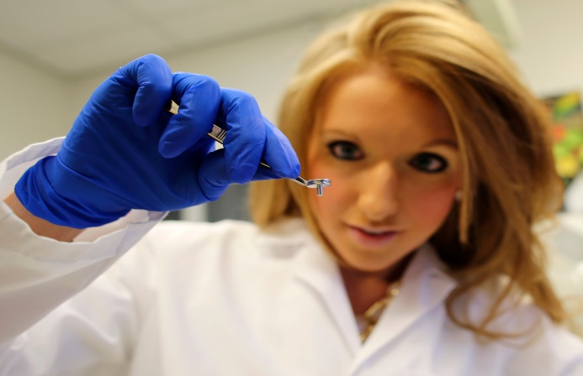
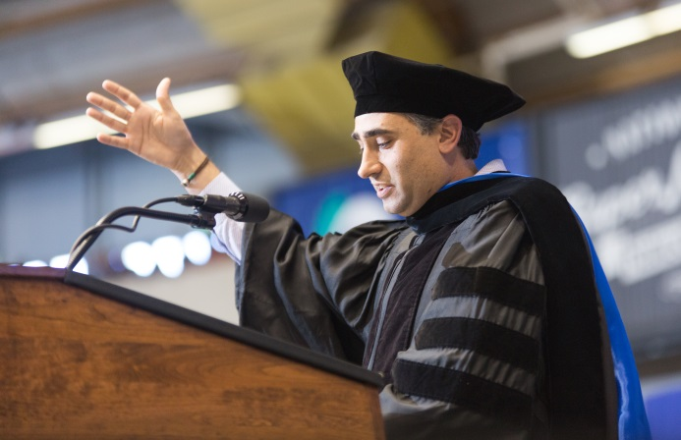
College of Engineering, Forestry & Natural Sciences Spring 2018 College Meeting May 4, 2018

Slide 26
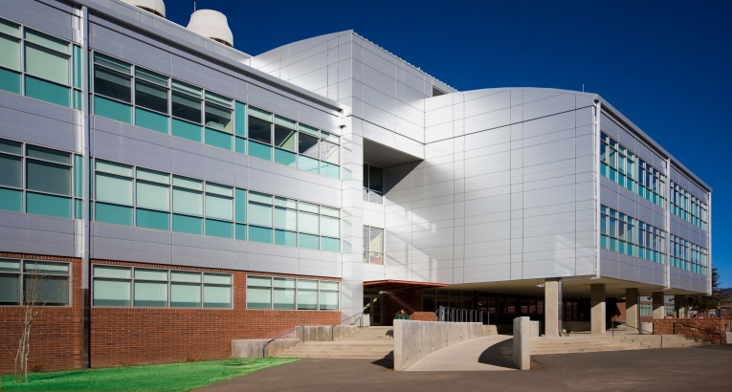
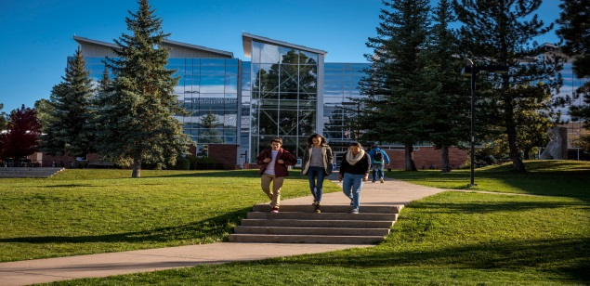
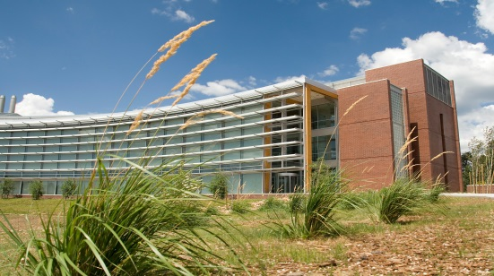
A few numbers . . .
500 Faculty and Staff
We occupy all or part of 29 buildings

Slide 27
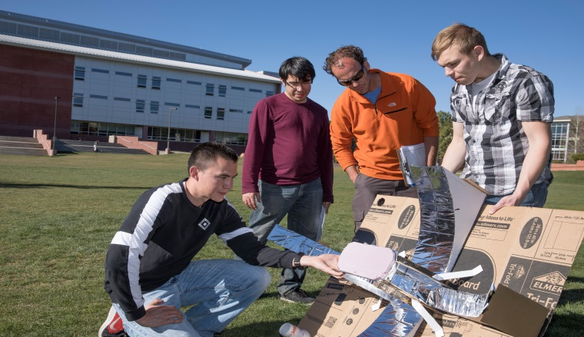
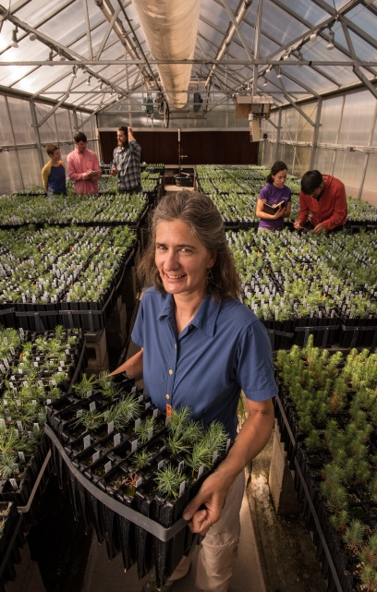
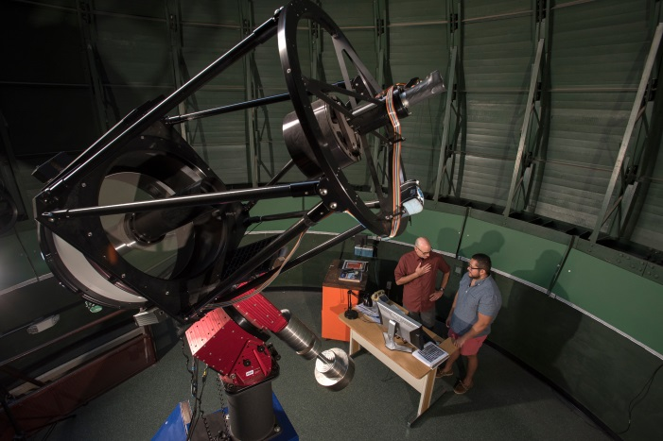
That’s a brief overview of where we are in august 2017

Slide 28
Research Centers and Institutes
Center for Bioengineering Innovation
Center for Ecosystem Science and Society
Center for Microbial Genetics & Genomics
Colorado Plateau Cooperative Ecosystems Study Unit
Colorado Plateau Research Station
Ecological Restoration Institute
Institute for Tribal Environmental Professionals
Landscape Conservation Initiative
Merriam Powell Center for Environmental Research
The Pathogen & Microbiome Institute
Moved to Office of Native American
Initiatives

Slide 30
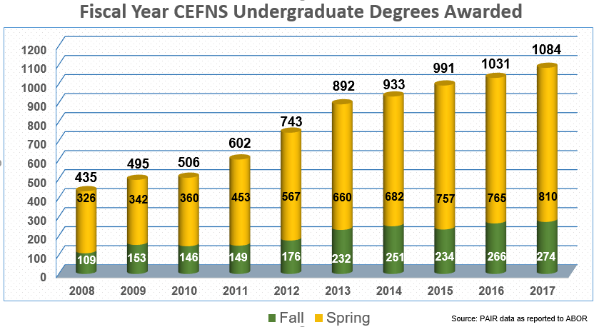
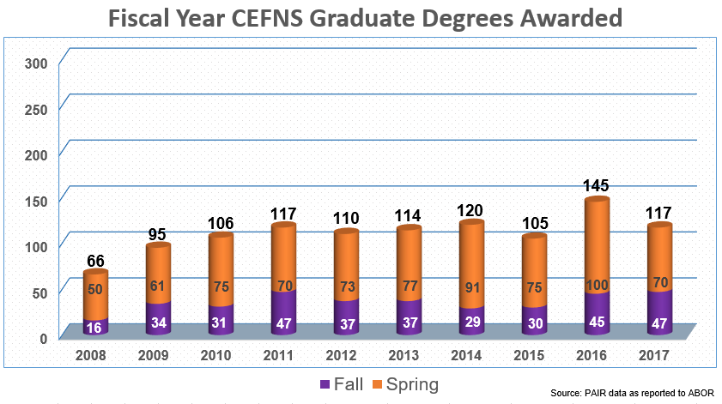
We need to respond to NAU’s investment in CEFNS research and graduate programs with increases in the number of enrolled graduate students and number of graduates.

Slide 31
CHALLENGES
“Intimacy at Scale”
Kate Fryer
EVP for Membership
American Chemical Society
Provide students with the NAU Experience as our numbers grow.
Provide faculty and staff with what they need to be effective and efficient.
Acquire more space for our activities.

