Slide 1
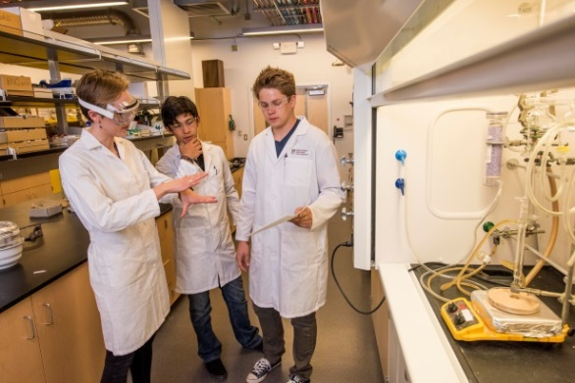
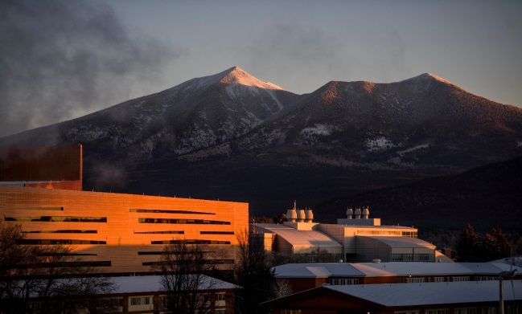
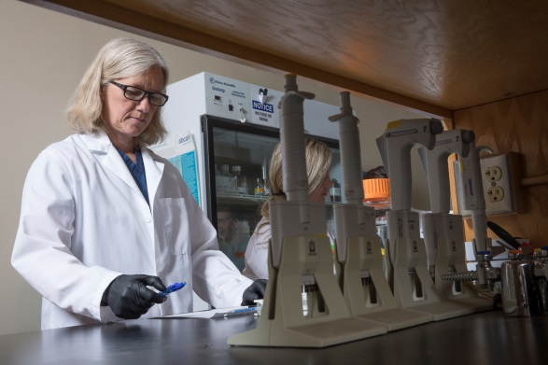
College of the Environment, Forestry & Natural Sciences Academic Year College Meeting August 23, 2018
Note: these sides may vary slightly in form from those presented during the CEFNS College Meeting

Slide 2
Agenda
Opening Remarks
President Rita Cheng and Provost Brian Levin-Sankevich
Formation of the new CEFNS
CEFNS Moves into the Future

Slide 3
Welcome New Faculty and Staff!

Slide 4
Two New Colleges The College of Engineering, Forestry & Natural Sciences (CEFNS) grew to be about 1/3 of the Flagstaff Campus and 1/4 of NAU.
Two colleges were formed from CEFNS

Slide 5
Formation of Two Colleges
Names:
College of the Environment, Forestry & Natural Sciences (CEFNS)
College of Engineering, Informatics & Applied Sciences (CEIAS)

Slide 6
Two New Colleges
CEFNS and CEIAS
Diane Stearns, Interim Dean
John Georgas, Assoc. Dean
Bury Hall now then Science Annex in February
CEFNS is functioning
Ongoing
Some of the needed actions
Need names for the two colleges
Find a space for the CEFNS Dean’s Office
Appoint an Interim Dean for the Engineering College
Separate people and accounts on July 1, 2018
Establish ongoing activities of the two colleges

Slide 7
CEFNS Moves into the Future
By the numbers, we’re still big!
Faculty = 219
Staff = 140
Buildings = 24
Faculty Senators = 8
Students = . . .

Slide 8
Retention
CEFNS Enrollment by Unit (23 Aug 18)
Unit | Undergrad | Grad | Total | YoY Change
BIO | 3015 | 118 | 3169 | 67
CHEM | 367 | 9 | 376 | 10
CSTL | N/A | 25 | 25 | -4
FORESTRY | 225 | 47 | 272 | 0
MATH | 206 | 70 | 276 | -3
P&A | 237 | 30 | 267 | 31
SES | 621 | 87 | 708 | 33
Totals | 4707 | 386 | 5093 | 139

Slide 9
CEFNS Moves into the Future
Opportunities to:
Redefine CEFNS
Proactively expand scholarly activities
Increase collaborations
Increase communication
Increase responsiveness
Focus on enrollment, retention, DFW’s
Mission, Vision, Strategic Direction, Annual Goals
PWJ will visit units once/year
Biweekly email updates
Dean’s Office Hours

Slide 10
CEFNS Moves into the Future
Concerns about weakened collaborations among previous CEFNS colleagues was a concern but its too early to determine the impact, if any.
However, there is an opportunity for increased collaboration . . .

Slide 11
Center for Science Teaching and Learning (CSTL) Outreach & Evaluation
Promoting public engagement and literacy in STEM areas & research
Initiating, coordinating & evaluating STEM education & outreach
Stand alone projects & Broader Impacts work (broadened & diversified research dissemination)
Audiences: Citizen scientists, teachers, K-12 students, museums, libraries, community groups
Current funders: NSF, NASA, NIH, private foundations
Local & national collaborators: CEFNS, TGen, USGS, Lowell Observatory, Museum of Science Boston, WestEd, etc.
Contact: Joelle.Clark@nau.edu & Nena.Bloom@nau.edu to discuss opportunities for collaboration!

Slide 12
CEFNS Moves into the Future
We need updated:
Mission
Vision
Strategic Direction
Aligned with NAU Strategic Goals and ABOR 2025 Metrics

Slide 13
CEFNS Moves into the Future
Core values are the fundamental beliefs of an organization. These guiding principles help companies to determine if they are on the right path to fulfilling their goals.
Suggested core values:
Build community
Encourage discovery
Promote diversity
Strive for excellence
Model integrity
Achieve sustainability
Suggested additions, deletions, changes?

Slide 14
CEFNS Moves into the Future
Suggested vision statement as developed by Chairs/Directors:
Inspired by our community and surroundings, the College of the Environment, Forestry, and Natural Sciences strives to provide a transformative education, cutting edge research, and a connection with diversity in an environment in which there is a work, life and cultural balance.
Suggested changes?

Slide 15
CEFNS Moves into the Future
Suggested mission statement, modified from current version by Chairs/Directors:
The College of the Environment, Forestry & Natural Sciences promotes integrated and cross-disciplinary undergraduate and graduate learning experiences in science, mathematics and technology. We are sustained by a commitment to transformative research and scholarship, and the creative application of knowledge to address global issues. Diverse faculty, staff and students actively collaborate to engage in the pursuit of possibilities, solutions, and discovery.
Suggested changes?

Slide 16
Issues to Address this Year
Student Recruitment and Retention
Space Constraints
Budget Challenges

Slide 17
Student Recruitment and Retention
NAU is a tuition-driven institution
ABOR has set first-to-second year retention goals and 6-year graduation rate goals
Virtually every NAU student takes a class offered by CEFNS
DFW Rates (impact retention & grad rates)

Slide 18
Space Constraints
The plan . . .
Peterson Hall occupants move to Science Annex
Peterson demolished
STEM 1 built on the general site of Peterson
Science & Health Building recently opened
Old Chemistry (Science Annex) being renovated but will not be dedicated to CEFNS
STEM 1 Building is in planning stages but will not be dedicated to CEFNS

Slide 19
Recent Financial Challenge

Slide 20
Recent Financial Challenge
Email on Monday July 30, 2018 informing units
of a CEFNS state account deficit for AY17/18
and the actions taken to address that deficit.
The state account has had a structural deficit for
a number of years but the College has had funds
to cover those deficits. The funds ran out last year.

Slide 21
Recent Financial Challenge
Previously realized that income was not keeping up with expenses and that these locals would eventually be in deficit.
Accounts that provided the buffer:
IDC – required to be invested in research and rightfully so.
Summer Overattainment – pays for a multitude of expenses
including Chairs’ packages, and instructional expenses not
covered by state funds, CIF, GTA pools and allocations, etc.
Exhausted every possible source of funds and received some help from the Provost.

Slide 22
Recent Financial Challenge
Deficit of approximately $260K had to be addressed
within about 48 hours.
Requested and received an additional 48 hours.
$260K = approximately 1% of the CEFNS state budget

Slide 23
Recent Financial Challenge
Year end close starts in June but takes 4-6 weeks to complete after June 30
So, you ask, why wasn’t this anticipated?
It was, for the last 4 years or so, but exactly which FY and the amount
could not be predicted because . . .
The state account was overspent in personnel.
Actual personnel expenses are not known until during year end close.
Additional funds from the Provost’s Office, if available, are not provided
until during year-end close.

Slide 24
Recent Financial Challenge
So, why was the personnel account overspent?
Provost and colleges have a mandate to offer the courses/sections
that students need. Hiring occurs even if funds to pay for
associated expenses have not been identified.

Slide 25
Recent Financial Challenge
The entirety of CEFNS
Addressing the deficit . . .
The total balance of locals in CEFNS including Summer
Overattainment and Program Fees was quite large.
It was felt that these accounts should cover the deficit.

Slide 26
Recent Financial Challenge
The guiding principles used to determine how to distribute
the deficit to units:
Units that received Temp Staffing Funds
Units that had sizeable balances in Summer
Overattainment and/or Program Fee accounts
(and had personnel who could justifiably be
paid on Programs Fees)
Course Fees cannot be used to pay the Instructor of Record

Slide 27
Recent Financial Challenge
Distribution of deficit between CEFNS and CEIAS
(since CEIAS units received Temp Staffing funds
during AY17/18):
CEFNS = 54% ($141,472; greater numbers but lower salaries)
CEIAS = 46% ($120,514; lower numbers but higher salaries)

Slide 28
Recent Financial Deficit
During this year we need to work together
to have units contribute to instructional costs
early in the year in a sensible manner so that
we don’t have this situation again this year.

Slide 29
Refreshments are served!

Slide 30
College of the Environment, Forestry & Natural Sciences Academic Year College Meeting August 23, 2018

