Slide 1
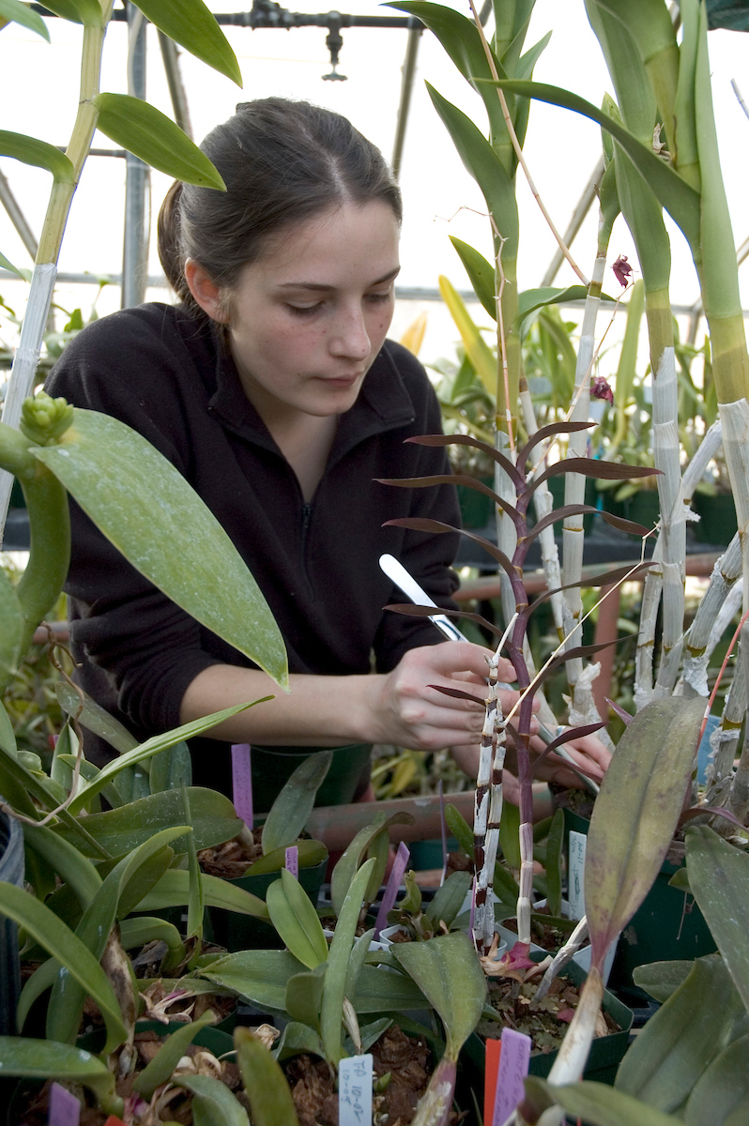
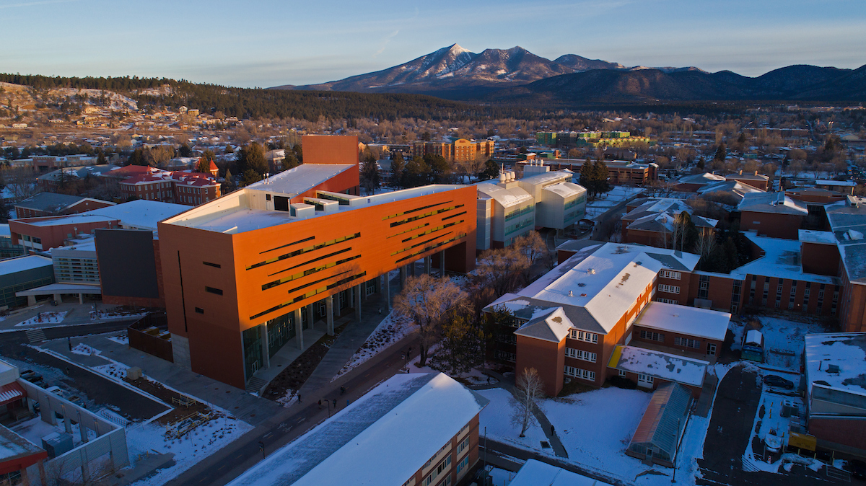
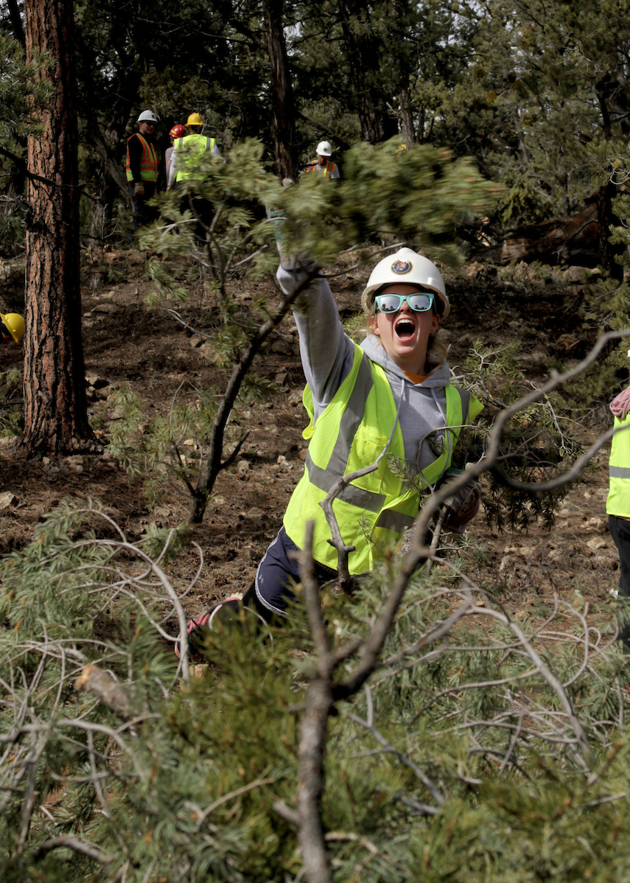
College of the Environment,
Forestry and Natural Sciences
August 21, 2019

Slide 2
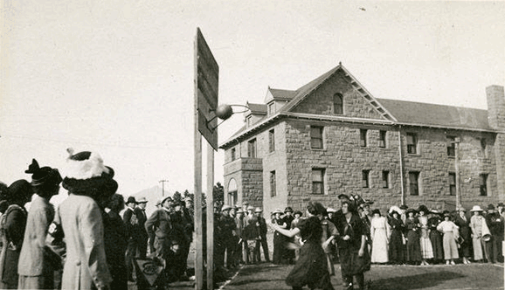
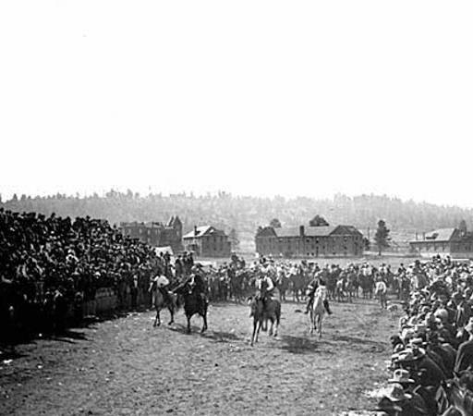
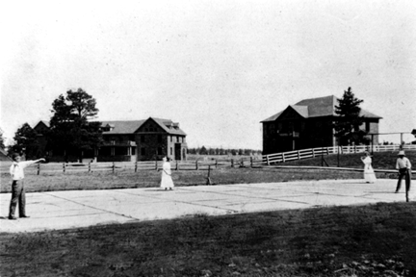
Changes in the Dean’s Office:
Bury Hall
Notes:
Introduce Bury Hall
Introduce Self
Introduce Cheryl Mossman – new FOM
Change to single Associate Chair

Slide 3
New Department Chairs…
and a new Department:
Department of Biological Sciences
Professor Alice Gibb
2. Department of Chemistry and Biochemistry Professor Brandon Cruickshank
3. Dept. of Astronomy & Planetary Sciences (APS)

Slide 4
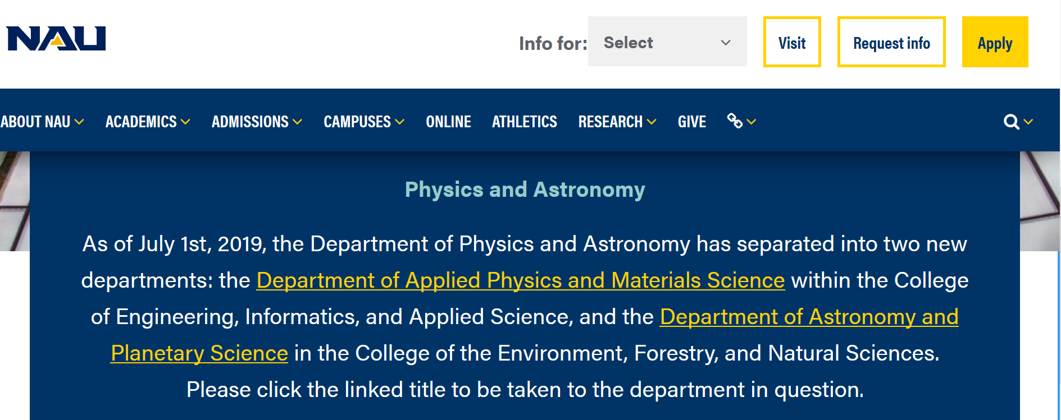

Slide 5
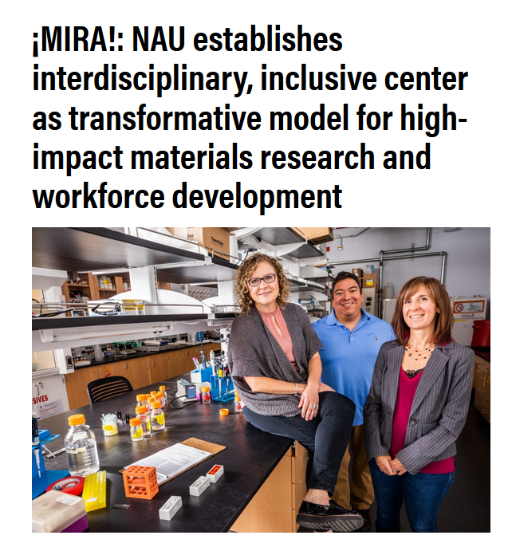
New Research Center with CEFNS affiliations: Center for Materials Interfaces in Research and Applications
¡MIRA!

Slide 6
New CEFNS Faculty
APS
Devon Burr
Joshua Emery
Biology
Rebecca Beresic-Perrins
Nicholas Bokulich
Jeenah Clattenburg
Aysun Patterson
Alison Singer
Heidi Trathnigg
Chemistry
Gayan Adikari Appuhamillage
Carmen Carrillo
Benjamin Sandler
Anges Nesia Zurek
Math and Statistics
David Armour
Nathan Diefenderfer
Adam Leighton
Daniel Malcom
Isaac Nketsiah

Slide 7
New CEFNS Faculty (cont’d)
Math and Statistics (cont’d)
Zachary Parker
Saikanth Ratnavale
SES
Michael Erb
John Fegyveresi
Christine Regalla
Helen Rowe
Forestry
Anita Antoninka
Catrin Edgeley
Alark Saxena
Alicia Azpeleta Tarancon

Slide 8
New CEFNS Staff
(since last fall)
CEFNS
Cheryl Mossman
APS
Anna Engle
Kathryn Powell
Biology
Kathleen Barton
Colleen Cassidy
Darryl Colebank
Biology (cont’d)
Teresa Henry
David John
Matthew Wint
Chemistry
Sophia Carvalho
Jogendra Pawar
ECOSS
Stephanie Mayer

Slide 9
New CEFNS Staff (cont’d)
MPCER
Caroline Havrilla
James Lauder
SES
Jordan Bright
Piyali Chanda
Forestry
Michael Sloan
ERI
Jonathon Donager
Jonathan Martin
Patrick Rappold
LCI
Martha Sample

Slide 10
Enrollment & Budget
CEFNS graduate enrollment: holding steady
- 367 students (+2)
CEFNS undergraduate enrollment: some decline
4,437 students (-86, -1.9%)
Declining enrollment impacts the bottom line
- $250K budget holdback in CEFNS at start of FY20

Slide 11
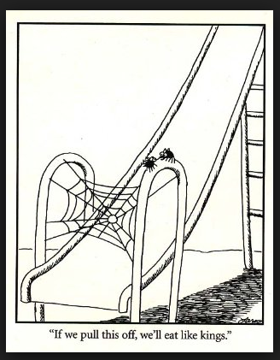
Priorities for Coming Year
Continue commitment to NAU strategic goals
Focus on recruitment and retention
Development of strategic plans at College and academic unit levels

Slide 12
College of Environment, Forestry & Natural Sciences ACUE Fellows*
2018-2019
Rebecca Best, School of Earth & Sustainability
Rachel Mitchell, School of Earth & Sustainability
Inès Montaño, Astronomy & Planetary Sciences
Ryan Porter, School of Earth & Sustainability
2018-2019 cont’d
Tyler Robinson, Astronomy & Planetary Sciences
Cristina Thomas, Astronomy & Planetary Sciences
Heidi Trathnigg, Biological Sciences
Bahattin Yildiz, Mathematics & Statistics
2017-2018
Tom Acker, Mechanical Engineering
Ana Araya-Anchetta, Biological Sciences
Sharon Cardenas, Center for Science Teaching and Learning
Bruce Fox, Forestry
2017 -2018
Mar Hill, Biological Sciences
David John, Biological Sciences
Adonna Rometo, Biological Sciences
*earned a Certificate in Effective College Instruction by successfully completing the ACUE Course in Effective Teaching Practices endorsed by the American Council of Education

Slide 13
Center for Science Teaching and Learning (CSTL) STEM education, outreach & evaluation
How we work with CEFNS faculty and staff:
We develop & implement Broader Impacts for research grants (Ex. Career grants)
We collaborate on K-20 STEM initiatives (REU, IUSE, IGE, S-STEM, ITEST, C-STEM)
We conduct program evaluations of grant & related activities
We are successful grant writers (NSF, NIH, NASA, foundations, & others) and have extensive partnerships to build-upon: TGen, USGS, Lowell Observatory, FUSD, Navajo Nation Department of Dine Education, & other NAU units.
Contact us: Joelle.Clark@nau.edu & Nena.Bloom@nau.edu to discuss opportunities for collaboration. For more information: https://nau.edu/cstl/

Slide 14
Flagstaff Festival of Science
Get involved! www.scifest.org
NAU Science and Engineering Day – Sept 21 (Shannon Shoots is coordinating)
K-12 speaker program - register https://www.scifest.org/in-school-presentations/

Slide 15
Thank you!

