Slide 1

Undergraduate Research
Website: nau.edu/ugr Email: ug-research@nau.edu

Slide 2


What is undergraduate research?
Projects of scholarly inquiry or creative activity
Collaborations with faculty
Examines, creates, and shares knowledge or products
Consistent with best practices in area of study

Slide 3

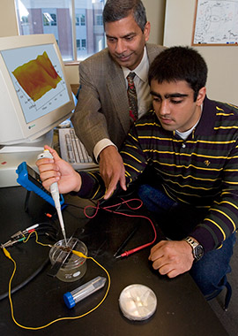
Who does undergraduate research?
Students who...
Major in any discipline
Are curious, self-motivated, and enthusiastic
Enjoys solving problems
Want to get hands-on experience
Are just like YOU!

Slide 4

Why should you get involved?
Professional Advantages
Job Training
Academic Advantages
Faculty Mentor Relationship

Slide 5
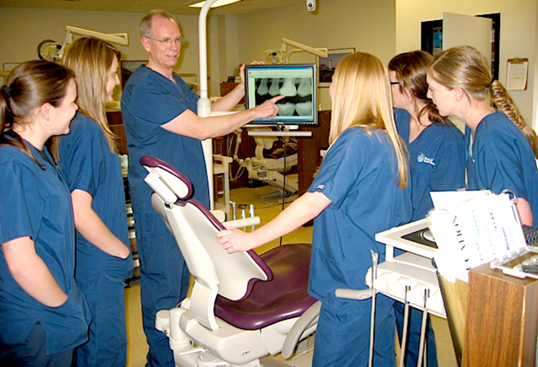
Professional Advantages
Build resume/curriculum vitae (CV) experience
Develop leadership and organization skills
Increase competitiveness in job market
Establish professional network in your discipline

Slide 6
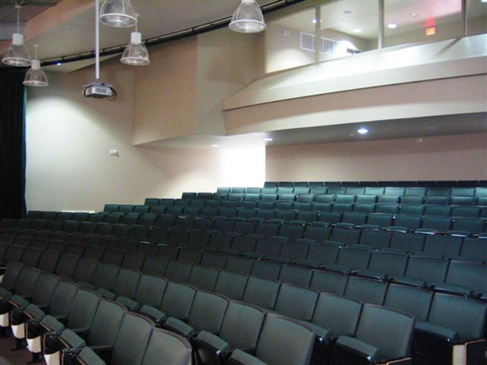
Academic Advantages
Engage in “hands-on” learning
Develop in-depth understanding of class topics
Improve presentation & dissemination skills
Be more competitive for post-baccalaureate program admission

Slide 7

Discipline Training
Apply discipline-specific knowledge outside classroom
Expand technical skills repertoire for future occupation
Gain knowledge beyond the scope of coursework

Slide 8
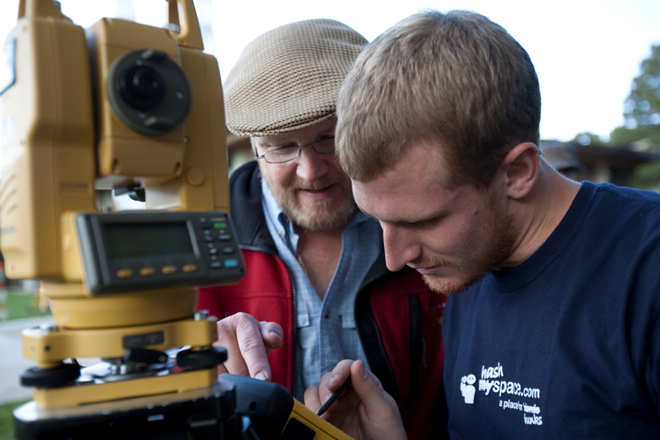
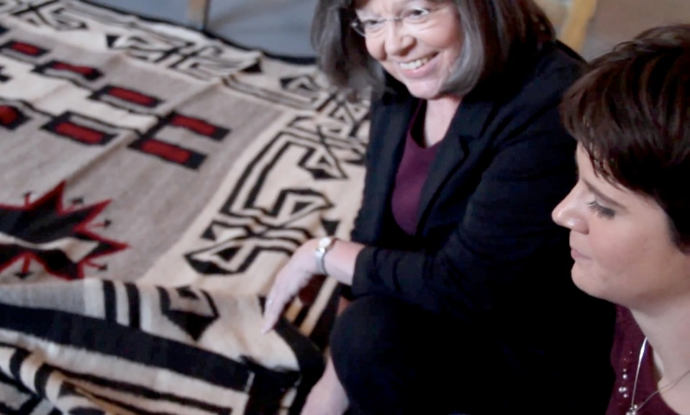
Faculty Mentor Relationship
Receive guidance as a researcher from established experts in your field
Demonstrate your abilities and skills to NAU faculty who will write recommendations

Slide 9
What kinds of projects do students do?
Evaluating the Impact of Wasted Energy (Michael O’Reilly)
Recasting Identity: Ethics from the Margins (Bryan Kimoto)
Predictive Early Assessment of Reading and Language (Madison Varney)
Employment Law Case Study (Nolan Cook)
Population Estimation of Big Brown Bats in Flagstaff (Camille Platts)
Nose Bleed: A Short Film (Jeremy Scott)
Molecular Ecology of the Nightingale Reed-Warbler (Liliana Ortiz)
Effects of Attention on Empathic Response (Morgan Malie)

Slide 10


How do students share the results?
Author (or co-author with mentor) journal articles
Conference presentations
  NAU Undergraduate Symposium
  National Conference on Undergraduate Research (NCUR)
  Discipline specific conferences

Slide 11


Research opportunities & funding
  xxx279 or xxx485 undergraduate research course for credit in any department with faculty mentor
  HURA: Hooper Undergraduate Research Award grant program
  NAU/NASA Space Grant – not just for astronomy majors!
  Global Research & Internship Program (GRIP)
  NAU research institutes and centers
  NAU UG Student Travel Awards & ASNAU travel support for conferences

Slide 12

Get the latest information & updates
SIGN UP on
the UG research email list
http://nau.edu/VPAA/Undergraduate-Research/Connect/
Dr. MaryLynn Quartaroli, Coordinator
ug-research@nau.edu
Room 321, Bury Hall (Bldg 8)
(928) 523-1026

