Slide 1
Undergraduate Research
Website: nau.edu/ugr Email: ug-research@nau.edu

Slide 2
What is undergraduate research?
Projects of scholarly inquiry or creative activity
Collaborations with faculty
Examines, creates, and shares knowledge or products
Consistent with best practices in area of study

Slide 3
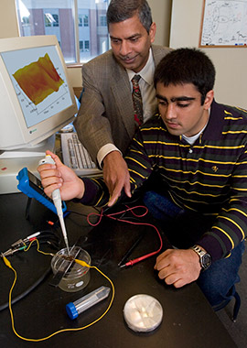
Who does undergraduate research?
Students who...
Major in any discipline
Are curious, self-motivated, and enthusiastic
Enjoys solving problems
Want to get hands-on experience
Are just like YOU!

Slide 4
Why should you get involved?
Professional Advantages
Job Training
Academic Advantages
Faculty Mentor Relationship

Slide 5
What kinds of projects do students do?
Evaluating the Impact of Wasted Energy (Michael O’Reilly)
Recasting Identity: Ethics from the Margins (Bryan Kimoto)
Predictive Early Assessment of Reading and Language (Madison Varney)
Employment Law Case Study (Nolan Cook)
Population Estimation of Big Brown Bats in Flagstaff (Camille Platts)
Nose Bleed: A Short Film (Jeremy Scott)
Molecular Ecology of the Nightingale Reed-Warbler (Liliana Ortiz)
Effects of Attention on Empathic Response (Morgan Malie)

Slide 6
Research opportunities & funding
xxx279 or xxx485 undergraduate research course for credit in any department with faculty mentor
HURA: Hooper Undergraduate Research Award grant program
NAU/NASA Space Grant – not just for astronomy majors!
Global Research & Internship Program (GRIP)
NAU research institutes & centers
NAU UG Student Travel Awards & ASNAU travel support for conferences

Slide 7
Get the latest information & updates
SIGN UP on
the UG research email list
http://nau.edu/VPAA/Undergraduate-Research/Connect/
Dr. MaryLynn Quartaroli, Coordinator
ug-research@nau.edu
Room 321, Bury Hall (Bldg 8)
(928) 523-1026

