Slide 1
Northern Arizona University sits at the base of the San Francisco Peaks, on homelands sacred to Native Americans throughout the region.
We honor their past, present, and future generations, who have lived here for millennia
and will forever call this place home.
San Francisco Peaks, Flagstaff, Arizona, 2-2-48;
Fronske Studio Collection; NAU.PH.85.3.231.273.
Notes:
I join you today from Flagstaff, on the ancestral and traditional homelands of a number of Indigenous communities. To recognize these communities, I would like to begin by offering NAU’s formal land acknowledgment: Northern Arizona University sits at the base of the San Francisco Peaks, on homelands sacred to Native Americans throughout the region. We honor their past, present, and future generations, who have lived here for millennia and will forever call this place home.

Slide 2
Cline Library
stuff
stuff
Special Collections & Archives
stuff
stuff
Special Collections
Archives
institution
Colorado Plateau Archives
University Archives
institution
Notes:
I’ll begin by providing some context for Special Collections and Archives, or SCA, and NAU. NAU is a federally accredited American Indian and Alaska Native serving institution and was recently recognized as a Hispanic Serving Institution, or HSI. NAU sets service to Native American students as its third strategic goal. This strategic goal is shared by Cline Library, NAU’s sole academic library, and by SCA. SCA’s mission within Cline Library is to connect and engage the world with the natural and human history of the Colorado Plateau and Northern Arizona University. Our archival holdings consist of two bodies of material: The Colorado Plateau Archives and Northern Arizona University Archives. This presentation will largely focus on archival collections within the Colorado Plateau Archives. These collections are typically donated to SCA by external donors who have some kind of connection, whether personal, familial, professional, or creative, with the Colorado Plateau and its communities.

Slide 3
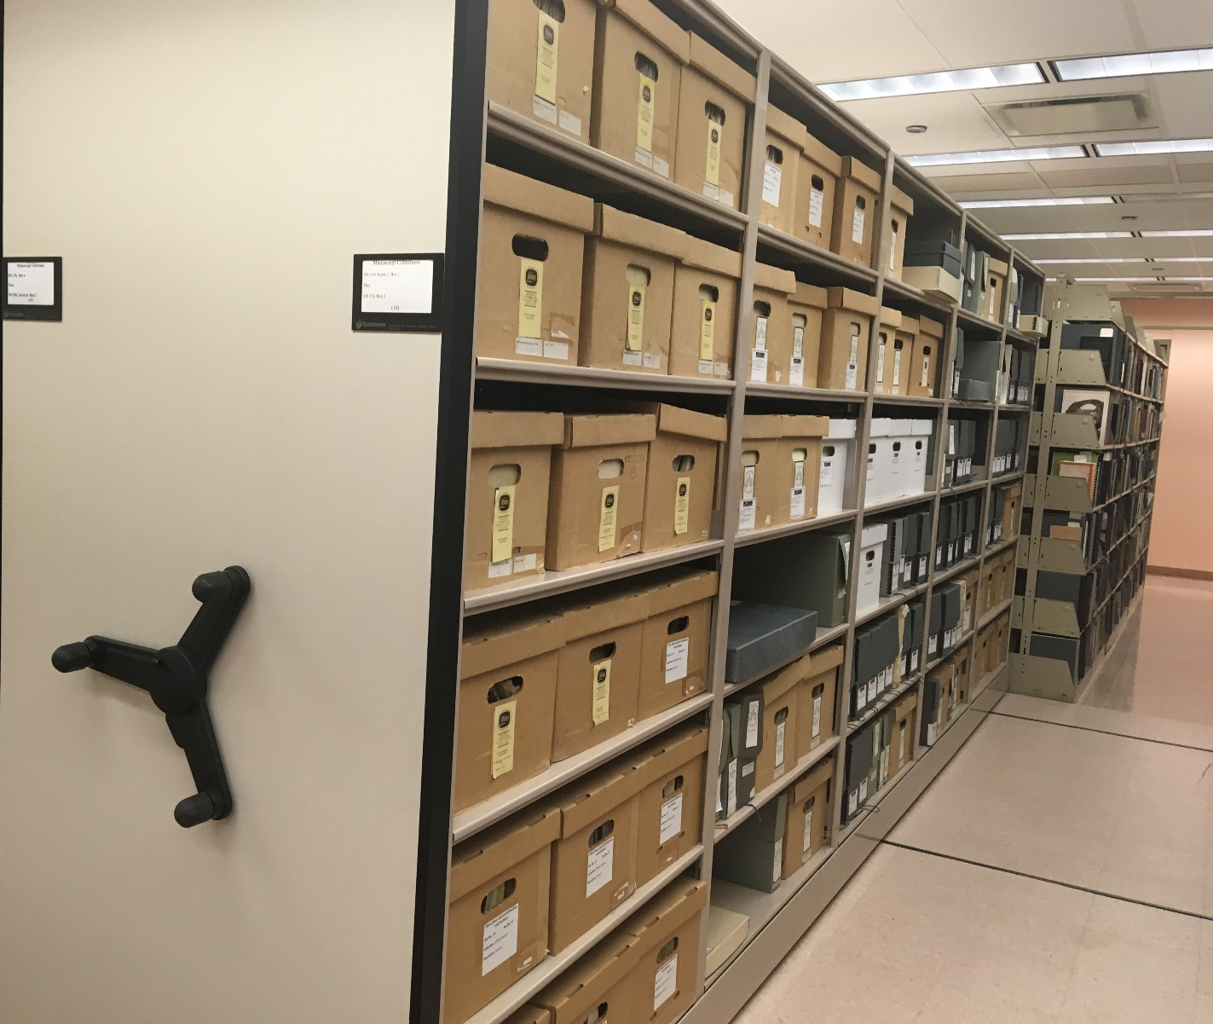
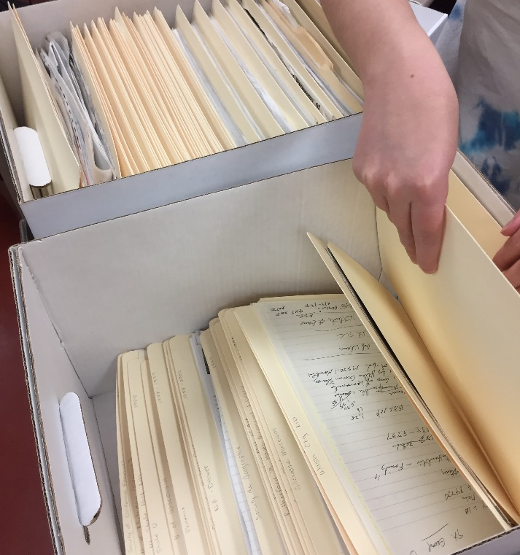
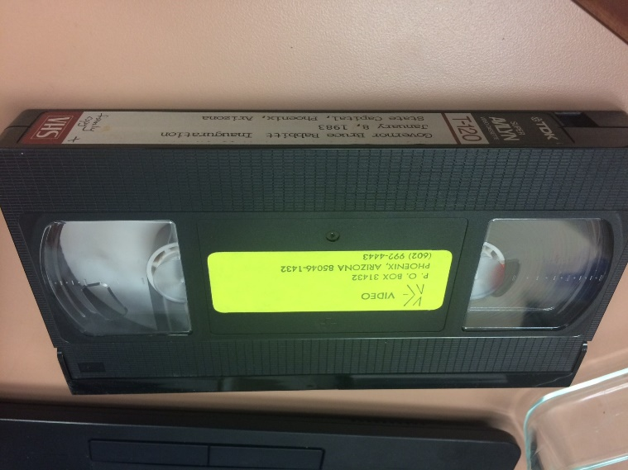
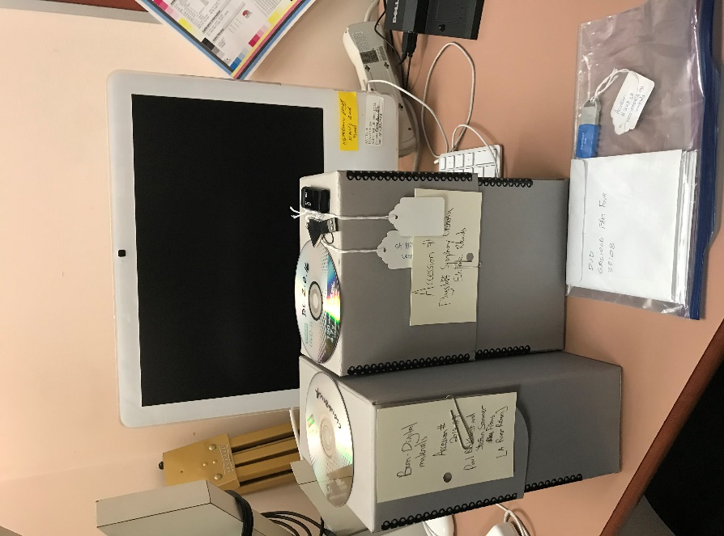

Slide 4
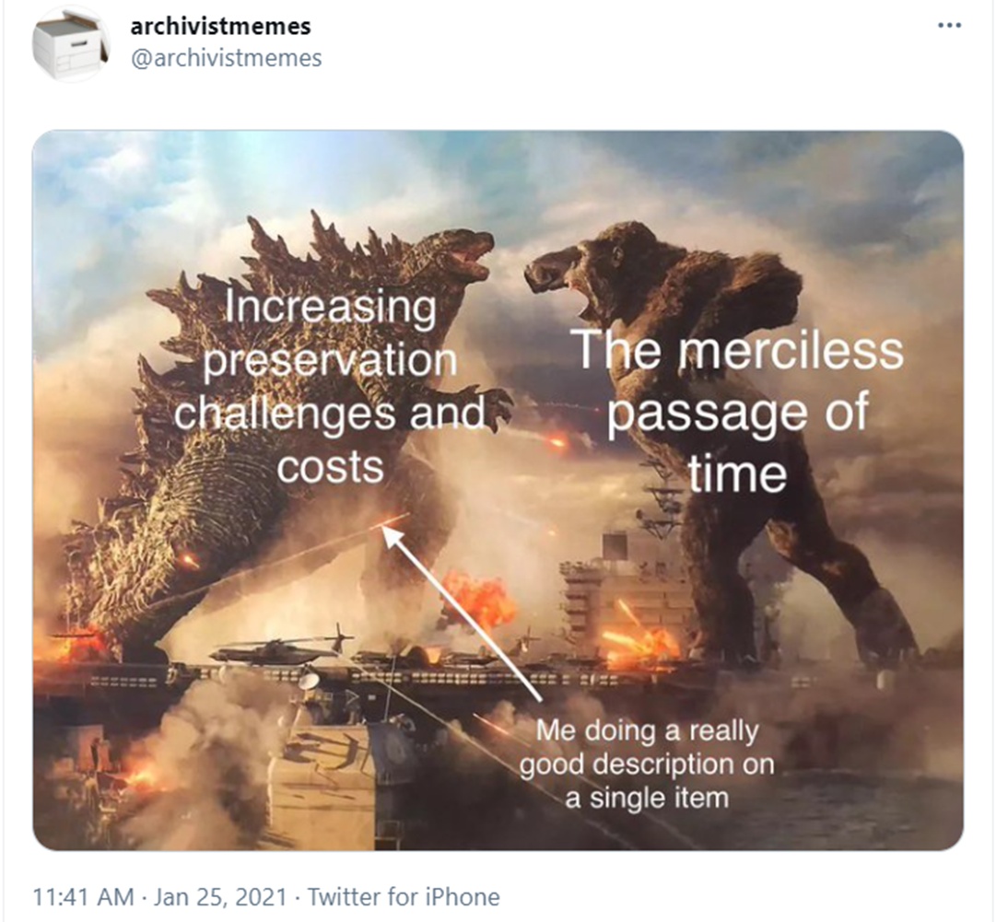

Slide 5
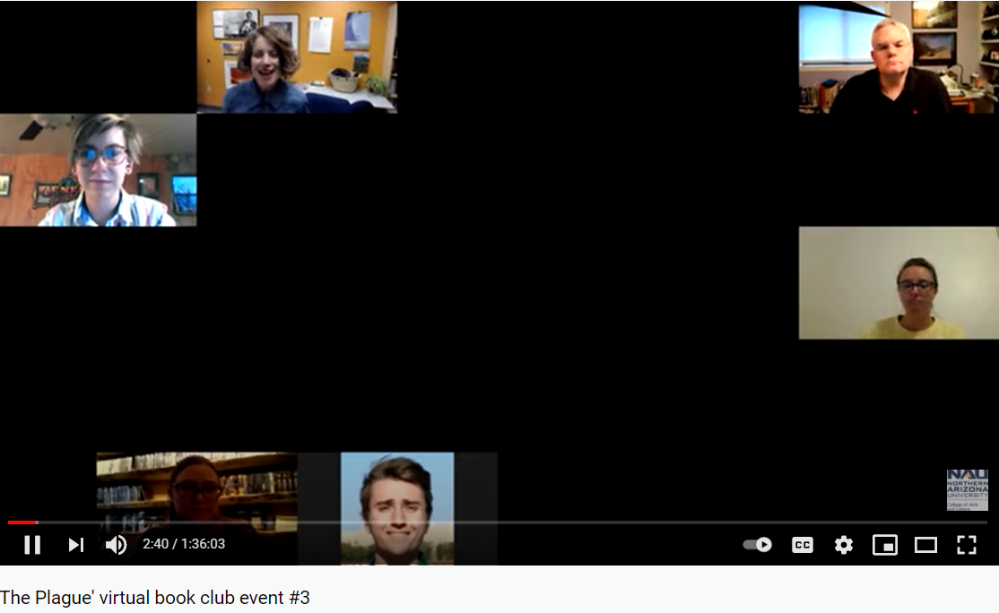

Slide 6
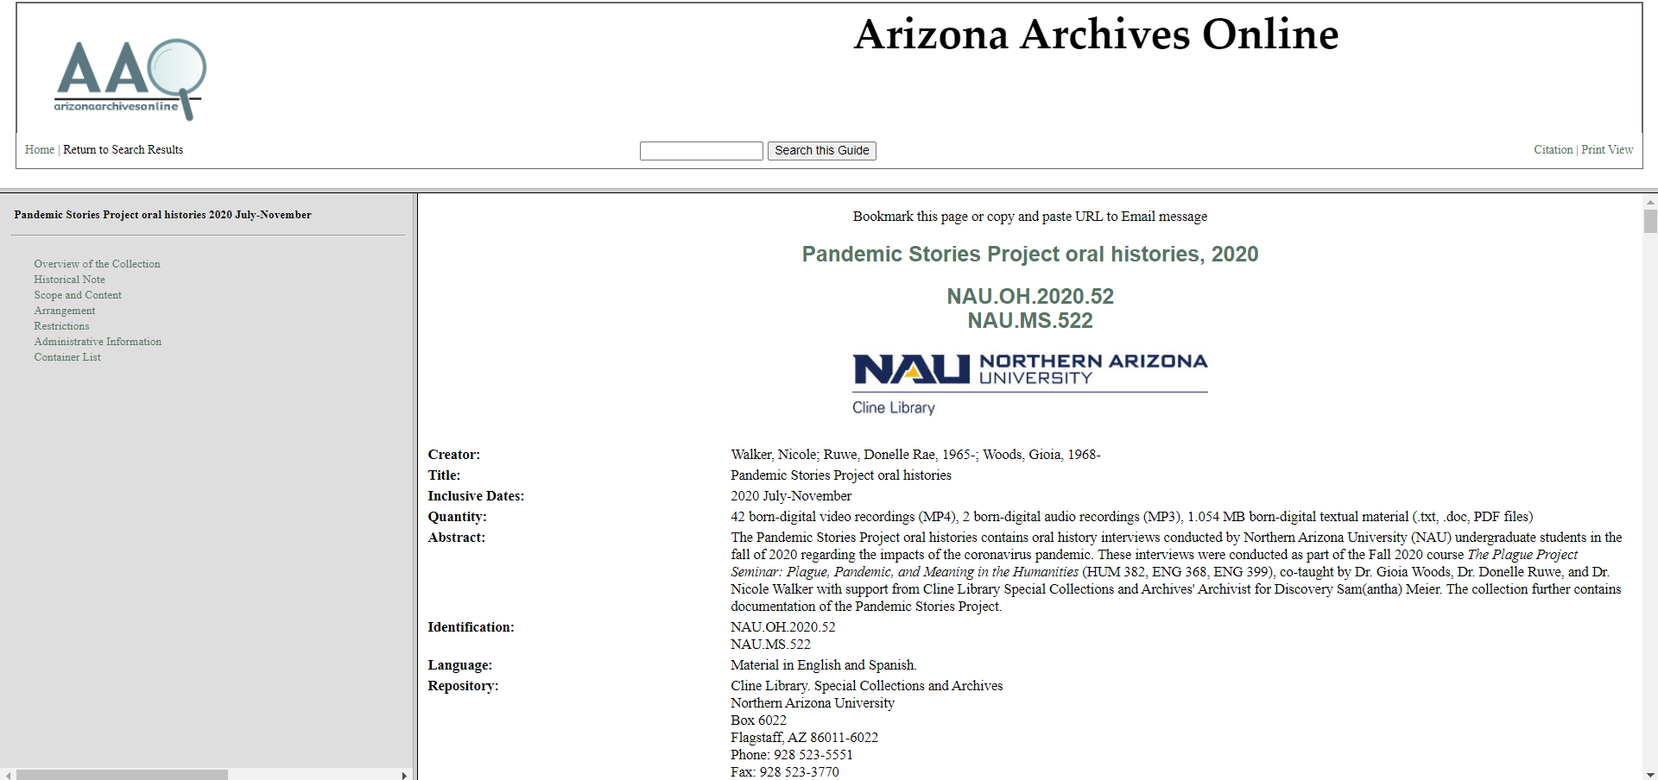

Slide 7
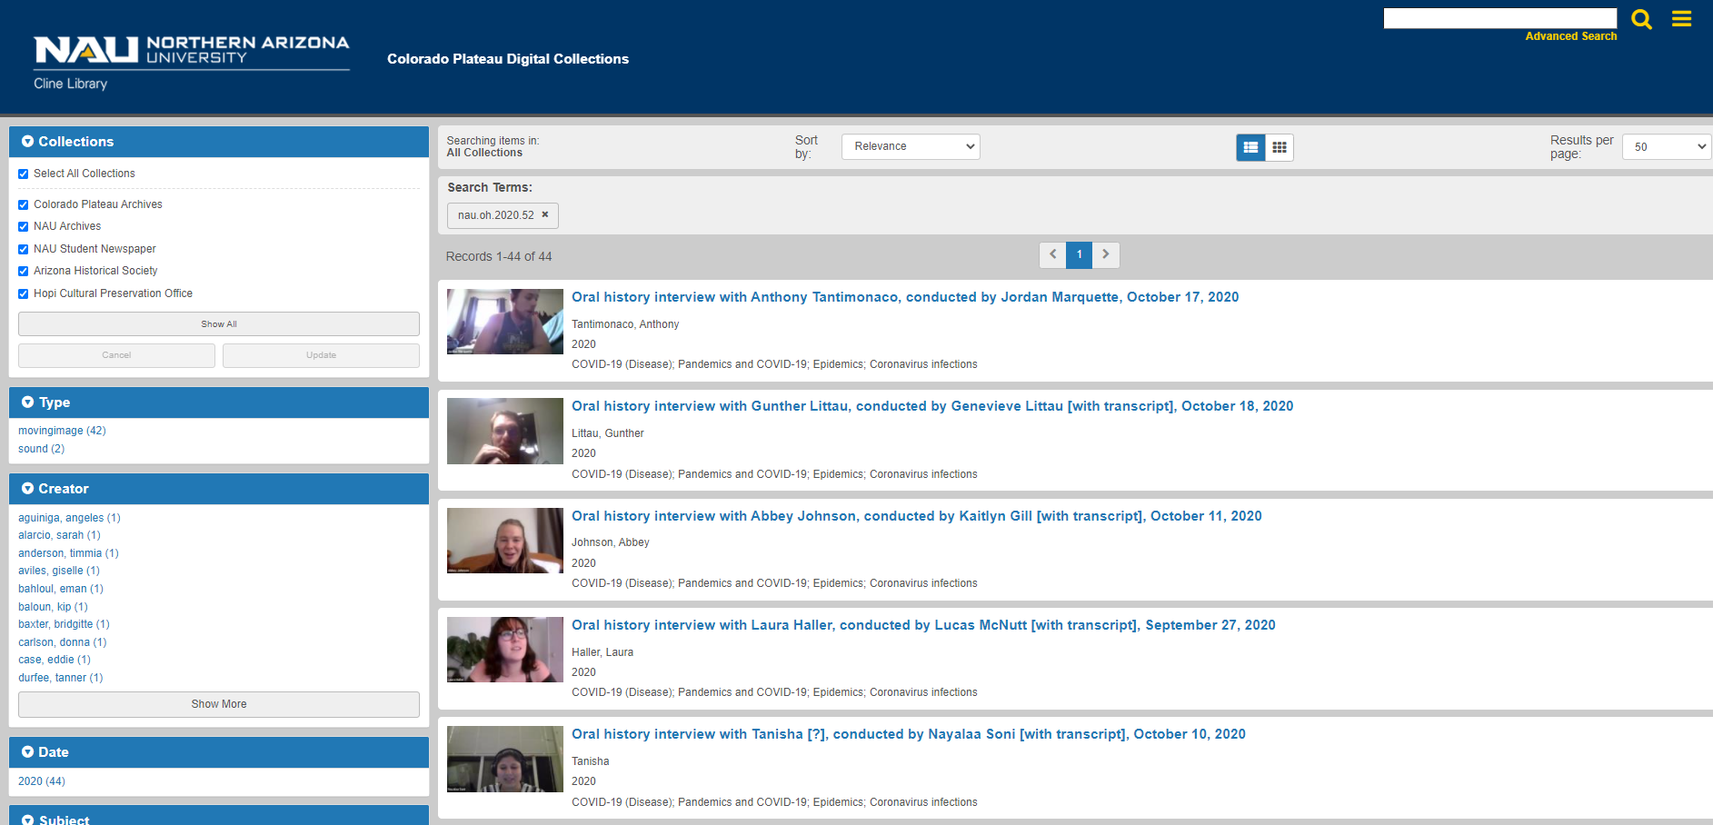

Slide 8
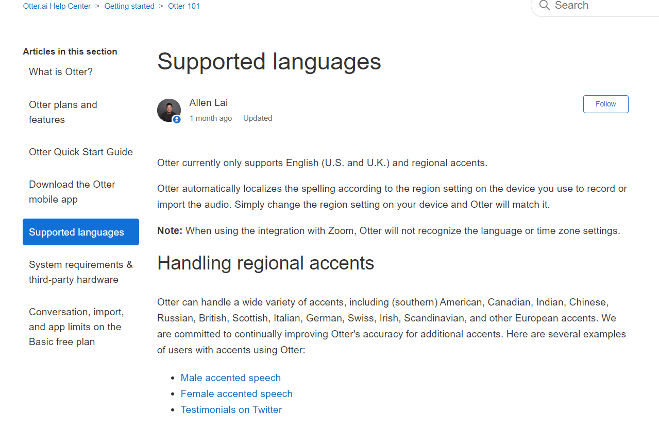

Slide 9
coconut trees
COVID-19
coven
coated wire
code
homemade mouse
masks
95 mouse
end 95
Notes:
All from Lena Del Rojo interview transcript

Slide 10
Questions?
Email me at: Samantha.Meier@nau.edu

