Slide 1
Learning the Language of Health
The Language of Health: An Editorial Style Guide to Effectively Communicate to the Public
Notes:
Link to LOH should already be in the chat: https://www.azhealthzone.org/style-guide/

Slide 2
Noelle Veilleux Markham, RDN (she/her)
Population Health Dietitian
Arizona Department of Health Services
Bureau of Nutrition and Physical Activity
Notes:
Good morning! My name is Noelle Veilleux Markham. I work at the AZ Department of Health Services in the Bureau of Nutrition and Physical Activity.
I’ve worked in state government as a registered dietitian for almost 10 years working on different CDC, USDA, or state funded initiatives.
Thank you for inviting me to join you during lunch on day 2 of this meeting. I hope the last couple of days have been fruitful with lots of opportunities for connecting with each other.

Slide 3
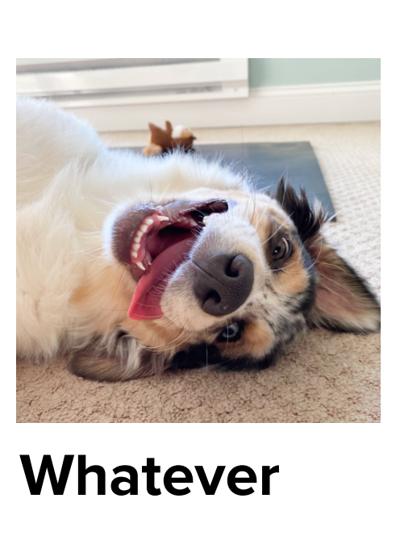
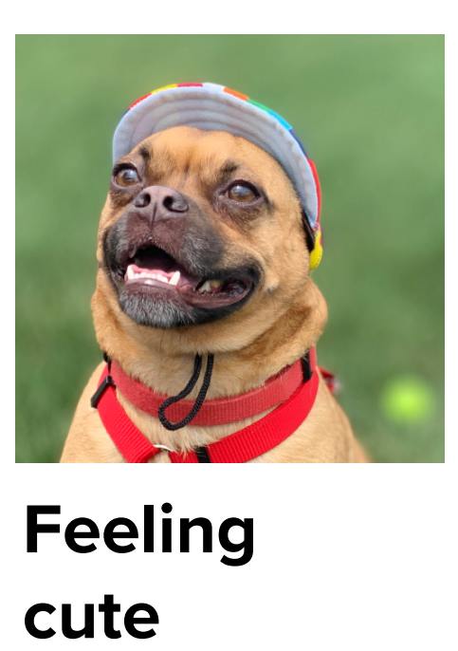
PICK YOUR PUP
1
2
3
Notes:
And, I’ve also been a participant at end of the day meetings or gatherings, so I’m curious to know the mix of how everyone is feeling. Show of hands, who’s still feeling ready for business like pup number 1 here? How about pup number 2? Still feeling good? And who’s feeling more like pup number 3?
Ok, we’ve got a mix! All right! I’m excited to be here with you all and share about a resource I use in my work and hope it will be helpful for all of you as well.

Slide 4
Overview
01
02
03
Context (Systems thinking and messaging approach)
Key Guiding Principles
Messaging Strategies
Notes:
In our time together today, I’m going to start by sharing some context for of how our office has approached reflecting on our messaging and how that relates to program implementation. I’ll share some of what I have found to be key guiding principles and strategies in putting the LOH style guide into practice. And towards the end of our time I’ll share some examples of different health or promotional messages that highlight the advantages and disadvantages of various messaging strategies.

Slide 5
Context: Systems thinking

Slide 6
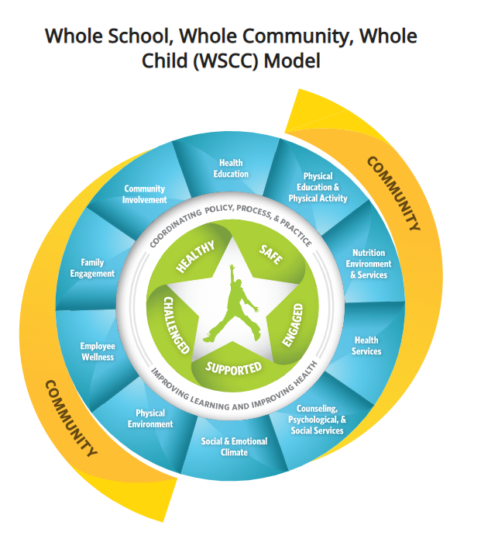
Context: system
Notes:
First, it’s important acknowledge the system or type of approach that this work fits within.
There are many frameworks to that are used in public health prevention–there’s the Spectrum of Prevention, the Spectrum of Opportunities for early care and education, the social ecological model and public health approaches, or and today we’re focusing on the WSCC model in school health.
Something all of these frameworks have in common is the idea that there is no one place or setting that is “the way” to improve health or have an impact in a community. There is overlap and interconnectedness that drives us to to be layered and comprehensive in our approaches to improve health.
Over the last few years as we’ve implemented some changes with our messaging approaches, it’s become clear that even though health messages are often directed at the individual, the decision to be intentional about messaging has impacts in multiple spaces in a prevention framework–that could include messaging that is present in a physical environment, social and community norms, or organizational changes to program policies or practices.

Slide 7
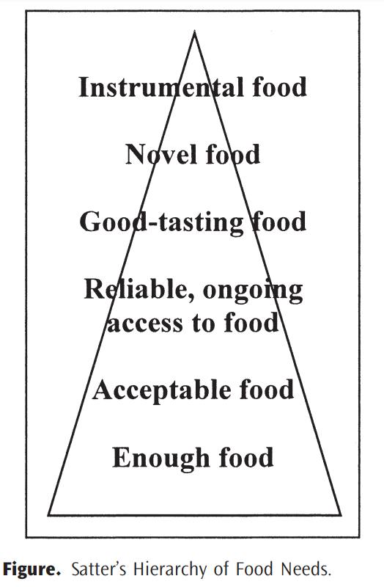
Hierarchy of food needs
Notes:
The other important piece of context is considering where health-oriented messages fit with a given population or group depending on their priorities as it relates to food. This consideration is part of taking a trauma-informed approach to our program efforts. A trauma informed approach includes and extends beyond messaging to promote a culture of safety, empowerment, and healing.
On the screen you’ll see a figure called Ellyn Satter’s hierarchy of food needs. Similar to Maslow’s hierarchy of needs, this framework can help us as public health practitioners understand what might be most relevant for our audience depending on their circumstances.
The bottom of the pyramid is simply getting enough food. Right? The concept that people need to have their basic needs met, and once those needs are met, we can move forward from there. It’s not until we have access to enough food that we can then be a little more discriminating with food safety or food quality. From there, once we have enough safe food, we can then prioritize accessing food reliably. I have enough food for today, what about next week, tomorrow, next month.
And then on to flavor and texture preferences. Novel foods–new foods. Maybe we have a little extra room in our budget to buy a trendy new ingredient. Our concerns about food waste decrease. And then at the very top is instrumental food.

Slide 8
Eating for health
Hierarchy of food needs
Notes:
At the very top is Instrumental Food, and this is the point where eating for health comes into play. So how does this interact with messaging? If our audience or a portion of our audience has unmet needs, then we could be having a mis-match where our messages, oriented to health, are not meeting people where they are.

Slide 9
Context: part 2
Messaging resource

Slide 10
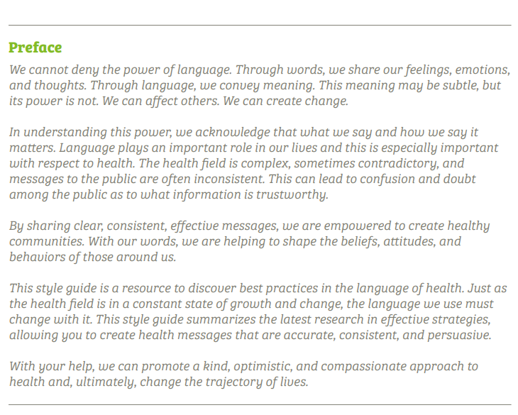
Language of Health
Notes:
This is the preface to The Language of Health right at the beginning of the document. The bulk of the guide is structured in a way to provide practical applications and considerations, but it feels important to set the stage for this work with a strong statement that acknowledges the power of language. I’m paraphrasing, but a main idea here is What we say and how we say it matters. Our words help to shape beliefs, attitudes, and behaviors. Not JUST behaviors—our words can impact the way people feel about themselves, about others, about their community.

Slide 11
Why a style guide?
Common resource
Consistent messaging
Reduce harm
Notes:
Why did we decide to develop a nutrition and physical activity focused style guide?
One, we wanted to have stronger consistency of our messages across programs. This includes internally with our state agency, but also local partners and contactors, external state agencies, and key partners.
Two, a common resource could give us a framework to work within, while still allowing for program autonomy and priorities in specific messaging or program areas.
Three, we wanted something that could help inform our work and mitigate any unintended harm stemming from our work. This was around the same time when program leaders in our office were beginning to explore trauma informed nutrition education and health equity. We wanted a tool that could guide our efforts in a way that aligned with the priorities and values in public health.

Slide 12
Policy, Systems, Environment
Education
Messaging
Notes:
The way program activities in public health nutrition are structured are usually in these 3 areas. And initially, we approached developing a style guide as a tool to really help shape our program messaging.

Slide 13
Policy, Systems, Environment
Education
Messaging
Social media
Billboards
Paid media
Marketing campaigns
Flyers
Notes:
It’s important to note that the messaging strategies and corresponding research is mostly looking at mass messages. Messages that are most impacted would be social media content, website content/articles, billboards and paid media placements, marketing campaigns, and promotional flyers.

Slide 14
General Health Communication Principles
Health
Nutrition and Food
Physical Activity and Fitness
Weight and Body Size
Disordered Eating and Diet Culture
Notes:
It is pretty standard for our messaging to include a focused on food, nutrition, PA, and health, but developing this resource gave us some new ways to also think about our messaging as it relates to weight and body size, weight stigma, and disordered eating and diet culture.

Slide 15
“These policies rest upon the assumptions: (1) that higher body weight equals poorer health, (2) that long-term weight loss is widely achievable, and (3) that weight loss results in consistent improvements in physical health. Our review of the literature suggests that these three assumptions underlying the current weight focused approach are not supported empirically. Complicating this further are the misguided assumptions (4) that weight stigma (i.e., pervasive social devaluation and denigration of higher weight individuals) promotes weight loss and (5) recognizing that one is “overweight” is necessary to spur health-promoting behaviors.”
Notes:
We were also examining how our work, being rooted largely in obesity prevention, could meaningfully reflect on the impact of weight stigma.
Here, we are presented with 5 assumptions that often drive health policy and messaging we see. Take note for number 4 and 5 here–the assumption that weight stigma promotes weight loss and that recognizing one is overweight is necessary to spur health promoting behaviors.

Slide 16
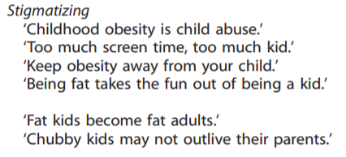
Assumption: Weight stigma promotes weight loss
Notes:
But here we see how well stigmatizing messages are perceived. This comes from a study cited in the LOH where, they showed participants 30 messages that were coded to be different “types” of obesity related messages. They recorded a variety of responses, including which messages people were most likely to “comply” with. On this slide, you can see the messages coded for physical activity, portion sizes, stigmatizing, or multiple topics.

Slide 17
Messages coded as stigmatizing received a notably lower percentage of participants indicating intent to comply
Notes:
The results were that most messages scored pretty well with intention to comply, except those coded as stigmatizing. The messages coded as stigmatizing had a notably lower percentage of participants who intended to comply.
The messages that were perceived to be most positive and motivating made no mention of ‘obesity’ at all

Slide 18
Most favorable messages
Fruit and vegetable consumption
Multiple health behaviors
Instill confidence and personal empowerment
Notes:
The messages that were most well received were the public health messages that focused on making behavioral changes (for example, increased fruit and vegetable consumption, increased physical activity) in a non-stigmatizing way. The non-stigmatizing messages received the most positive ratings and highest intentions for compliance.

Slide 19
Key guiding principles: Health-related messages should be audience focused, practical, and positive.
Notes:
So where does this lead us? One of the main take-aways from the LOH is that for our messages to be effective, we can develop and select messages that are audience focused, practical, and positive.

Slide 20
Audience focused
Practical
Meet people where they’re at and enhance cultural relevance
Provide actionable behaviors;
Include only need to know information; Make messages clear
Positive
Use respectful, considerate messages; Provide messages of optimism and hope; Collaborate, don’t dictate
Notes:
These guiding principles apply across all health topics–whether its food, movement, body size.
Focus on the audience: Are we considering the hierarchy of food needs? Has this population experienced generational trauma, stigma from using benefits, or weight stigma? Understand that one message will not work for everyone. Meet people where they are...messages that are unrealistic and don’t fit a person’s culture or lifestyle are not likely to inspire change.
Practical: Health gets confusing really fast, even when we try to make it simple. Messages that are actionable, directed at behaviors and clear are better received.
Positive: Messages that are optimistic, hopeful, and less prescriptive invite people to connect to messages and resonate well.

Slide 21
Messaging strategy: Promote a healthy relationship with food
Notes:
Something else that developing the LOH helped us uncover is the value in framing our messages to promote a healthy relationship with food rather than focusing primarily on nutrition or health benefits. Health messages can help support a positive relationship with food.

Slide 22
Messages that promote a healthy relationship with food:
Allow people to choose foods that are good for the body and bring enjoyment
Frame with a gain perspective
Acknowledge the many reasons people eat
Notes:
What does that look like?
We can frame things with a gain perspective--what can we gain from the foods we eat? Focusing on what can be gained, or the positive aspects like enjoyment, can help people see food from a positive perspective.
Messages that promote a healthy relationship with food acknowledge the many reasons people eat so that they can go about their lives able to choose foods that are both nourishing and also eat the foods that bring them enjoyment, and that includes promoting a healthy relationship with all foods. This is important to remember even if our role is to help promote behavior change to support health.

Slide 23
Messaging Strategy Examples
More effective
Less effective
There are multiple dimensions of health
Health is weight-neutral
There are social determinants of health
Focus broadly on how groups of people are affected
Framing health as physical health (or one other dimension of health) only
Using weight as the end goal of health
Focusing too much on one determinant of health
Implying/assuming everyone has equal/easy access to health care
Notes:
And there are many more messaging strategies included in the style guide than I’m able to touch on today. Each topic contains a section for Effective Messaging Strategies and Strategies to Avoid. Effective messaging strategies are those that are well received—messages that people respond to in the way that trends toward health promotion. Strategies to avoid is the opposite, strategies that people do not respond well to and may result in unintended harm.

Slide 24
Balancing act
Promote a healthful diet
Individual choice
Behavior design
Word choice in policy
Food neutrality
Social determinants of health
Disordered eating habits/stigma
Word choice in mass marketing
Notes:
Sometimes it may feel like a balancing act. Using the language of health and having it as a resource to refer to has been a tool to articulate the nuances that can exist in this work. Promoting a healthful diet, but avoiding food dichotomies like healthy or unhealthy.
Understanding health can be impacted by individual choice and social determinants of health. What message or approach is relevant for the audience I’m working with?

Slide 25
Balancing act
Personal responsibility as one of many influences
Everyone should be able to make the choices that allow them to live a long, healthy life regardless of their income, education, or ethnic background
Groups (in general) are affected
Not everyone has the same opportunities to be as healthy as others
Focusing on one social determinant only
Low-income individuals are not able to live a long, healthy life due to poverty
Individuals are solely responsible
Make the healthy choice the easy choice
Individual responsibility
Multiple factors influence health/SDOH
Notes:
And that looks perhaps a little something like this where messages are acknowledging the bigger picture rather than all-or-nothing messages about health.
Let’s look at the messages on the left talking about individual responsibility. Messages that talk about individual responsibility as one piece of the overall picture were better received than those that place all responsibility on the individual. While environmental changes to make the healthy choice the easy choice are effective, it may not be feasible nor effective for the public to be told to “make the healthy choice the easy choice” as it is outside their control.
On the right is somewhat similar-- messages that focus too much on one social determinant of health aren’t received as well keeping messages more general.
For example, we know health disparities exist across racial and economic groups. But even though race or income is a known determinant of health, singling out certain groups should be avoided when communicating to the public.

Slide 26
Wellness policies
Word choice on signage
Worksite wellness
Policy, Systems, Environment
Education
Curriculum selection
Focus of lessons
Messaging
Social media
Billboards
Paid media
Marketing campaigns
Flyers
Notes:
Ultimately, reflecting on word choice and language in our messaging has also served a springboard for reflecting on activities in other intervention components across the spectrum of prevention including: curriculum selection, modifying lessons, state level strategic planning, training and professional development needs, partner engagement.

Slide 27
Context: system
Notes:
First, it’s important acknowledge the system or type of approach that this work fits within.
There are many frameworks to that are used in public health prevention–there’s the Spectrum of Prevention, the Spectrum of Opportunities for early care and education, the social ecological model and public health approaches, or and today we’re focusing on the WSCC model in school health.
Something all of these frameworks have in common is the idea that there is no one place or setting that is “the way” to improve health or have an impact in a community. There is overlap and interconnectedness that drives us to to be layered and comprehensive in our approaches to improve health.
Over the last few years as we’ve implemented some changes with our messaging approaches, it’s become clear that even though health messages are often directed at the individual, the decision to be intentional about messaging has impacts in multiple spaces in a prevention framework–that could include messaging that is present in a physical environment, social and community norms, or organizational changes to program policies or practices.

Slide 28
Another Look

Slide 29
Crafting the message
What am I trying to achieve with my message?
Identify messaging strategies to avoid
Is there anything else to consider for this audience?
Identify messaging strategies to use
Notes:
That breakdown of strategies can help guide the approach to take in crafting our message. This is what has been helpful for me, in looking for a structure in navigating this work–let’s process through these steps together.
What am I trying to achieve with my message? Is weight the focus, or is the focus on a health promoting behavior regardless of weight change?
Identify effective strategies to use
Identify messaging strategies to avoid
Is there anything else to consider for this audience and their culture/preferences/circumstances?

Slide 30
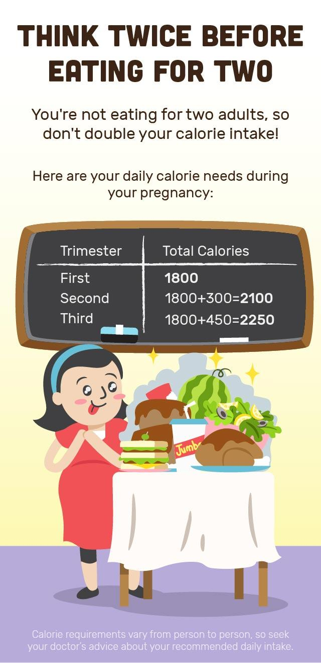
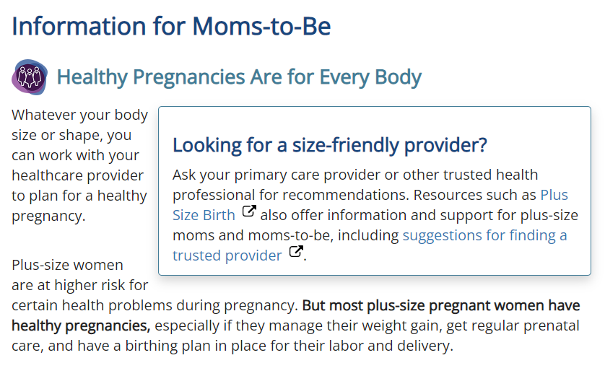
Focus on the
positive.
NIH Pregnancy for Every Body
Health Hub
Notes:
Here’s an example of two different messages focusing on pregnant women.
NIH: On the left, right off the bat there is a message that says any body shape or size can plan for a healthy pregnancy.
Health Hub: Contrast that on the right, and there’s a laser focus on calorie counts with assumptions that pregnant people will eat with abandon and that is the sole cause for increased weight gain during pregnancy.

Slide 31
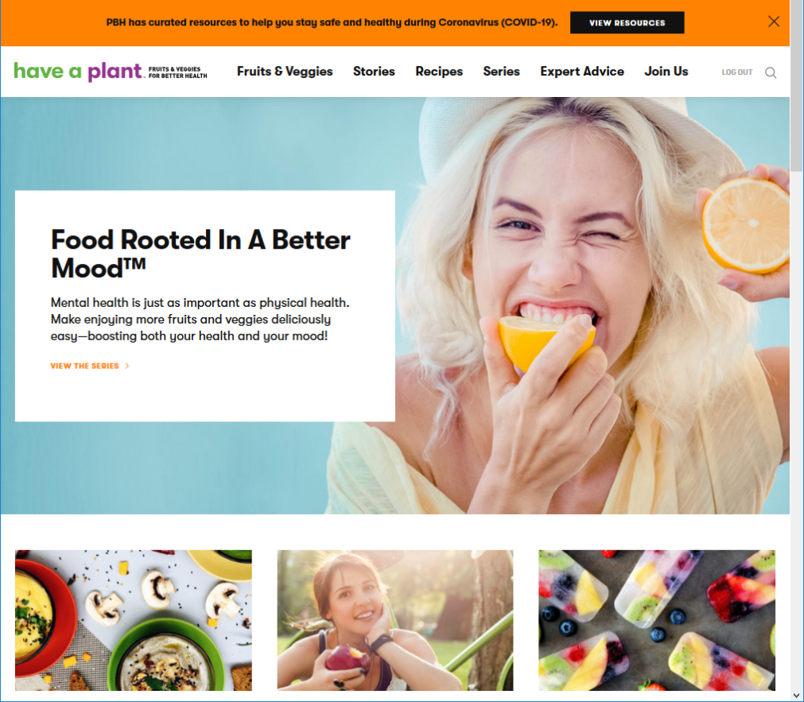
Notes:
Food rooted in a better mood—health is multi dimensional. Not just physical health, but mental health as well.

Slide 32
feed your good
at wagamama, we create food that makes you feel alive. Food that nourishes and energises, like our comforting yaki soba, fueling you with the good stuff, so you can be out there enjoying the things you love.
Notes:
Let’s take a look at this food advertisement with this in mind.
Identify effective messaging strategies in the example
Identify potential messaging strategy to avoid
“at wagamama, we create food that makes you feel alive. Food that nourishes and energises, like our comforting yaki soba, fueling you with the good stuff, so you can be out there enjoying the things you love.”
Take a minute to look at the word choice. What stands out to you?

Slide 33
feed your good
at wagamama, we create food that makes you feel alive. Food that nourishes and energises, like our comforting yaki soba, fueling you with the good stuff, so you can be out there enjoying the things you love.
Food is meant to be enjoyed
Focus on intrinsic reasons to eat healthy
Focus on the positive
Notes:
Food is meant to be enjoyed
Focus on intrinsic reasons to eat healthy
Focus on the positive

Slide 34
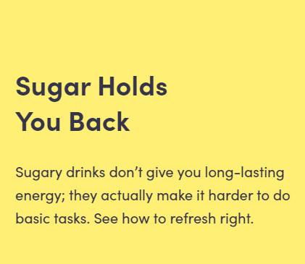
Notes:
Let’s look at another example. What strategies to avoid might be happening here? The message says “Sugar holds you back. Sugary drinks don’t give you long-lasting energy; they actually make it harder to do basic tasks. See how to refresh right.” What is this message trying to convey?

Slide 35
Using negative messages
Discussing diets that must be perfect or clean
Notes:
Here we have examples of two strategies to avoid:
Using negative messages
Discussing diets that must be perfect or clean

Slide 36
Notes:
Let’s try one more.

Slide 37
Focusing solely on nutrients
Does not emphasize protein, fatty acids, or other notable nutrient attributes of plant-based foods
Food is meant to be enjoyed
“Explore” and “possibilities” tap into creativity and trying new foods
Notes:
Food is meant to be enjoyed
“Explore” and “possibilities” tap into creativity and trying new foods
Focusing solely on nutrients
Does not emphasize protein, fatty acids, or other notable nutrient attributes of plant-based foods

Slide 38
Recap
Identify messaging strategies to avoid
What am I trying to achieve with my message?
What else to consider for this audience?
Identify messaging strategies to use
Notes:
These are things we can think about as we develop marketing flyers, build social marketing campaigns, develop content for our program’s website.
What am I trying to achieve with my message? Is weight the focus, or is the focus on a health promoting behavior regardless of weight change?
Identify effective strategies to use
Identify messaging strategies to avoid
Is there anything else to consider for this audience and their culture/preferences/circumstances?

Slide 39
Recap
Health promoting behavior and a healthy relationship with food
Identify messaging strategies to avoid
Negative message
Promotes black and white thinking
What am I trying to achieve with my message?
Multiple dimensions of health
Weight neutral
Pregnancy? Traditional foods? Weight stigma?
What else to consider for this audience?
Identify messaging strategies to use
Notes:
What am I trying to achieve with my message? Is weight the focus, or is the focus on a health promoting behavior regardless of weight change?
Identify effective strategies to use
Identify messaging strategies to avoid
Is there anything else to consider for this audience and their culture/preferences/circumstances?

Slide 40
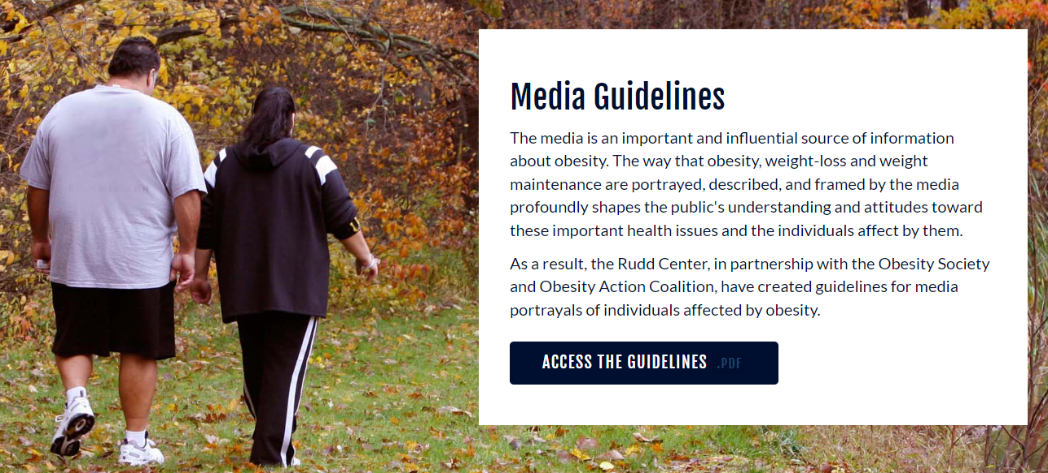
Resources
https://www.azhealthzone.org/style-guide/
https://uconnruddcenter.org/research/weight-bias-stigma/
Notes:
Language of Health Style Guide
https://www.azhealthzone.org/style-guide/
Here’s the link to the full Language of Health Style guide. This has all of the messaging strategies I mentioned today as well as a lot more that I didn’t have time to mention. There are also LOTS of additional resources and citations within the document as well, if you’re curious about the research informing the strategies that are included.
UCONN Rudd Center for Food Policy and Health
https://uconnruddcenter.org/research/weight-bias-stigma/
UCONN Rudd Center has some good resources of weight bias or weight stigma. Here you can find specific resources for healthcare providers, policy makers, and other audiences. There’s also a media guide and image bank here as well. I’d love to see more resources like this, I think there’s still room to grow, but currently this is one of the primary places to look for information on weight bias specifically.

Slide 41
Cited articles
Freeland-Graves, J. H., Nitzke, S., & Academy of Nutrition and Dietetics (2013). Position of the academy of nutrition and dietetics: total diet approach to healthy eating. Journal of the Academy of Nutrition and Dietetics, 113(2), 307–317. https://doi.org/10.1016/j.jand.2012.12.013
Hunger J, Smith J, Tomiyama AJ. An evidence-based rationale for adopting weight-inclusive policy. Social Issues and Policy Review, 2020; 14(1): 103-107. DOI: 10.1111/sipr.12062.
Puhl R, Peterson JL, Luedicke J. Fighting obesity or obese persons? Public perceptions of obesity-related health messages. Int J Obes(Lond). 2013;37(6):774-82. doi: 10.1038/ijo.2012.156.
Rubino, F., Puhl, R. M., Cummings, D. E., Eckel, R. H., Ryan, D. H., Mechanick, J. I., Nadglowski, J., Ramos Salas, X., Schauer, P. R., Twenefour, D., Apovian, C. M., Aronne, L. J., Batterham, R. L., Berthoud, H. R., Boza, C., Busetto, L., Dicker, D., De Groot, M., Eisenberg, D., Flint, S. W., … Dixon, J. B. (2020). Joint international consensus statement for ending stigma of obesity. Nature medicine, 26(4), 485–497. https://doi.org/10.1038/s41591-020-0803-x

Slide 42
Thanks!
Still curious? Let’s stay in touch!
Noelle.Veilleux@azdhs.gov
602-364-3316
Please keep this slide for attribution

