Slide 1
Funding Health in Schools
Keri Schoeff
Title IV-A Safe, Healthy & Active Students Specialist

Slide 2
State and Local Funds
School Budgets- M&O Funds
PTA/PTO Fundraising
Health Moves Minds
Fuel Up to Play 60!

Slide 3
ESSA Federal Funding
Title I
Title II
Title IV-A
Title IV-B

Slide 4
Emergency Authorized Federal Funding
CARES Act- ESSER I- expired
CRRSA- ESSER II- Sept. 30, 2023
ARP- ESSER III- Sept. 30,2024

Slide 5
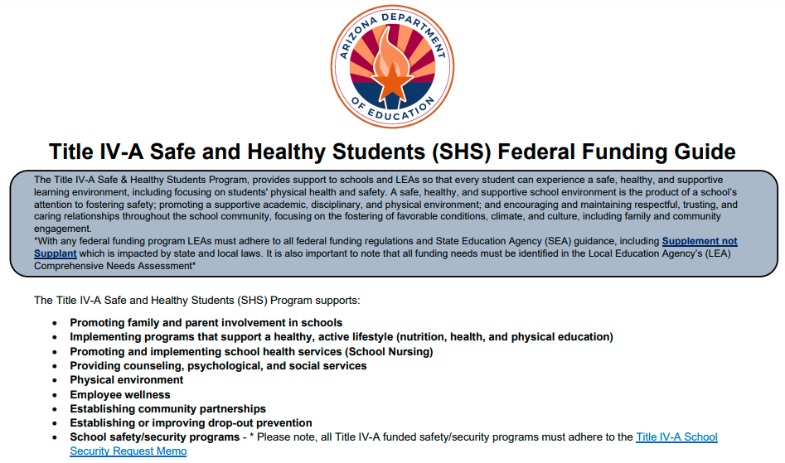
Safe and Healthy Students Federal Funding Guide

Slide 6
Questions?

Slide 7
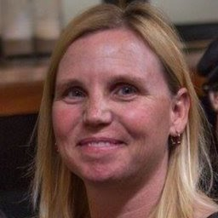
Thank YOU!
Website https://www.azed.gov/safeandhealthy/
Email keri.Schoeff@azed.gov
Phone 602.771-8713

