Slide 1
AMAZING RURAL AZ TOWN
August 2021
Notes:
“If you can’t measure it, you can’t improve it” but determining what to measure is no easy task. Last 8 months, researched nationwide best practices in community development to create a comprehensive yet concise tool to benchmark community strength. The Local First Arizona Rural Community Strength Index helps to measure the current strength of a rural community and provides a roadmap to creating a vibrant, inclusive, and sustainable Arizona economy.
Focuses on community-level outcomes as the key metric of success
Provides a baseline for understanding and measuring key contributors to community
health and resiliency
Employs quantitative and qualitative local data to guide future development initiatives
Strengthens the capacity of local leaders and institutions
Deploys a network of statewide resources to help build stronger, more resilient
communities

Slide 2
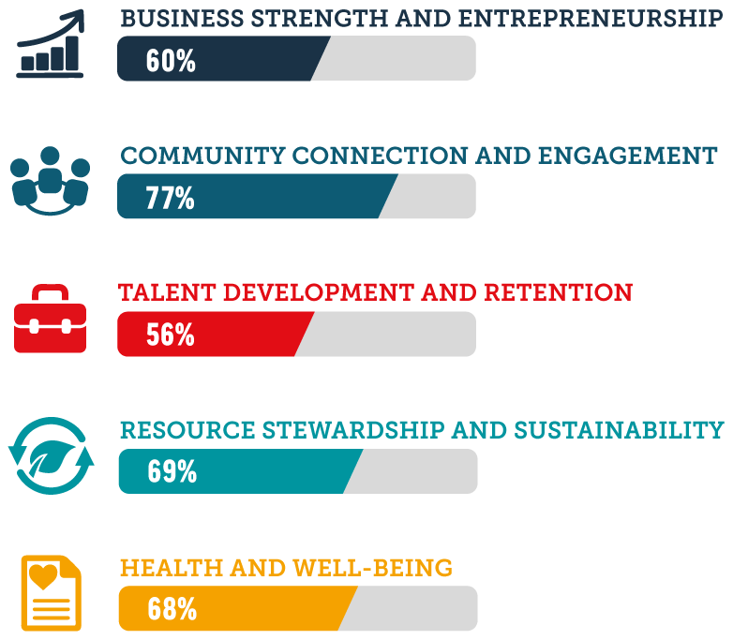
YOUR TOWN, AZ
BENCHMARK
SCORE
66
INDEX RESULTS
Each indicator consists of a series of measurable metrics with data that will be collected and evaluated internally by Local First Arizona. Data collection includes quantitative and qualitative research through online sources, community engagement, and personal interviews.
All data is confidential
Notes:
(5) pillars of strength identified that, when optimized, move the needle on community resiliency include:
Health and Well-Being
Business Strength and Entrepreneurship
Community Connection and Engagement
Talent Development and Retention
Resource Stewardship and Sustainability
Utilizing readily available data sources like OEO, the census, and Center for Future of Arizona progress meters along with a series of community surveys and focus groups, we feel we can now begin to measure the impacts of the hard work we all do in strengthening our rural communities.
2 great partners that have been working with us to test the process and evaluate the validity of results helped to create this real-time example of one of our communities. Not a D - its a starting point.

Slide 3
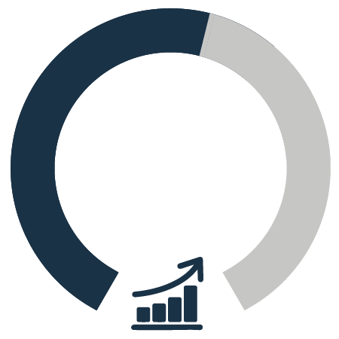
YOUR TOWN, AZ
Business Strength and Entrepreneurship
60
• Economic Diversity and Mobility
• Local Banking and Access to Capital
• Local Procurement
• Regional Integration
• Entrepreneurial Culture
Notes:
Unemployment rate, poverty rates
Availability of local banks and financing
Attitudes on spending local,
Participation with regional partners, state partners (survey)
Broadband access, planning & zone, policy

Slide 4
YOUR TOWN, AZ
Community Connection and Engagement
77
• Social Integration
• Civic Participation
• Third Places
• Organizational Diversity and Collaboration
• Perception of Leadership
Notes:
Community Acceptance, Hometown Pride
Civic Engagement
Community Centers

Slide 5
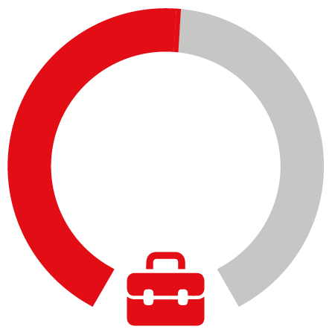
YOUR TOWN, AZ
Talent Development and Retention
56
• Community Attractiveness
• Job Quality
• Labor Pool
• Basic Education
• Continuing Education
Notes:
Housing
Perception of job opportunities
Educational attainment
Mentorship

Slide 6
YOUR TOWN, AZ
Resource Stewardship and Sustainability
69
• Built Environment: Growth Patterns
• Built Environment: Complete Streets
• Sustainability: Public Sector
• Sustainability: Private Sector
• Sustainability: General Culture
Notes:
Walkability Score
Perceptions of sustainability
Public attitudes on energy conservation

Slide 7
YOUR TOWN, AZ
Health & Well-Being
68
• Health Indicators
• Healthy Habits
• Places to Be Active
• Healthy Food: Supply Chain
• Healthy Food: Access
Notes:
County Health Ratings
Food insecurity

