Slide 1
Lessons Learned from the COVID Prison Project Meghan Peterson, MPH¹; Kathryn Nowotny, PhD² Center for Health Equity Research, University of North Carolina – Chapel Hill School of Medicine Department of Sociology, University of Miami

Slide 2
Roadmap
COVID Prison Project Background
COVID Prison Methods
COVID Prison Findings
RADx Project
Next Steps

Slide 3
COVID-19 in Carceral systems
The U.S. leads the world in COVID-19 infection and mass incarceration
As of April 2022,, 2,874 people in prisons have died from COVID-19
We don’t know enough about how COVID-19 spreads in correctional facilities
Data reporting and mitigation strategies are inconsistent
Notes:
LBR
*Note that several systems stopped reporting any COVID data, so the number of is likely higher for incarcerated people

Slide 4
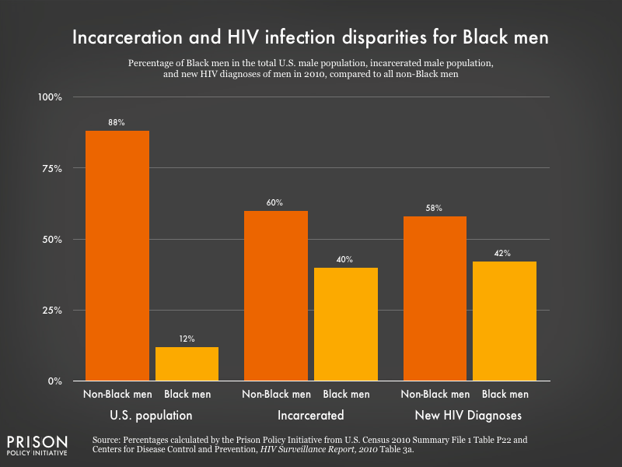
Carceral Settings as Spaces of Risk
¼ of the incarcerated population has a chronic condition
Overcrowding and inability to engage in social distancing
Mistrust of healthcare systems and personnel
Credit: Prison Policy Initiative
Notes:
LBR
Chronic conditions: In 2011–12, an estimated 40% of state and federal prisoners and jail inmates reported having a current chronic medical condition while about half reported ever having a chronic medical condition (BJS data)
Overlapping disparities: obviously, higher percentage of Black people in prisons; women in particular have poorer outcomes (more likely to report chronic conditions, mental health diagnoses, SUD, lack of reproductive health care)
Mistrust: surveys have shown that incarcerated people mistrust healthcare providers, particularly older people that are BIPOC
Long-lasting: opioid overdose post-release, death post-release…

Slide 5
COVID-19 in Prisons
No centralized prison COVID-19 data
Systems provide piecemeal data dashboards
COVID Prison Project born to aggregate and track pandemic data

Slide 7
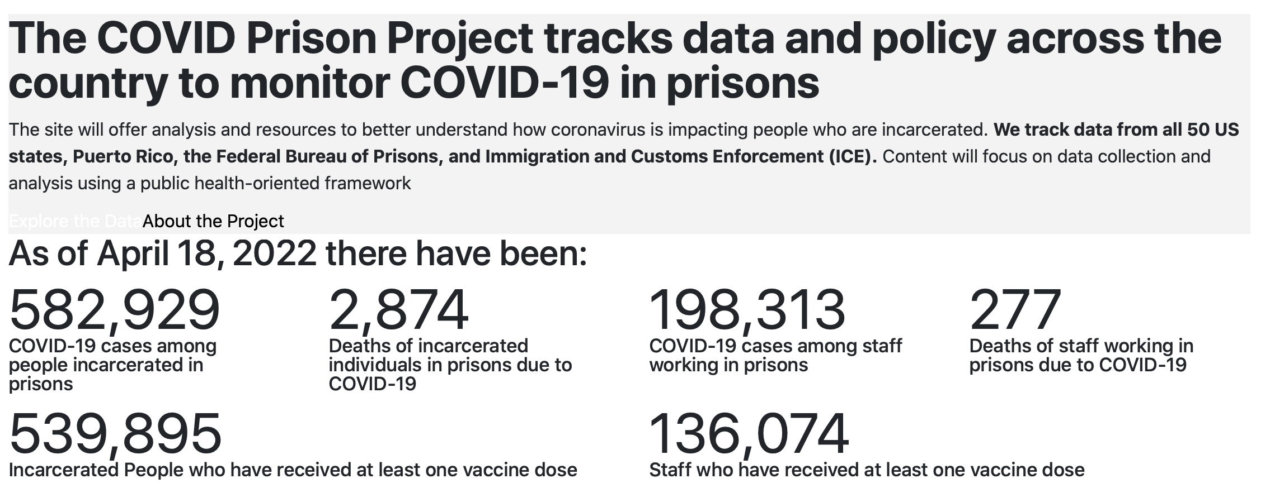

Slide 8
Utility of data project
Transparency on conditions behind the walls
Centralized resource for people to report conditions they, family members experience
Source for media to highlight human rights abuses/data quality
Foundation for legal research

Slide 9
COVID-19 in prisons
Case rate was 3-5x higher among people who were incarcerated than in the general population
Reporting from DOCs is inconsistent, mistakes in the data
Deaths misattributed or missing
Decreased frequency of reporting since summer 2021
Vaccinate data uninterpretable

Slide 10
What we wish we knew at outset
Documenting DOC-end mistakes
Monitoring changes is important
Web scraping needs human oversight
Media

Slide 11
Radx-UP: COVID-19 testing and prevention in correctional settings
In response to NOSI-20-121, we propose to increase the reach, access, uptake, and impact of COVID-19 testing among incarcerated people and staff in prison and jails.
Aim 1: Identify ethical concerns and potential solutions for COVID-19 testing and vaccine strategies in correctional facilities using a community-engaged strategy.
Aim 2: Characterize incidence of COVID-19, disease progression, and related-outcomes and effectiveness of testing and contact tracing (among staff and people who are incarcerated) in correctional facilities.
Our long-term goal is to mitigate the impact of COVID-19 in correctional facilities while considering the ethical issues that must be addressed to optimize implementation and effectiveness.
Notes:
LBR
Highlight: We’re the only project focused on incarcerated populations
Aim 1: We will conduct a series of interviews at each site (FL, MN, RI, WA) over the study period with three separate groups: incarcerated people, medical providers, correctional staff and correctional leaders. These focus groups will focus on ethical issues related to COVID-19 testing, contact tracing, data sharing, and vaccines. Our multidisciplinary team inclusive of formerly incarcerated individuals will engage through participatory analysis of focus group data, historical archives, and dialectic sessions on the current state of science to iterate strategies to improve reach, access, uptake, and impact of COVID-19 testing in correctional facilities.
Aim 2:
Utilizing testing strategies deemed feasible and ethical in aim 1, we will utilize 74,812 COVID-19 tests to test and re-test a total of 16,859 incarcerated people and correctional staff for active infection over a six-month period in the FL, MN, and RI state prison systems and the Yakima County Jail in WA. Facilities will provide identifiable data on people who are tested, re-tested, their contact testing protocols, including patient demographics, comorbidities, and COVID-19 health outcomes. Using these data and national correctional facility-level data from the COVID Prison Project, we will estimate COVID-19 baseline prevalence and cumulative incidence, rates of disease progression, and outcomes and use a stochastic dynamic transmission model of COVID-19 to model effectiveness of testing strategies in reducing incidence, given individual, correctional, and community level characteristics.

Slide 12
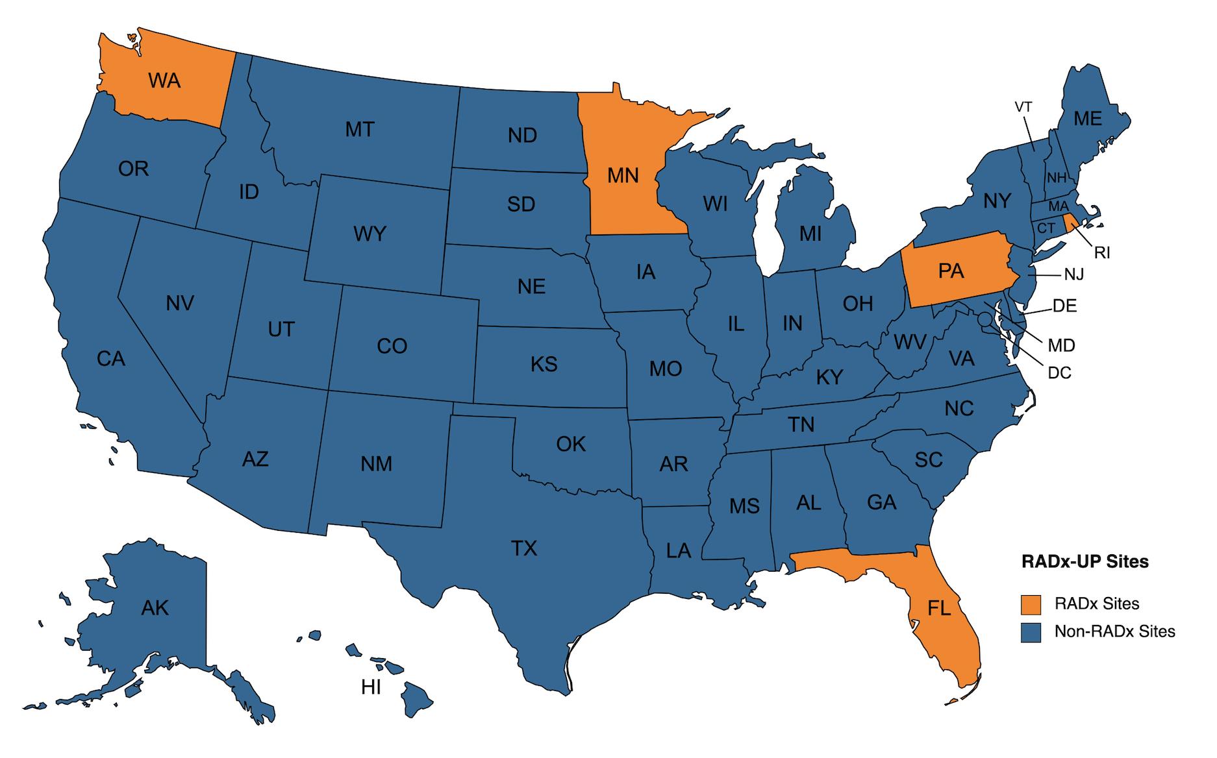

Slide 13
AIM 1
Planned
Four sites
Four groups of respondents
Longitudinal
Focus groups
Content Analysis of Archival Data
Adjusted
Four sites still planned
Four groups of respondents
One time only, with some carefully chosen follow up interviews
One on one interviews only
Content Analysis of Archival Data
Identify ethical concerns and potential solutions for COVID-19 testing and vaccine strategies in correctional facilities using a community- engaged
Notes:
**MM here

Slide 14
Preliminary findings
Information/communication
Movement and isolation
Testing
Vaccination
Missed Opportunities
Ecosystem
Notes:
**MM here
Info/comm: coming from CO’s, and CO’s themselves felt a lack of information from leadership
Isolation: 23 hours, having to move to a new area with new neighbors
Testing: mixed opinions on voluntary
Vacc: getting leftover vaccines, having differing opinions on vaccines from CO officers that change with shift
Missed Opportunities:
Ecosystem:

Slide 15
Preliminary Recommendation Examples
Prioritize sharing information about COVID & protocol changes with people who are incarcerated and staff.
Involve people who are incarcerated in creating & implementing COVID information and protocol messages.
Ensure that medical isolation and quarantine are not punitive and are, instead, medically oriented.
Give both positive and negative test results in a way that optimizes privacy.
Consider the financial, emotional, and physical well being of correctional workers.
Vaccination strategies for people who are incarcerated should include education about the vaccine and communication about logistics.
Notes:
**MM here

Slide 16
Aim 2: Characterize incidence of COVID-19, disease progression, and related-outcomes and effectiveness of testing and contact tracing in correctional facilities.
Incarceration Data
Demographics (race, age, sex, gender) | DOC Administrative Data
Type of Facility (jail, prison) and blueprint/layout | DOC Administrative Data
Type of Housing Unit (dormitory, single cell, double cell) person lives in | DOC Administrative Data
Ventilation in facility (HVAC – yes or no?) | DOC Administrative Data
Capacity of Facility | DOC Administrative Data
Custody Level of Facility Person is in (minimum, maximum, medium) | DOC Administrative Data
# of people released from March 2020 to current time by month (COVID-related) | DOC Administrative Data
# of people released from March 2020 to current time by month (non-COVID-related) | DOC Administrative Data
# of people admitted from March 2020 to current time by month | DOC Administrative Data
COVID-19 Testing Information
Previous Non-RADx COVID-19 Test Received (Yes/No; Date) | Medical Record
Medical Comorbidities (e.g., diabetes, respiratory disease, cardiovascular disease, hypertension, cancer, chronic kidney disease, and smoking history) | Medical Record
Seasonal Influenza Vaccination History | Medical Record
COVID-19 Test Used | Medical Record
COVID-19 Test Result (+, -, inconclusive) | Medical Record
Exposed to Positive Case | Medical Record
Put in Quarantine from March 2020 to current time | Medical Record
Put in Medical Isolation | Medical Record
COVID-19 Vaccine Received (Yes/No; Date) | Medical Record
# of COVID-19 Vaccine Doses given | Medical Record
Type of COVID Vaccine Received | Medical Record
Notes:
LBR

Slide 17
Aim 2: Characterize incidence of COVID-19, disease progression, and related-outcomes and effectiveness of testing and contact tracing in correctional facilities.
COVID-19 Clinical Outcomes
Asymptomatic/Symptomatic/Pre-symptomatic | Medical Record
Date of Onset of Symptoms | Medical Record
Symptoms (Cough, Shortness of Breath, Subjective Fever, Chills, Muscle aches, Headaches, Sore Throat, Loss of Taste, Loss of Smell, Unknown) | Medical Record
Required Hospitalization | Medical Record
Death | Medical Record
Policy Information
Visitation, Sanitation, Symptom screening, Masking, Isolation, Transfers | DOC Policy Documents
Facility and Community Level Information
Healthcare expenditures | DOC Administrative Data
Built Environment of the Facility (e.g. do people recreate and eat in congregate, have shared bathrooms, etc.) | DOC Administrative Data
Number of people incarcerated participating in activities and their purpose (working, recreating) | DOC Administrative Data
Daily Census of People Incarcerated and staff assigned to facility, in specific housing units. | DOC Administrative Data
Staff shift schedule and number of people working | DOC Administrative Data
Notes:
LBR

Slide 18
Lessons learned and takeaways
Complex legal barriers to data sharing
Ongoing public health crisis in correctional settings
Need for adaptable testing strategies
Need for public health oversight of carceral responses
Notes:
**MM here

Slide 19
Long-term goals
Agent-based modelling of different correctional systems
Ethical guidance for COVID-19 mitigation in correctional settings
Integration of RADx data into a larger database of prison data
Notes:
*MM here

Slide 20
Questions?
Meghan_Peterson@med.unc.edu

