Slide 1
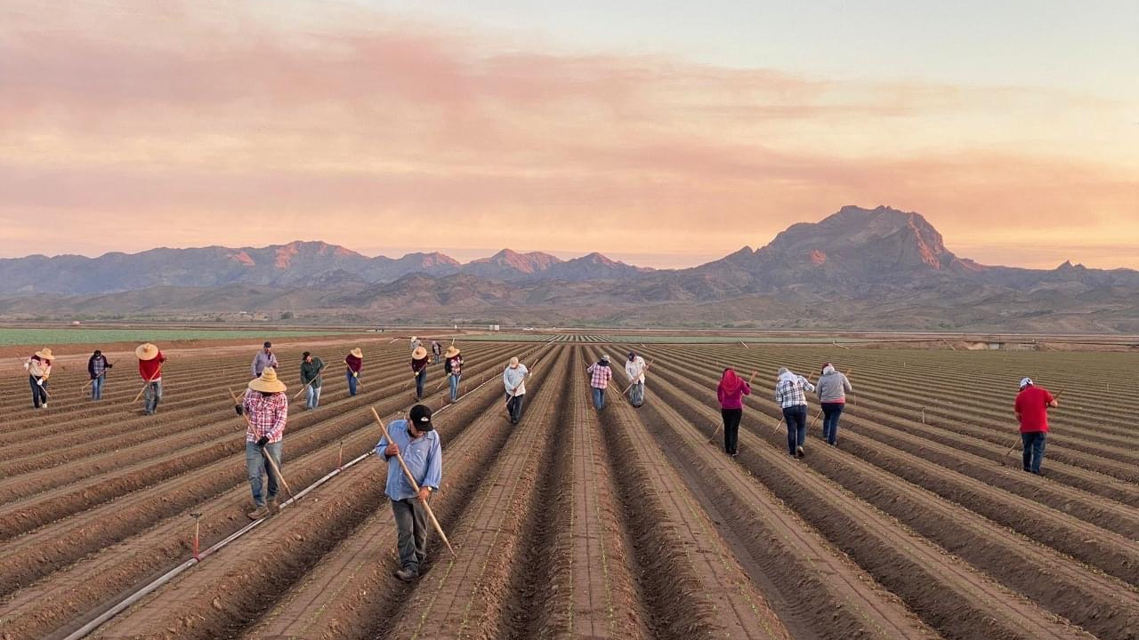
Promotores de Salud / Community Health Workers
The Health Equity Model of Yesterday, Today and Tomorrow
Emma Torres,MSW
Executive Director and founder of
Campesinos Sin Fronteras

Slide 2
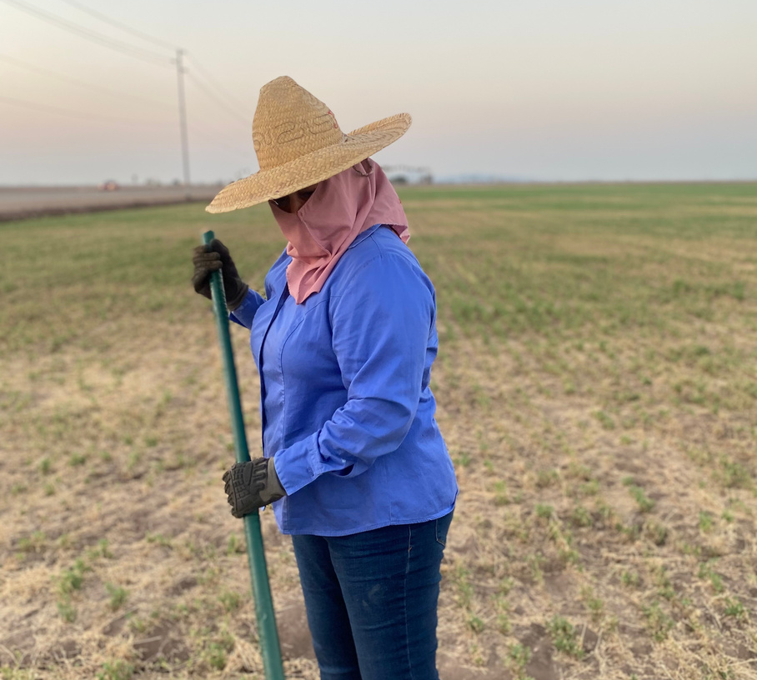
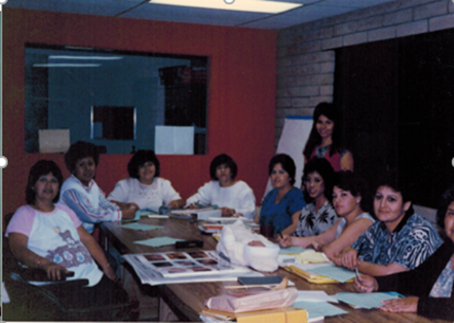
History
CAMPESINOS SIN FRONTERAS
1980s -
Social & Economic Disparities
Poor wages for farmworkers
Working conditions
Limited access to healthcare
Limited state and federal programs

Slide 3
"Community Knows Best"
The Start of the Promotora/Community Health Worker Model
Promotoras were women from the communities they served:
Natural helpers and leaders
Trusted members of their community
Turn to elders for advice
Build strong relationships among each other
Support and advocate for each other
Are resourceful and natural fundraisers experts on vaquitas, cundinas, rifas, etc.
CAMPESINOS SIN FRONTERAS

Slide 4
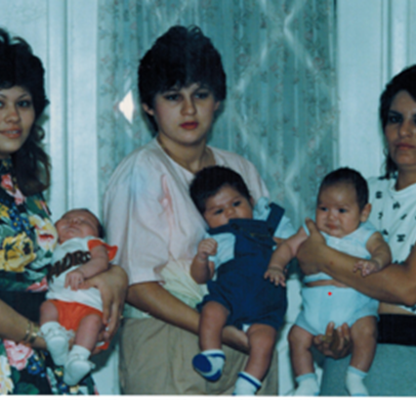
"Community Knows Best"
The Start of the Promotora/Community Health Worker Model (1985)
Today Promotora's natural abilities are Known as:
Required Skills and Competencies or
Core competencies
CAMPESINOS SIN FRONTERAS

Slide 5
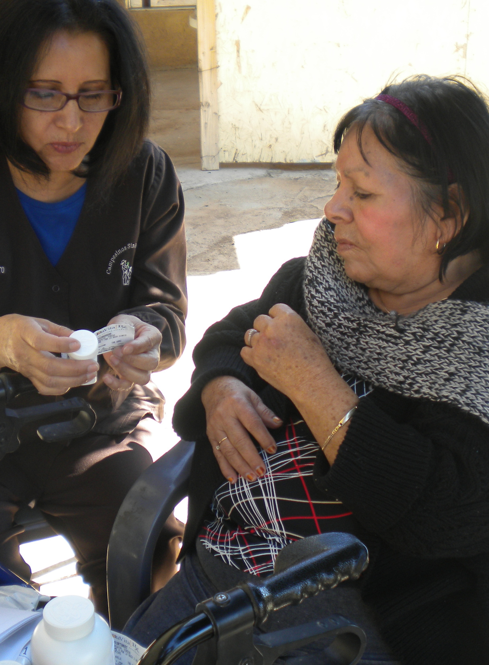
Promotoras
Know their community firsthand
Identify barriers and challenges
Impact on the healthcare system
Are strong advocates for ensuring access to care for those they serve
Become involved in solving people's needs: food, housing, employment
(Addressing social determinants of health)
CAMPESINOS SIN FRONTERAS
Promotoras are Transformational Leaders
not "transactional leaders"

Slide 6
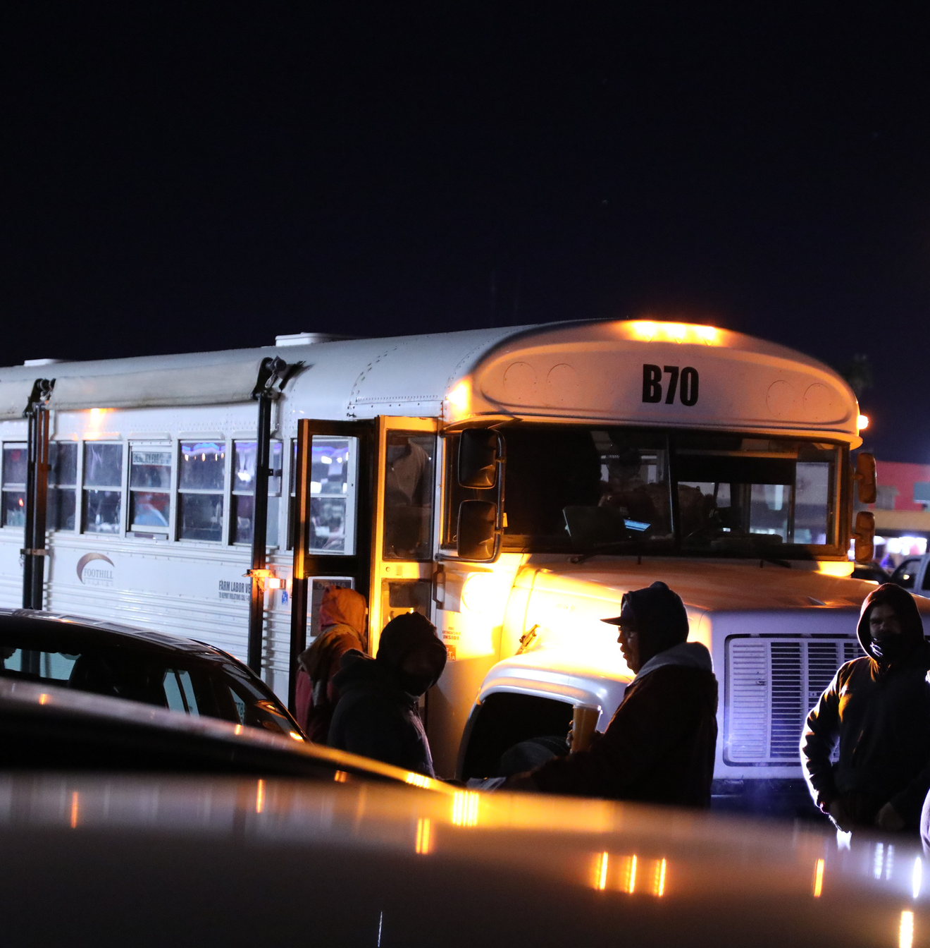
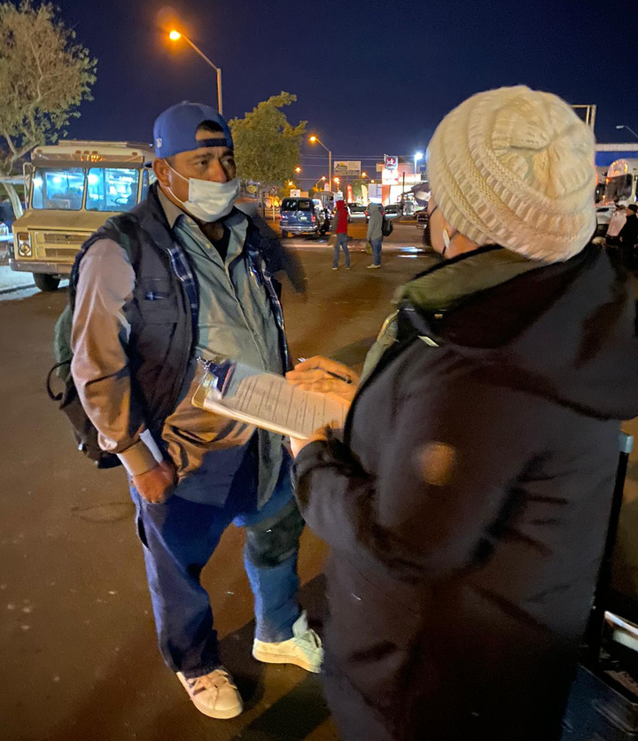
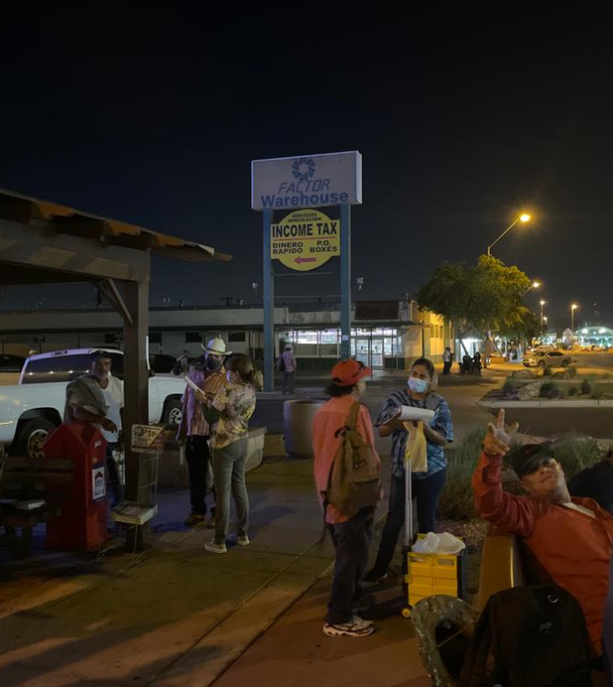
"Meet and Serve people where they are"
CAMPESINOS SIN FRONTERAS
Early morning outreach
No matter the weather
Are culturally and linguistically appropriate

Slide 7
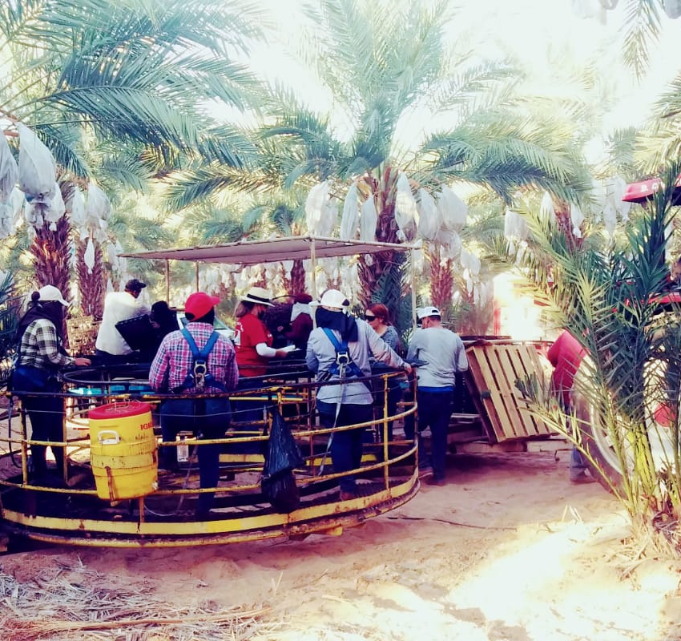
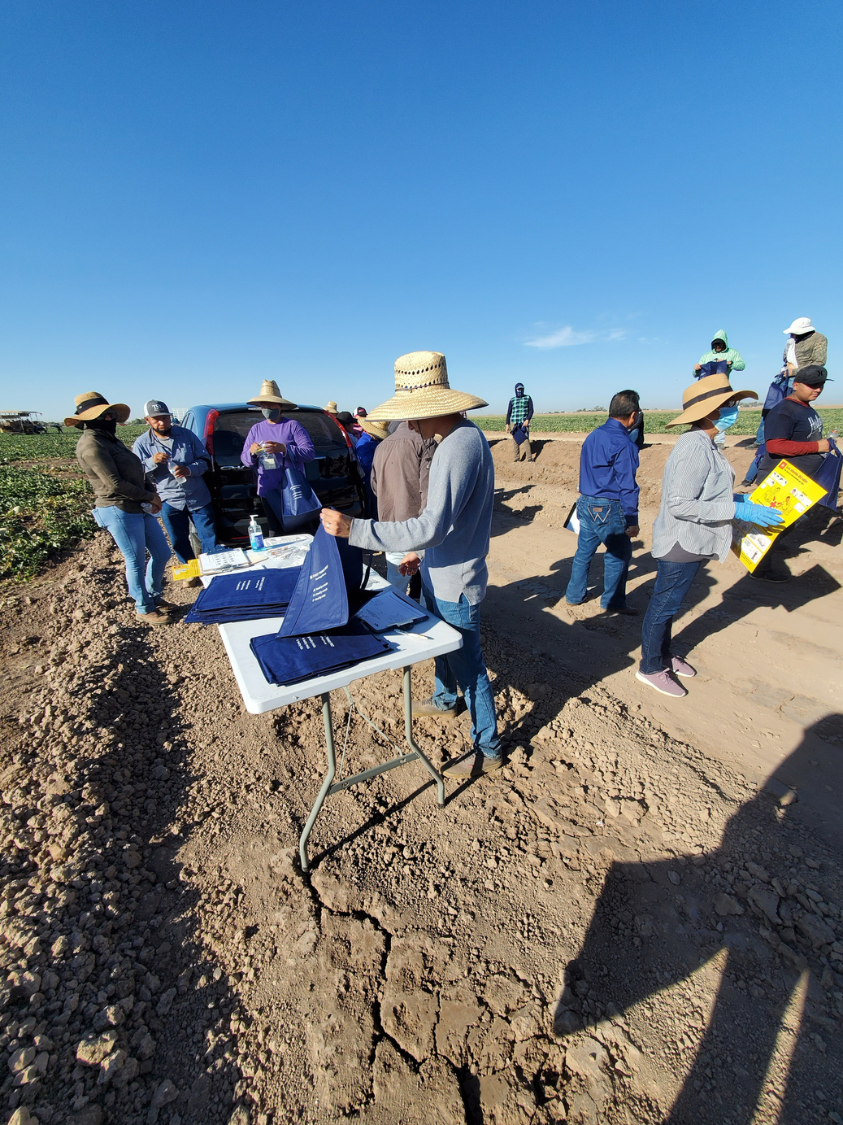
Reach farmworkers at their work sites
.
CAMPESINOS SIN FRONTERAS

Slide 8
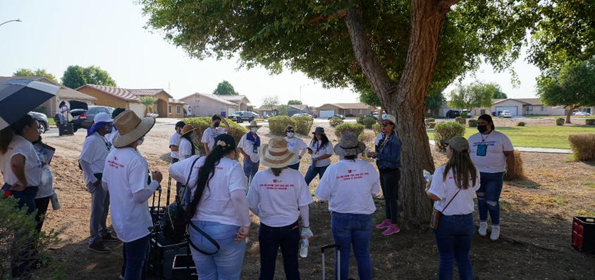
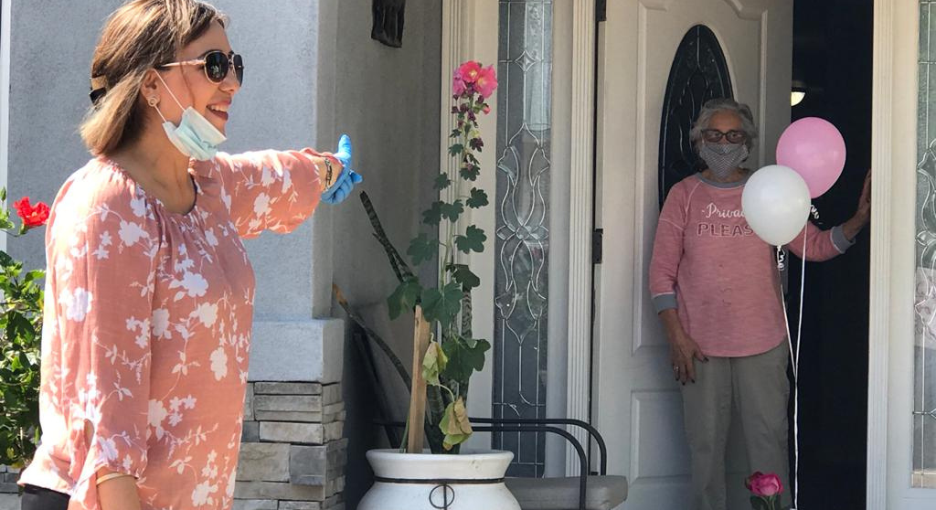
COVID 19 did not stopped them
CAMPESINOS SIN FRONTERAS

Slide 9
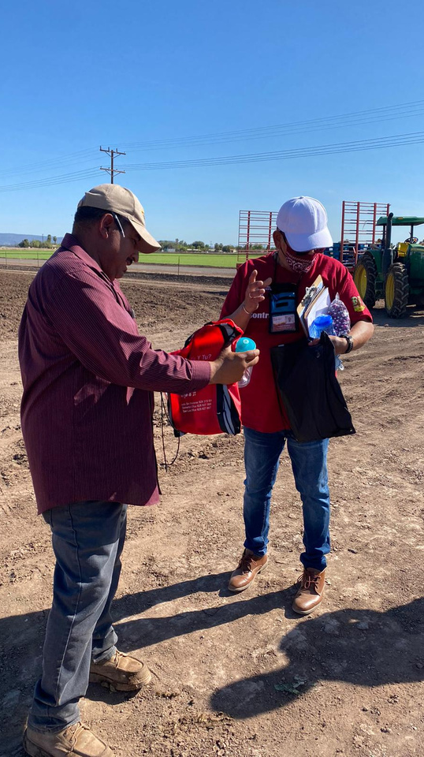
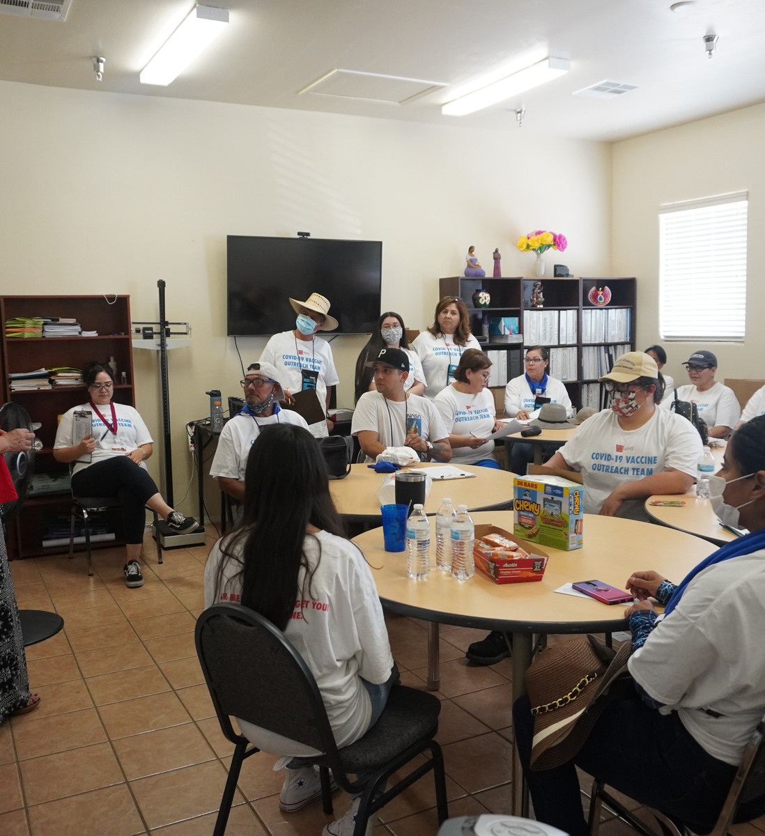
YEAR 2020
Promotores are Frontline workers, boots on the ground and fearless leaders serving their community
CAMPESINOS SIN FRONTERAS
RECRUITED
ORGANIZED
TRAINED
DEPLOYED
"UNIDOS CONTRA EL COVID19"

Slide 10
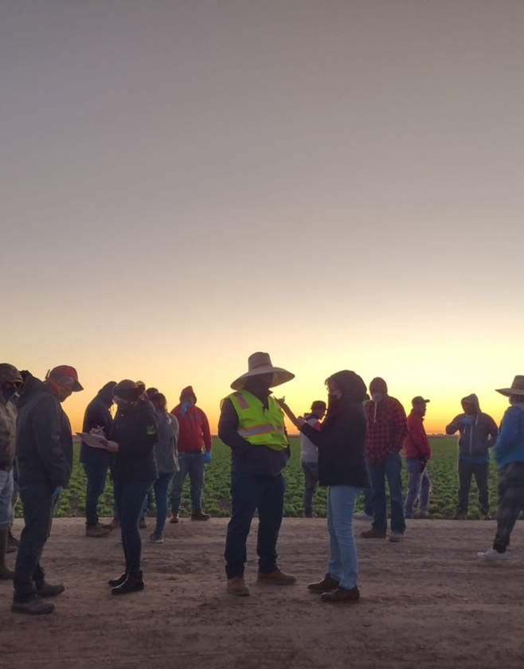
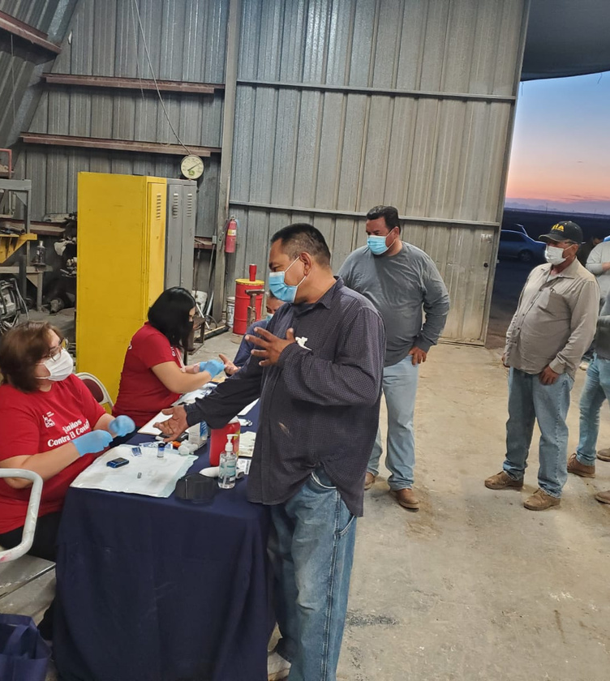
CAMPESINOS SIN FRONTERAS
CSF Promotor@s embracing the call to service!

Slide 11
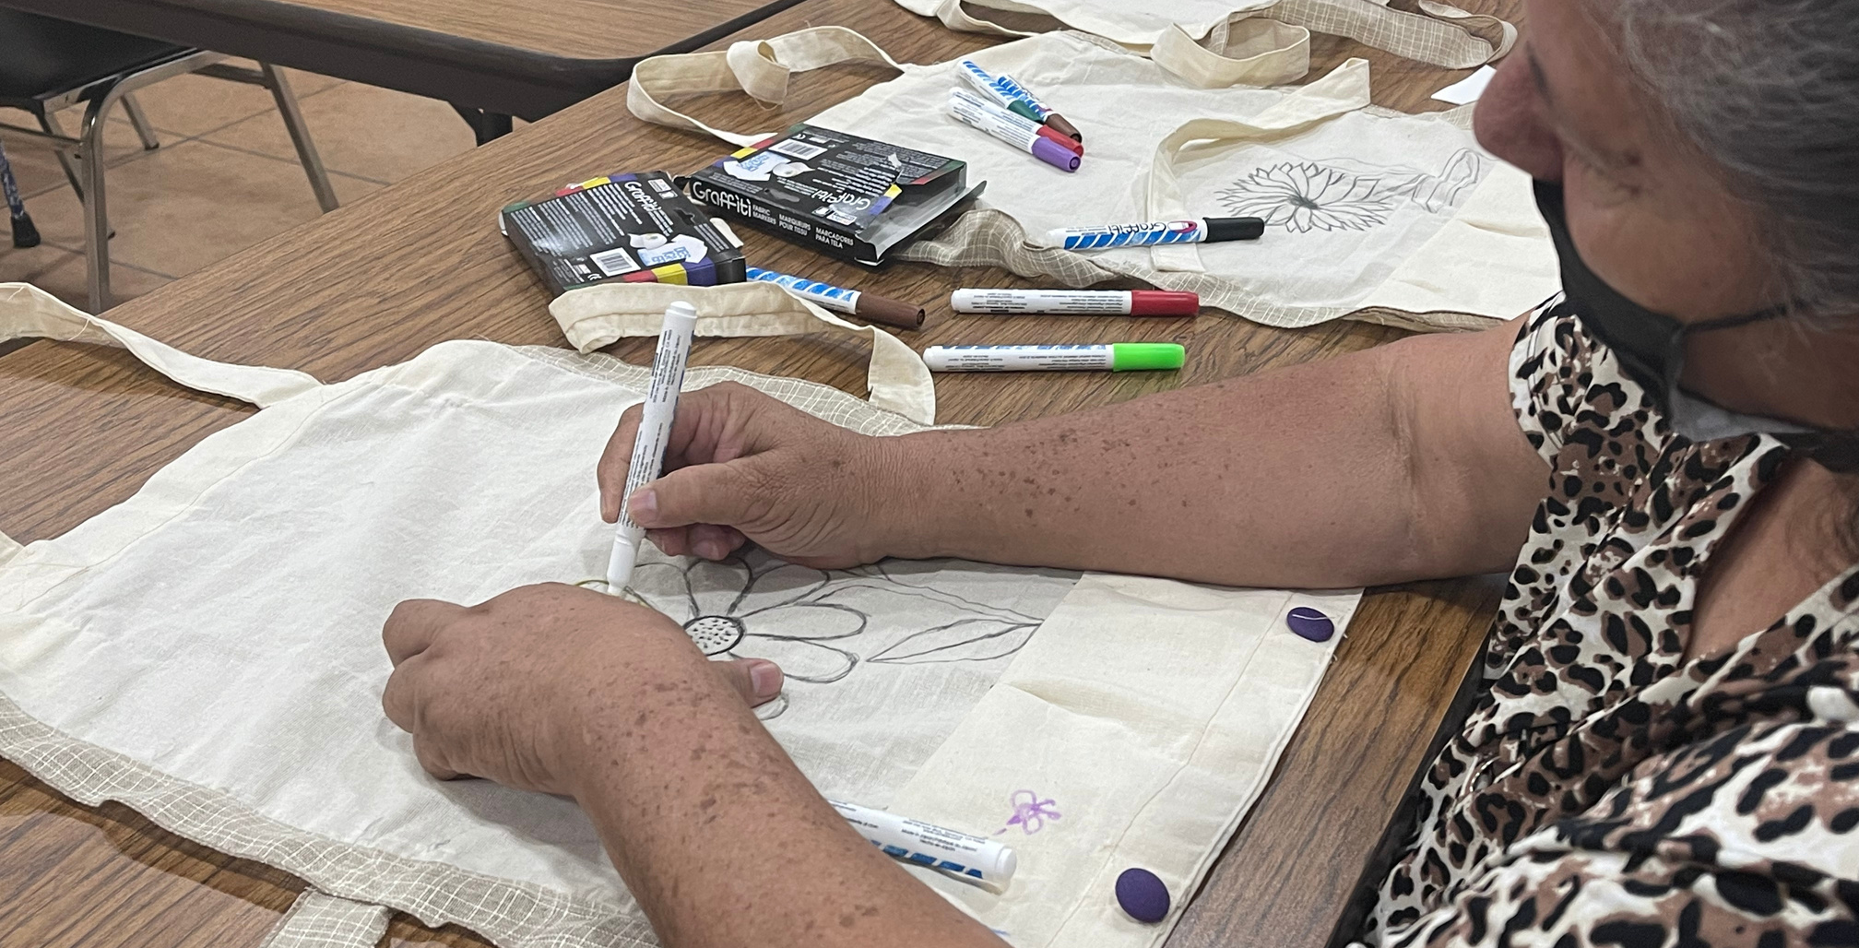
Good things take time.
CAMPESINOS SIN FRONTERAS
EMMA TORRES
ETORRES@CAMPESINOSSINFRONTERAS.ORG
TEL: 928-627-5995
THANK YOU!
GRACIAS!

