Slide 1
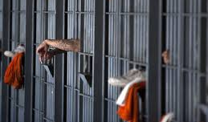
Covid19 Impact Navajo Nation Correctional facilities

Slide 2
Introduction
My Background:
Tódichiìnii (Bitterwater) clan, Tóahanií Near the Water) clan, maternal grandfather is of the Tłízilłní (Manygoats) clan, and my paternal grandfather is of the Kinłichii’nii (Kinlichini) clan.
Originally from the Black Mesa community around the Peabody Mining
BSW/MSW in Social Work, PhD in Social Justice
Navajo Department of Corrections:
Navajo Department of Corrections since 2003
NDOC is a part of the Division of Public Safety
23 years with Navajo Social Services holding various management positions

Slide 3
Response to Covid19
March 2, 2020: policy and protocol on handing of new arrests and serving inmates: Judicial Courts, Chief Prosecutors Office, Navajo Police and the Office of the President;
Release of those inmates with serious health issues; diabetics, heart disease, asthma, cancer, anyone over the age of 60 who had served more than half their sentence;
Protocol to assess new arrests, isolation positives individuals, monitoring w/n the facility, weekly meetings with health care staff, review issues, and continuedly reviewing plans;
Training of Corrections Officers, support personnel;
Tracking Covid positive cases; inmates, staff, and family;
Internal Data collection.

Slide 4
January to December 2020 Covid Positive Detainees

Slide 5
January to December 2021 Covid Positive Detainees

Slide 6
2020 Impact of Corrections Officers

Slide 7
2021 Impact on Corrections Officers

Slide 8
2020 Impact on Support Staff

Slide 9
2021 Impact Support Staff

Slide 10
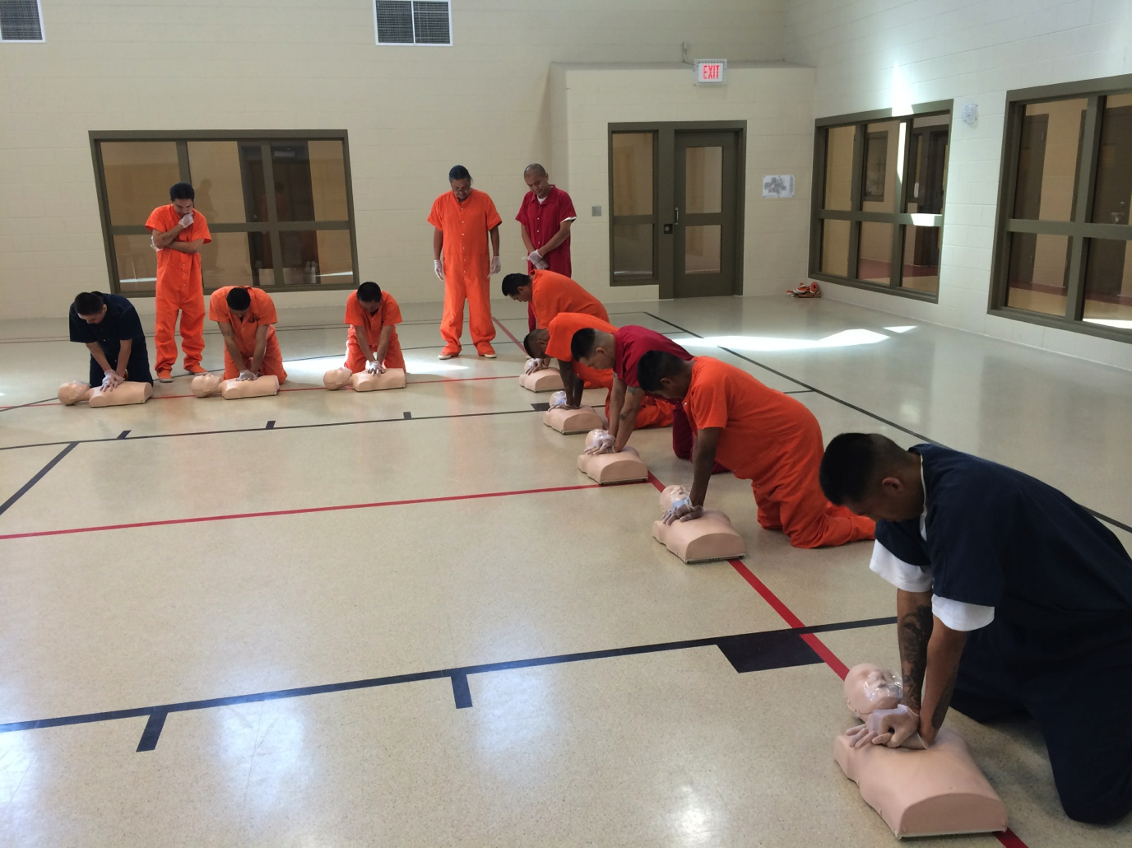
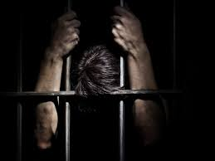
What was lost for more than a year
To provide intervention services to incarcerated individuals
To provide direct face to face training for staff
Cancelled all visitation
Court hearings were done virtually when internet was working (impact on the rights of individuals)
Incarcerated male from stock photos (Adobe)

Slide 11
Classroom education

Slide 12
Preparation for Sweat Lodge

Slide 13
Inmates setting up a tent in Tuba City for a community event

Slide 14
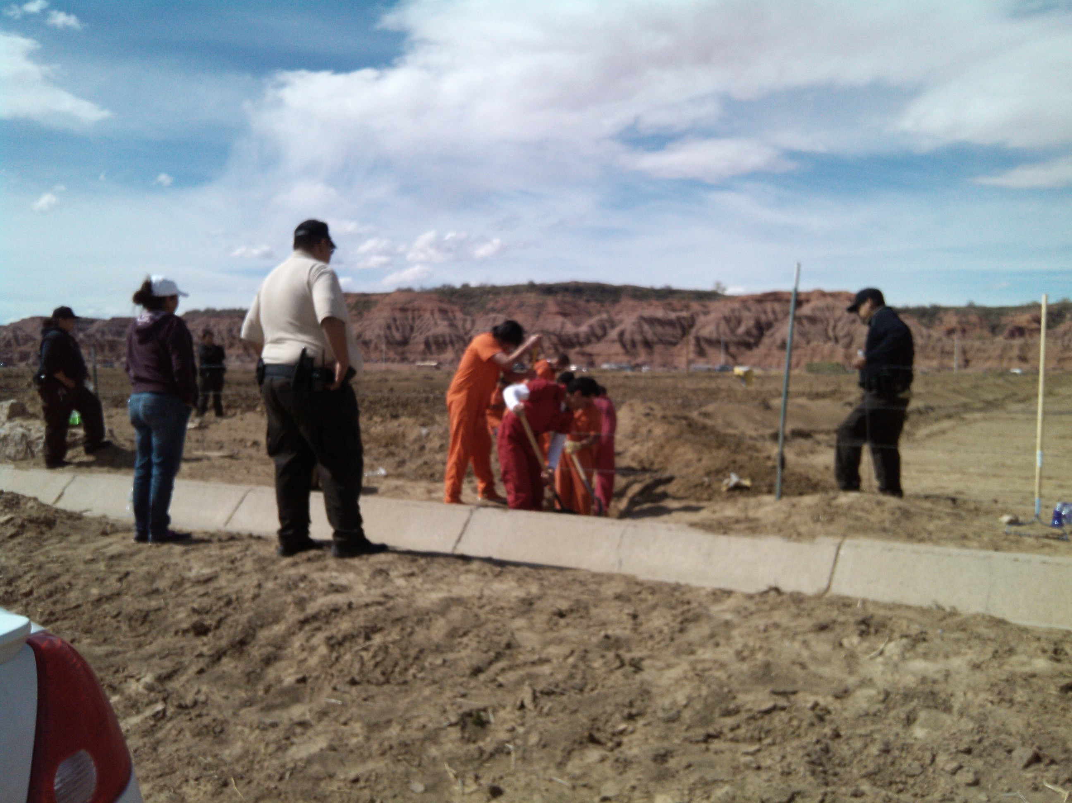

Slide 15
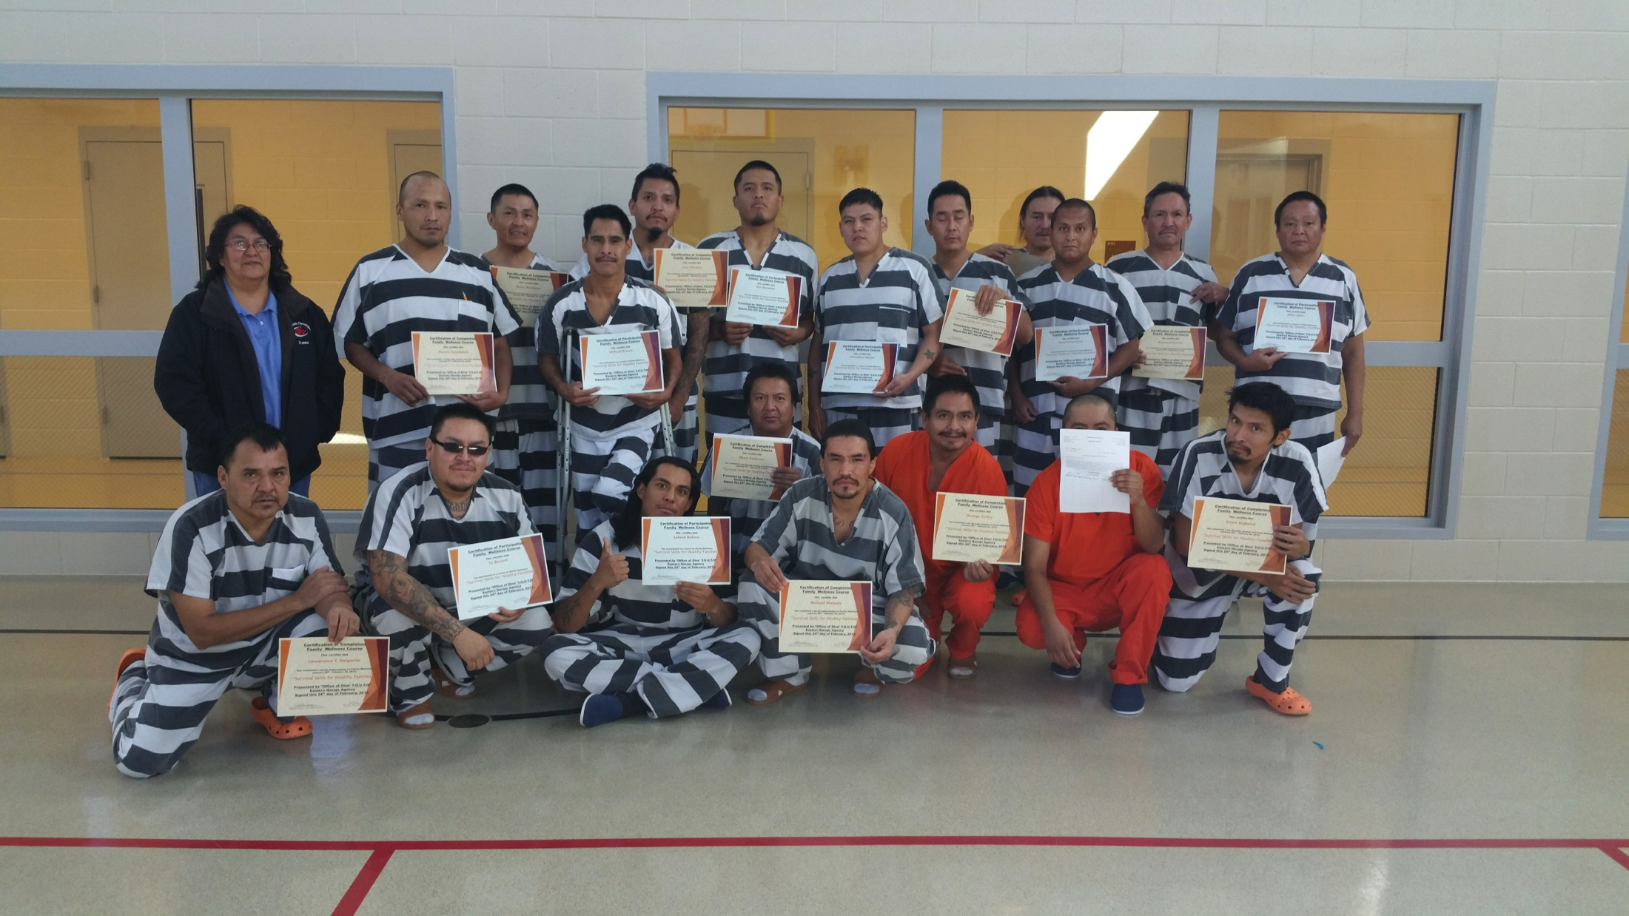
Graduation

Slide 16
Community Event

Slide 17
Facility Capacity
1. Window Rock – temporary holding; 8 to 12 hours.
2. Crownpoint – 42 bed serving adults w/8 temporary detainment of juveniles.
4. Chinle – 42 bed serving adults
48 juvenile facility serving (currently closed for renovation).
5. Kayenta – 80 bed adult serving
4 juvenile temporary holding
6. Tuba City – 132 bed adult serving
48 juvenile facility serving with 10 temporary hold (pretrial or 8 to 12 hour holds).
296 adult serving beds and 84 juvenile serving.

Slide 18
Students learn about the corrections system

Slide 19
Students on tour of facilities

Slide 20
Q n A following presentation by Corrections officers

Slide 21
Services
Referrals for AA individual and group counseling on site
Sweat Lodge Services through partnerships with DBMHS and Indian Health Services
Gardening projects in Tuba City and Kayenta completed its first year
Young Fathers Parenting: Capacity Builders
Faith based 12 Step AA Programs
Faith Based individual and group work focusing on anger management, social skills, budgeting
Community Services chopping wood, packing food boxes for food banks, serving food at community dinners, gardening,
Independent study general education, other
College courses in locations available
Classes in 1st Aide, Food handlers

Slide 22
Services continued
Cooking classes with Special Diabetes, exercise classes with Special Diabetes, recreation
Bible study,
Referral for medical, dental and other health care needs
Referrals to public defenders when requested
Provide reading and writing materials
Community Services Workers assist in the kitchen, laundry and cleaning of the facility
Community Services Workers also assist local recourses to clean offices, yard work as long as they are closely supervised at all times

Slide 23
Conclusion of an event

Slide 25
Quarterly Inspections

Slide 26
Conclusion and Questions

