Slide 1
Childhood Obesity Within Tuba City Service Unit
TUBA CITY REGIONAL HEALTH CARE CORPORATION
Community Health Division
Health Promotion Disease Prevention
Presenters: Monica Huber & Elena Curley

Slide 2
TCRHCC
Provides services to a 6,000 square mile area.
8 Service Areas/Chapters.
Approximately serves 100,000 individuals
94% Native Americans
Services provided to the community includes comprehensive inpatient/outpatient emergency services; dental and ophthalmology services; orthopedics; OB/GYN, oral surgery; eye surgery; and urological procedure and community health services.

Slide 3
Health Promotion Disease Prevention
Best Practice: Diabetes-related Education
Services Provided:
Take CHARGE
School-Based Activities
Community-Based Activities

Slide 4
Tuba City Childhood Obesity Trends
School-Based Prevention Activities

Slide 5
Tuba City Service Area School-Age Childhood Obesity Trends
Thirteen-Year Percentile Body Mass Index (BMI) Trends
Notes:
Fall 2018
2819 Assessed
3662 Enrolled

Slide 6
Tuba City Service Area School-Age Childhood Obesity Trends Over Time

Slide 7
Fall 2022 Childhood Obesity by Schools

Slide 8
Childhood Obesity by Location
Fast Food Accessibility
Fresh Fruit & Vegetables Availability
Exercise Opportunities
Grocery Store Access
School Environment VS. Community Environment
Time Spent at School VS. Home

Slide 9
Student Based Activities

Slide 10
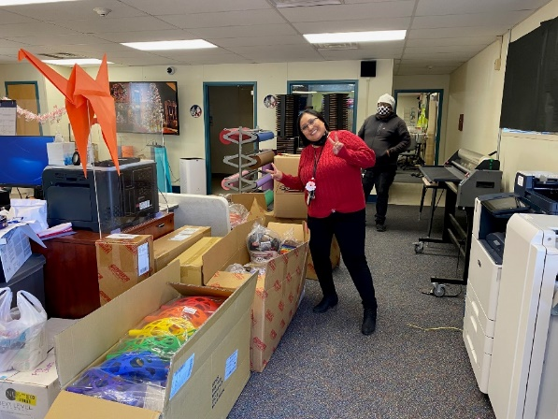
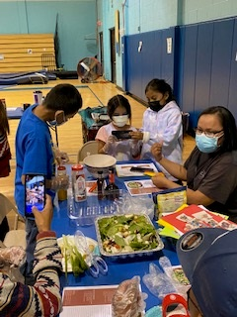
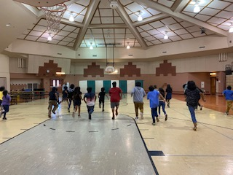
School-Based Services
Coordinated Approach to School Health (CASH) Program
11 Schools
School Health Team Leaders
Classroom Movement Break Challenge
Bi-Annual FitnessGram Assessment
Capacity Building for Staff/Families

Slide 11
Take C.H.A.R.G.E

Slide 12
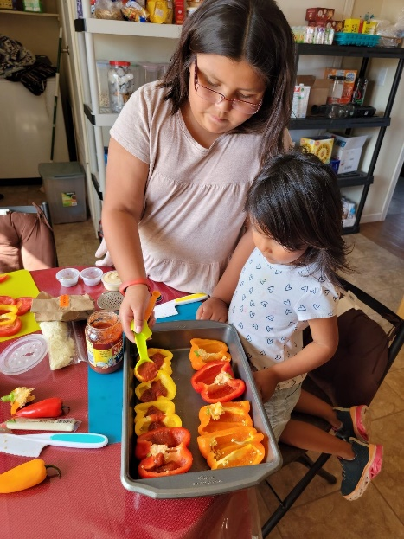
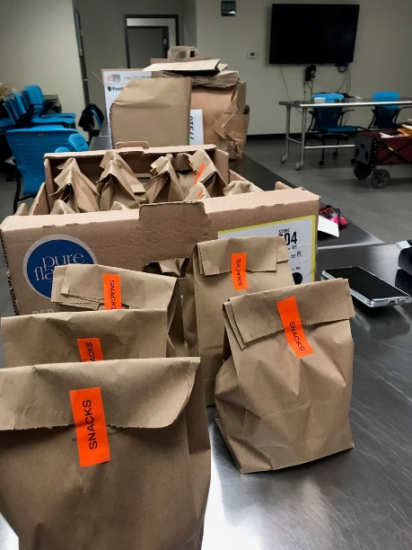
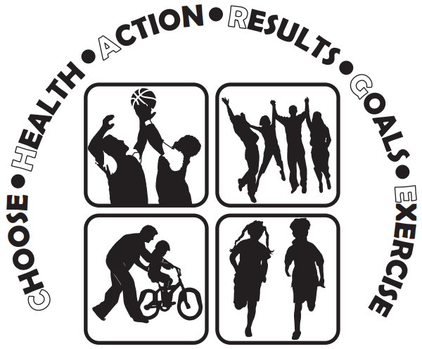
Take C.H.A.R.G.E
Childhood Obesity Intervention Program
Eligible target group:
Referral-based
9-12yo
BMI Percentile equal and greater than 85%
12-week Course
Pre/Post FitnessGram Assessment
Deliver culturally appropriate nutrition education, Physical Activity and life skills for youth and their families.

Slide 13
Community-Based Activities

Slide 14
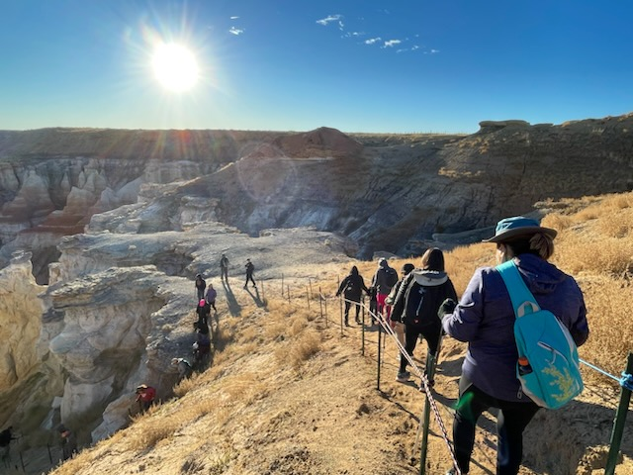
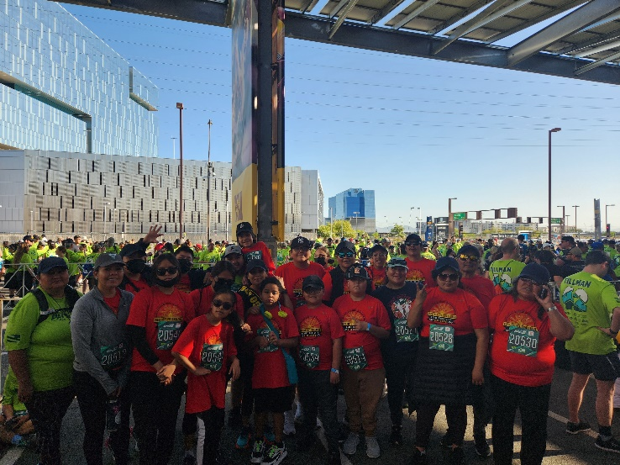
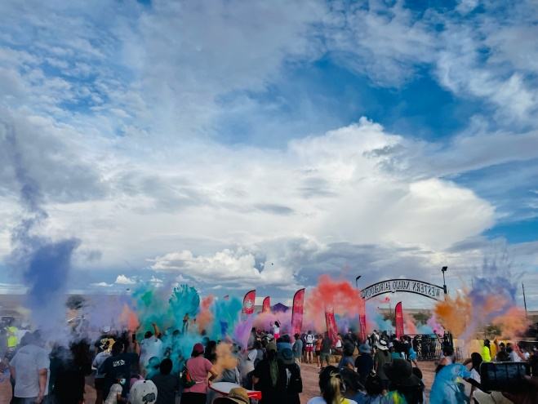
Community-Based Activities
Get Fit Challenge
Just Move It
Hiking Series
Community Health Improvement Planning (CHIP)
Lifestyle Balance Classes
Nutrition & Physical Activity Education & Demonstrations
HPDP Fitness Classes for Youth and Adults

Slide 15
Family, Collaboration & Community
Teamwork & Communication
Partnerships
Administrator Meetings
School Health Team Leader Meetings
Pediatric Obesity Task Force Meetings
Community Health Improvement Planning Meetings
Collaboration Meetings

Slide 16
Recipe for Success- A Coordinated Approach
Environment
Community
Family
Individual
Schools
CHIP
EXERCISE FRIENDLY COMMUNITY
SCHOOL HEALTH INDEX TRAINING
REGIONAL FOOD SYSTEMS TEAM
SCHOOL HEALTH NEWSLETTER
PEDIATRIC OBESITY TASK FORCE
JUST MOVE IT
ACTIVE SUMMER YOUTH PROGRAM
SOCIAL MARKETING
YOUTH BASKETBALL LEAGUE
YOUTH BASEBALL LEAGUE
LOCAL WELLNESS POLICY
LIFESTYLE HEALTH EDUCATION
SCHOOL HEALTH TEAM LEADER INITIATIVE
FITNESS CENTER
END YEAR SCHOOL HEALTH LUNCHEON
MY PLATE, MY FAMILY CURRICULUM
AYSO SOCCER League
JUNK FOOD TAX INITITIAVE
ZUMBA 4 KIDS/TEENS
SCHOOL GARDEN EDUCATION
LOCAL WELLNESS POLICY
GET FIT CHALLENGE
PARENT/STUDENT DIABETES-RELATED EDUCATION
GAREN EXPO
NAVAJO NATION TRAILS INITITIAVE
AFTERSCHOOL PROGRAM
FITNESSGRAM
PROJECT
FAMILY NIGHTS
LIFE SKILLS
NAVAJO WELLNESS MODEL FAMILY NIGHTS
CLASSROOM MOVEMEENT BREAKS
HIKING SERIES
EXERCISE
FVRX PROGRSM
CULTURE
BEHAVIORAL HEALTH
NUTRITION
EDCUATION CENTER
YOUTH FITNESS CENTER
TAKE CHARGE

Slide 17
Questions?

