Slide 1
COVID-19 in U.S. Prisons: Policy Implications and Health Outcomes Carolyn Camplain, JD, PhD(c)
Notes:
Marúaweeka Everyone,
My name is Carly Camplain I’m here to defend my dissertation prospectus entitled COVID-19 in US Prisons: Policy Implications and Health Outcomes. My dissertation chair is Dr. Julie Baldwin, regents professor and director of the Center for Health Equity Research, and my committee includes Dr. Luis Fernandez, professor and chair of Criminology and Criminal Justice her at Northern Arizona University; Aila Hoss, an assistant professor of law at the University of Tulsa College of Law; and Joe Mihaljevic, assistant professor in the school of informatics, computing, and cyber systems here at NAU.
You will see artwork throughout my presentation. All of this art was created by people who were or currently are incarcerated.

Slide 2
Agenda
Background
Theory/Framework
Aims
Methods
Expected Outcomes and Potential Implications

Slide 3
Background

Slide 4
COVID-19 and Incarceration
1,517,000 individuals incarcerated
1,943 state and federal prisons
High risk of exposure to COVID-19
Individuals Incarcerated in US Prisons
COVID Cases: 400,000
COVID Deaths: 2,700
US Prison Staff
COVID Cases: 100,000
COVID Deaths: 200
Tim Lamb, “Country Dog”. 2015. Solana State Prison, CA. Linoleum Print.
Notes:
Prisons and jails had the largest clusters of COIVD-19 cases and are epicenters for transmission
Currently there are about 1.5 million individuals are incarcerated in about 2,000 state and federal prisons
Prisons are long term correctional facilities run by the state or federal government that hold persons with sentences of more than one year. Throughout this presentation, the term prison does not include jails – which are local short-term facilities which hold individuals awaiting trial or serving sentences of less than one year.
These facilities are extremely important but outside the scope of this dissertation.
Individuals who are incarcerated in prisons are at a high risk of exposure to COVID-19
There are almost 400,000 confirmed cases and over 2,700 Total confirmed deaths of individuals who are incarcerated in US prisons
Staff of these facilities are also highly impacted by covid. The Total confirmed cases in US prisons are over 100,000 where Total confirmed deaths in US prisons are almost 200

Slide 5
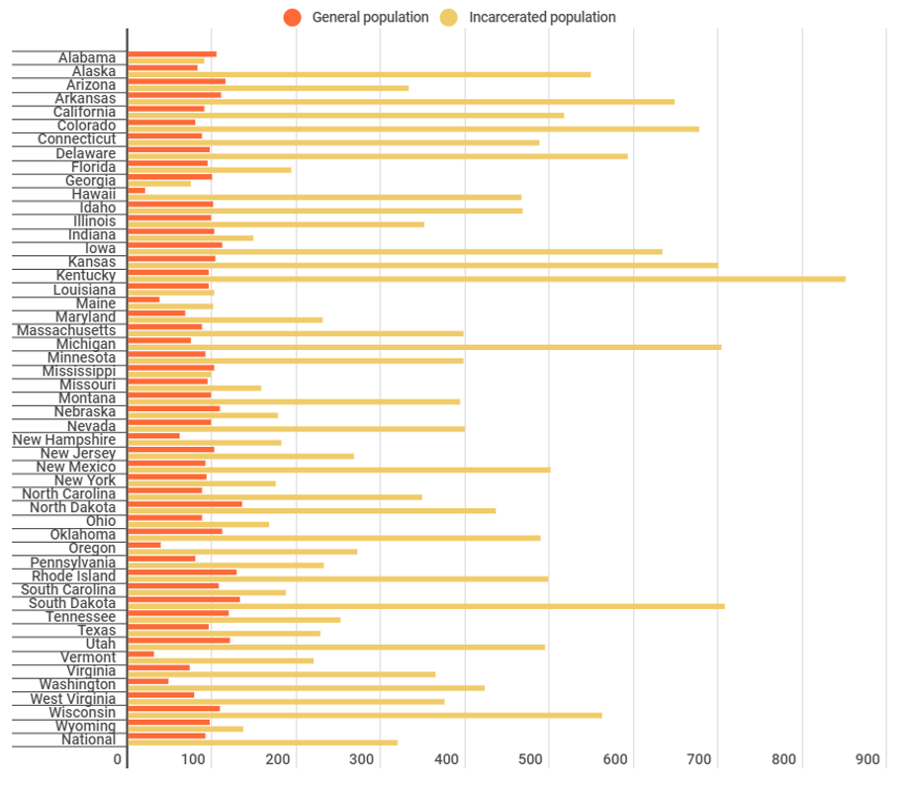
COVID-19 Cases per 1,000 in the Prison and the General Population as of March 31, 2021
Notes:
Throughout prisons in the US, case rates of COVID-19 are almost 4 times the national rate and death rates were two times higher.
This figure shows the COVID-19 cases per 1,000 in prisons and in the general population. As you can tell, the COVID rates in prisons, denoted by the yellow bars are much higher than COVID-19 rates among the general population, denoted by orange. There are three exceptions in the Southern US: Alabama, Georgia, and Mississippi.

Slide 6
Individuals Incarcerated are a Unique Population
Higher risk of developing severe complications from COVID-19
At risk of poor health outcomes and health disparities
Disproportionate overrepresentation
Low socioeconomic status
Individuals experiencing homelessness
Racial/ethnic minority groups
Less educated and unemployed
Michael Pelletier, “Free Spirit”. Oil.
Notes:
Individuals incarcerated are a unique population.
They at higher risk of developing severe complications from COVID-19. The population that makes up individuals who are incarcerated tend to have prior vulnerability to disease morbidity and are already at risk of poor health outcomes and health disparities.
There is also Disproportionate overrepresentation of groups also at higher risk of COVID-19 in the general population, including Individuals with low socioeconomic status, Individuals experiencing homelessness, Members of racial/ethnic minority groups, and individuals who are Less educated and unemployed.

Slide 7
Prisons are a Unique Environment
High density, finite space
Exposure to physical and mental health complications
Poor conditions
Violence
Overcrowding
Lack of adequate medical care
Isolation
Poor ventilation
In more severe cases
Filthy conditions
Rampant/extreme violence and violent activity
Solitary confinement
Amber Daniel, Untitled.
Notes:
The prior vulnerability paired with often stressful and unhealthy conditions creates a perfect environment for not only substantial COVID-19 spread but more severe symptoms and outcomes among the population.
Prisons often have a high-density population with finite space which exposes individuals to physical and mental health complications not seen in the general population such as high stress and many infectious diseases.
Conditions in prisons include violence, overcrowding, lack of adequate medical care, poor ventilation, and isolation. In more severe cases, the conditions can be filthy, there can be rampant and extreme violence and violent activity, and solitary confinement as a form of punishment.

Slide 8
Why is this Important?
No autonomy over location and daily lives
More vulnerable to COVID-19 and complications due to higher prevalence of pre-existing conditions
Health care
Constitutional right to health care
Higher costs for healthcare in facilities
Lack of infrastructure and equipment
95% of individuals who are incarcerated will return back to the general population
Unknown. 2006. San Quentin State Prison, CA. Acrylic.
Notes:
Focusing on individuals who are incarcerated during a pandemic is imperative due to the fact that they have no autonomy over their location and daily lives. They are more vulnerable to COVID-19 due to their higher prevalence of pre-existing conditions, including hypertension, diabetes, heart disease, asthma, arthritis, certain cancers, and hepatitis, compared to non-institutionalized adults. Thus, individuals incarcerated in prison may be at higher risk for developing severe complications from COVID-19.
Higher risk for developing severe complications not only means lower quality of health and life but also higher costs for health care in prisons. Individuals incarcerated in the US have a constitutional right to healthcare. They are entitled to reasonable medical care and access to screening, a professional medical judgment, diagnosis, and administration of the treatment prescribed by a physician. However, even with the constitutional requirement, correctional institutions often do not provide a satisfactory level of care.
It has become even more apparent during the COVID-19 pandemic that prisons lack the health care infrastructure needed to manage patients with complications of the disease. Prisons often transport individuals with more complex medical needs to outside health care facilities. These transfers to and from community hospitals prove dangerous due to overcrowded hospitals and the potential of spread.
COVID-19 has had a disproportionate effect on incarcerated populations which creates unique and complex public health impacts not only to individuals incarcerated in prisons but also the communities that most will inevitably return to. It is important that public health officials, politicians, and healthcare workers pay special attention to incarcerated populations during the COVID-19 pandemic and other epidemics and pandemics.

Slide 9
Theory and Frameworks
Notes:
To fully address this complex issue, it is necessary to frame the proposed study through the lens of several relevant theories and frameworks.
The theoretical foundations of this study are the Legal Determinants of Health and Disparate Impact while the framework guiding the methods will be Public Health Law Research.

Slide 10
Disparate Impact
Laws and policies produce widespread health disparities
Disparate impact
A policy or practice that applies equally to everyone in theory, but has a disproportionate adverse impact on persons of historically disadvantaged populations.
Cary Harrell, “Sun-Flower”. 2016. San Quentin State Prison, CA. Linocut.
Notes:
Law and policy are considered a foundational determinant of health. Law has the ability to alter the environment; educate, incentivize, and deter individuals; and mandate safety procedures.
However, historically and currently, laws and policies created continue to produce widespread health disparities that have left many marginalized populations at a severe disadvantage.
Laws and policies have the opportunity to have disparate impact, specifically on racial/ethnic minorities. Disparate impact discrimination is when a policy or practice applies equally to everyone in theory, but has a disproportionate adverse impact on persons of historically disadvantaged populations such as people of color.
Many criminal laws are those that historically and currently have been created to incarcerate people of color, with individuals in power attempting to make it seem that they were for the good of all. Crime waves and “criminal behavior” show patterns of disproportionate imprisonment of Indigenous peoples, Black people, and immigrants, which in turn, results in the persistent and disproportionate incarceration of these groups. In the US criminal justice system, people from disadvantaged groups are faced with different outcomes for similar cases and with harsher sentences or more convictions.
Disparate impact is a foundational theory for my dissertation because it shows how prisons create an environment in which our most disadvantaged populations become further disadvantaged during an outbreak such the COVID-19 pandemic.

Slide 11
Legal Determinants of Health
Law can translate ideas into policies and practice to help to achieve health related goals
Law can strengthen health institutions
Law can implement fair, evidence-based health interventions
Creating and implementing laws should be guided by science
Artist Unknown. Artworks from
the Archives of the William James Association.
Notes:
To understand disparate impact and the implementation of public health policies, we can use the legal determinants of health.
There are four legal determinants of health
The first one states that law can translate ideas into policies and practice to help to achieve health related goals.
The second states law can strengthen health institutions.
The third legal determinant is that law can implement fair, evidence-based health interventions.
Finally, the fourth legal determinant suggests that creating and implementing laws should be guided by science.
Law and policy changes can be an effective intervention to address public health concerns and achieve health-related goals. However, all too often, decisions are made without a systematic, rational, or evidence-based plan.
The legal determinants of health help to bridge disparate impact to our driving framework.

Slide 12
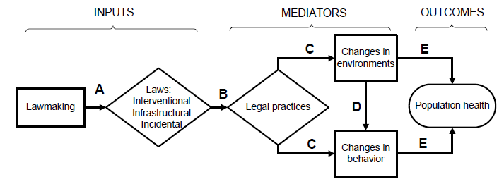
Public Health Law Research
Path A examines policymaking and the factors that influence adopted laws or policies
Path B focuses on the implementation and enforcement of the laws or policies – how the laws or policies are in practice compared to how they are written
Notes:
The Public Health Law Research framework suggests you can objectively measure how a law can impact health and through which mechanisms laws impact health.
Simply, PHLR is “the scientific study of the relation of law and legal practices to population health”. PHLR focuses on laws intended to affect population health and those that have unintended health effects. This branch of public health evaluates the effectiveness of public health interventions and the effectiveness of law as the tool used to facilitate the interventions.
In this framework, laws and policies are the independent, explanatory variables. Some of you may know them as “exposures”. Health outcomes of interest, such as morbidity and mortality are the dependent or response variables or as specific person on this call may know it as the “outcome”.
The mediators along the causal pathway include the legal practices, implementation, and the changes in environment and behavior of who and what the policies impact.
To note, each pathway in this model can be studied independently.
Path A in the figure on your screen examines policymaking and the factors that influence the final adopted laws or policies.
Path B focuses on the implementation and enforcement of the laws – how the laws are in practice compared to how they are written.

Slide 13
Public Health Law Research
Notes:
This dissertation will be looking at paths C, D, and E.

Slide 14
Public Health Law Research
Path C looks at how the laws and policies in practice impact changes in environments and individual behaviors
Path D looks at how laws impact the environments and institutions and how those, in turn, impact individual behaviors
Notes:
Path C looks at how the laws and policies in practice impact changes in environments and individual behaviors.
Path D specifically looks at how laws impact the environments and institutions and how those, in turn, impact individual behaviors
The final step, part E, looks at how health outcomes are impacted by the changes in environments and behavior.

Slide 15
Purpose and Objective

Slide 16
Purpose and Objective
Purpose: to build the evidence base for policy interventions related to COVID-19 and infectious disease in US prisons
Objective: to assess the impact of policies and procedures on COVID-19 outcomes including testing, positive cases, and deaths in prisons across the US.
Leslie Rae, “Frangipani Dreams”. 2017. The Prison Arts Coalition. Acrylic.
Notes:
Purpose is to build the evidence base for policy interventions related to COVID-19 and infectious disease in US prisons
Objective is to assess the impact of policies and procedures on COVID-19 outcomes including testing, positive cases, and deaths in prisons across the US.

Slide 17
Proposed Research Aims

Slide 18
Research Aim 1
Aim 1: Describe the health care access policies and policy implementation changes during the COVID-19 pandemic in prisons in all 50 US states, Washington D.C., the Federal Bureau of Prisons, and Immigration and Customs Enforcement run institutions.
Aim 1.1: Estimate the association between changes in health care access policies and COVID-19 testing rate and case rate.

Slide 19
Research Aim 2
Aim 2: Describe the COVID-19 mitigation strategy policies and policy implementation changes during the COVID-19 pandemic in prisons in all 50 US states, Washington D.C., the Federal Bureau of Prisons, and Immigration and Customs Enforcement run institutions.
Aim 2.1: Estimate the association between changes in COVID-19 mitigation strategy policies to COVID-19 case rate and percent positivity among individuals who are incarcerated and prison staff.

Slide 20
Methods
Notes:
Please note that the following methods will be used for both aims 1 and 2, using respective exposure and outcome variables. To guide us through the methods, I will be using an example to provide context.

Slide 21
Data Source – The COVID Prison Project
Longitudinal study that tracks data and policy to monitor COVID-19 in US prisons
Jurisdictions
All 50 states
Washington DC
Federal Bureau of Prisons
Immigration and Customs Enforcement (ICE)
March 2020 – December 2021
Tameca Cole, “Locked in a Dark Calm”. 2016. Collage and Graphite on Paper
Notes:
Data from the COVID Prison Project between March 2020 and December 2021 will be utilized to meet the proposed aims. The COVID Prison Project is a longitudinal study that tracks data and policy across the country to monitor COVID-19 tests administered and positive cases and deaths among individuals incarcerated and staff in US prisons. Currently, the COVID Prison Project is reporting data from 53 prison systems from all 50 US states, Washington DC, the Federal Bureau of Prisons, and Immigration and Customs Enforcement (ICE).

Slide 22
Primary Variables
Variable Name
Inmates Tested for COVID-19
Inmates Positive for COVID-19
Inmate Deaths due to COVID-19
Staff Positives for COVID-19
Staff Deaths due to COVID-19
Notes:
The five primary variables available through the COVID Prison Project include: incarcerated individuals tested for, positive for, and deaths due to COVID-19 and staff positive for and deaths due to COVID-19. Data were collected from Department of Corrections websites and supplemented with data and information from the media and other press releases. Please note that there are additional variables for some states and each variable is unique to each jurisdiction.

Slide 23
Policies and Procedures
Policies and Procedures | Example | Mitigation or Healthcare
Staff Testing | State reports that testing is available on-site to staff as needed | Mitigation
Staff Masking | Staff required to wear PPE/Masks while onsite | Mitigation
Inmate Screening | New screening practices for those coming into the facility through intake or transfer | Mitigation
Inmate Masking | Facility mandates that everyone who is incarcerated are required to wear a mask | Mitigation
Inmate Social Distancing | Everyone who is incarcerated is sleeping socially distanced at 6 feet apart | Mitigation
Inmate Releases | Facility is releasing individuals early | Mitigation
Facility Healthcare | Facility suspends or reduces copays fully for all or COVID related medical expenses | Healthcare
Community Healthcare | Facility has stopped transporting to routine medical appointments outside of prison | Healthcare
Notes:
The COVID Prison Project’s policy arm tracks and stores policies and data that are related to COVID-19 in prisons for both individuals who are incarcerated and staff. All data were collected from publicly available sources on statewide prison policy including Department of Corrections websites, facebook pages, twitter pages, and news releases for all 50 states, Washington DC, the Federal Bureau of Prisons, and ICE. This table shows examples of policies and procedures from the COVID Prison Project’s policy data.

Slide 24
Policies and Procedures
Policies and Procedures | Example | Mitigation or Healthcare
Staff Testing | State reports that testing is available on-site to staff as needed | Mitigation
Staff Masking | Staff required to wear PPE/Masks while onsite | Mitigation
Inmate Screening | New screening practices for those coming into the facility through intake or transfer | Mitigation
Inmate Masking | Facility mandates that everyone who is incarcerated are required to wear a mask | Mitigation
Inmate Social Distancing | Everyone who is incarcerated is sleeping socially distanced at 6 feet apart | Mitigation
Inmate Releases | Facility is releasing individuals early | Mitigation
Facility Healthcare | Facility suspends or reduces copays fully for all or COVID related medical expenses | Healthcare
Community Healthcare | Facility has stopped transporting to routine medical appointments outside of prison | Healthcare
Notes:
An example of a mitigation strategy policy and procedure is Staff required to wear PPE/Masks while onsite

Slide 25
Policies and Procedures
Policies and Procedures | Example | Mitigation or Healthcare
Staff Testing | State reports that testing is available on-site to staff as needed | Mitigation
Staff Masking | Staff required to wear PPE/Masks while onsite | Mitigation
Inmate Screening | New screening practices for those coming into the facility through intake or transfer | Mitigation
Inmate Masking | Facility mandates that everyone who is incarcerated are required to wear a mask | Mitigation
Inmate Social Distancing | Everyone who is incarcerated is sleeping socially distanced at 6 feet apart | Mitigation
Inmate Releases | Facility is releasing individuals early | Mitigation
Facility Healthcare | Facility suspends or reduces copays fully for all or COVID related medical expenses | Healthcare
Community Healthcare | Facility has stopped transporting to routine medical appointments outside of prison | Healthcare
Notes:
An example of a healthcare policy is suspending or reducing copays for all or COIVD related medical expenses.

Slide 26
Policy Evaluation
Policy Evaluation
It may inform and improve policy development, adoption, implementation, and effectiveness, and builds the evidence base for policy intervention
Policy Impact Evaluation
Did the policy produce the intended outcomes and impact?
Examine the content and impact of a policy
Determine and understand the merit, worth, and utility of a policy
Notes:
For Aims 1 and 2 we will use policy evaluation to code and analyze the policies and procedures that I just described then compare that data to our health outcomes variables.
In general, policy evaluation applies evaluation principles and methods to examine the content, implementation, or impact of a policy. We can develop an understanding of the merit, worth, and utility of a policy.
We can conduct policy evaluations at every step of the policy’s life.
We can evaluate policy content during the development stage to understand the content and context of the policies.
We can evaluate policy implementation which can provide important information about the barriers to and facilitators of implementation.
Or we can evaluate the impact of the policy – which I will be doing for this dissertation.
The purpose of a policy impact evaluation is to see if the policy produced the intended outcomes and impact. Or simply, are the policies doing what they’re supposed to?

Slide 27
Coding Policies and Procedures
Defining the scope
Collecting the law and creating the legal text
Coding the law
Publication and dissemination
Tracking and updating the law
Conducting background research
Developing coding questions
Legal Epidemiology
& Policy Surveillance
Quality control
Notes:
In this policy impact evaluation, I will be utilizing legal epidemiology methods. Although policies and procedures have been collected through the covid prison project, I will also collect the policies and procedures systematically with very specific steps, develop coding questions from legal constructs and key elements of the policies, and code the policies and procedures using the developed questions. I will let you know, this is a watered down explanation of legal epidemiology. If you’re interested in this methodology, please let me know or visit lawatlas.org

Slide 28
Coding Policies and Procedures
Example: facility suspends copays fully for all medical care
Jurisdiction | Policy Present?
AK | 1
AL | 0
AR | 1
AZ | 0
Notes:
I’m going to start with an example that I will use throughout the methods section.
My policy example is “Facility suspends copays fully for all medical care”
This is a simple example – it gets more complex with even this specific policy (remember, they can suspend or reduce the copayment to see a health care provider for all medical or COIVD related medical expenses)
For our example of “facility suspends copays fully for all medical care”, all 53 jurisdictions would be coded in the binary – 0 for the policy not being present and 1 for the policy being present.

Slide 29
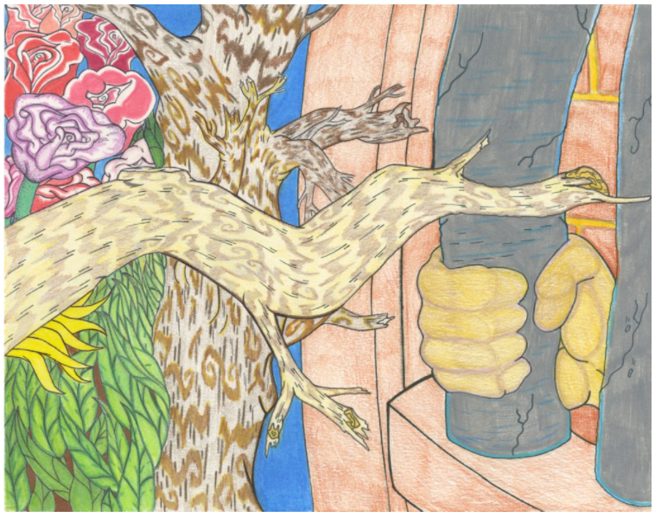
Causal Inference
I will evaluate associations between previously explained policy data (think 0s and 1s) and COVID-19 outcomes
Individuals Incarcerated Tested for COVID-19
Individuals Incarcerated Positive for COVID-19
Individuals Incarcerated Deaths due to COVID-19
Prison Staff Positives for COVID-19
Prison Staff Deaths due to COVID-19
Lamont Thergood, “The Day”. 2014. Collection of Jeffery Greene.
Notes:
The next step in our methods leads us to look for a causal inference or association between the previously explained policy data (think 0s and 1s) and COVID-19 outcomes including testing, case, and death rates.

Slide 30
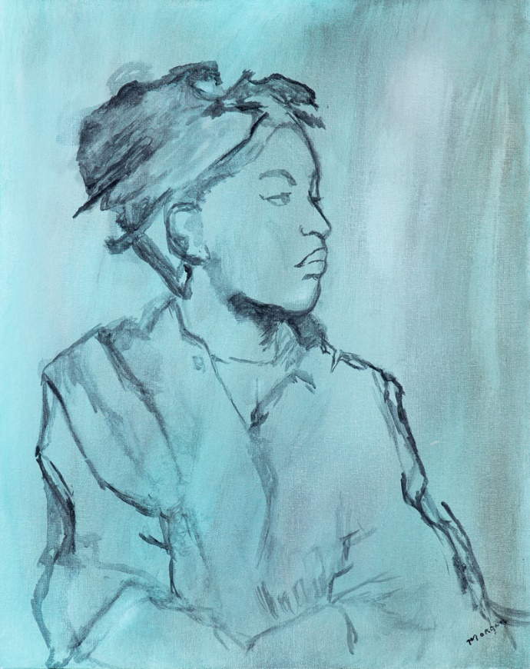
Quasi-Experimental Study
Causal inference is a key challenge in public health policy research
Near impossible to randomize jurisdictions to an intervention or control group
Utilizes a comparison group (or counterfactual)
The counterfactual needs to be as similar as possible to the treatment group
Gerald Morgan, “Sister”. 2017. San Quentin State Prison, CA. Acrylic.
Notes:
“Causal inference is a key challenge in public health policy research intended to asses past policies and help decide future priorities.”
To combat this challenge, I will be using a quasi-experimental study design.
In quasi-experimental research designs, the policy acts as the intervention and the “treatment” are evaluated based upon how well or poorly they achieve their objectives measured by a pre-specified set of indicators.
This is quasi-experimental because participants or even jurisdictions, are not randomized to an intervention or control/comparison group.
Quasi-experimental study designs utilize a comparison group (counterfactual) that is as similar as possible to the treatment group in terms of pre-intervention characteristics.
With a quasi-experimental study design, it is possible to estimate the impact of a law or policy on an outcome.

Slide 31
Interrupted Time Series (With Comparison Jurisdiction)
Matched on COVID-19 testing rate
Implementation of Policy
AZ
NM
Notes:
Using a counterfactual, we can compare the outcomes of interest of those having benefitted from a policy with those of a group who are similar.
Quasi-experimental interrupted time series (with comparison jurisdictions) uses a matched comparison jurisdiction, a jurisdiction that is matched on some sort of variable such as prison population size or characteristics and which did not implement the policy.
Interrupted time series allows health systems researchers to estimate whether and how much an intervention changed an outcome of interest, given the level and trend of the outcome before the intervention; whether effects occurred immediately after the intervention or with delay; whether effects were transient or long term; and whether other factors than the intervention could explain observed changes.
Using our example (with a completely made up scenario), we see that we are comparing AZ and NM. AZ and NM, in this example, are matched on rates of COVID-19 testing. Each observation is the point in time where the outcome – or in this case – testing rate– is recorded. The X represents our implementation of the policy in Arizona. We can see if the implementation of the policy had an impact on rate of testing in AZ using time and compared to NM, the comparison jurisdiction.
However, we will need to control for confounders.

Slide 32
Expected Outcomes and Potential Implications

Slide 33
Expected Outcomes and Potential Implications
A policy evaluation can potentially show which laws, policies, or procedures facilitate, challenge, or harm health
This study could potentially show the impact of health care and mitigation strategy policies and procedures on COVID-19 health outcomes of individuals incarcerated in prisons across the US
Long-term goal
To help guide policy creation and implementation in correctional facilities to prevent, control, and the spread of infectious disease, whether that be during an epidemic, pandemic, or an outbreak in a single facility
Bobby Evans, “Eagles’ Nest”. 2015. San Quentin State Prison, CA. Origami.
Notes:
The impact that COVID-19 has had on incarcerated populations is great. Even with law and policy changes, we are still unsure how they impact health outcomes of individuals who are incarcerated. This study will allow us to see potential causal scientific knowledge regarding the impact of health care and mitigation strategy policies and procedures on COVID-19 health outcomes of individuals incarcerated in prisons across the US. Results may provide evidence to direct policy changes in correctional facilities and laws at the state and federal level.
The long term goal of this dissertation is To help guide policy creation and implementation in correctional facilities to prevent and control the spread of infectious disease, whether that be during an epidemic, pandemic, or an outbreak in a single facility

Slide 34
Questions?

Slide 35
Three Papers
COVID-19 Prison Policy Landscape: A Longitudinal Landscape of Policies and Procedures Related to Healthcare and Mitigation Strategies of COVID-19 in US Prisons
This paper will provide the findings of both Aim 1 and Aim 2
How Health Care Policies and Practices in US Prisons Impact Testing and Case Rates
This paper will provide the findings of Aim 1.1
How Mitigation strategy Policies and Practices in US Prisons Impact Testing and Case Rates
This paper will provide the findings of Aim 2.1

