Slide 1
Developing a Quality Assurance System & Examining the Validity and Reliability of Performance Assessments (Part 1 of 3)
Cynthia Conn, PhD
Assistant Vice Provost, Professional Education Programs
Kathy Bohan, EdD
Associate Dean, College of Education
Sue Pieper, PhD
Assessment Coordinator, Office of Curriculum, Learning Design, & Academic Assessment

Slide 2
Introduction
Notes:
Context: NAU Professional Education Programs (PEP) statistics
23 Initial Teacher Preparation Programs:
Enrollment: 2,385 (average of last 3 years)
Graduates: 607 (average of last 3 years)
18 Advanced Programs:
Enrollment: 1,059 (average of last 3 years)
Graduates: 456 (average of last 3 years)
NCATE Accredited in 2011
CAEP Self-Study submitted July 2016
CAEP Site Visit occurred in March 2017
Anticipate receiving accreditation decision in October 2017
Main Campus in Northern Arizona (Flagstaff)
17 community campus sites on average 2 to 5 hours in multiple directions from main campus

Slide 3
What is Your Context?
Size of EPP, including enrollment and number of programs
EPP’s timeline for accreditation, if being pursued
Notes:
We would like a sense of the size of your programs and allow you to meet others with a potentially similar context.
Please form a line ---- starting on the left if…
you consider your institution to be small in terms of number of initial and advanced programs (<10) and enrollment of programs (<1,000)
Middle if…
you consider your institution to be medium sized in terms of initial and/or advanced programs (10-25) and enrollment of programs (1,000 to 2,000)
Large if…
you consider your institution to be large in terms of initial and/or advanced programs (25+) and enrollment of programs (2,000+)?
We would like a sense of the timeline for accreditation or re-accreditation.
Please find a place in line --- starting on the left if…
your institution completes program review through a state process
your institution is exploring CAEP accreditation or is in the candidacy process
your institution has recently been re-accredited through NCATE or TEAC and is now transitioning to CAEP
your institution is in the process of writing your CAEP Self-Study in the next 1 to 3 years
your institution has submitted the CAEP Self-Study report and will be having this year or has recently had a Site Visit
your institution has be accredited by CAEP

Slide 4
Workshop Objectives
Objectives
Parts 1 & 2: Discuss model and strategies for developing a comprehensive Quality Assurance System (CAEP Standard 5.1)
Part 3: Discuss the importance of examining validity and reliability of the use and interpretation of locally developed performance assessments (CAEP Standard 5.2)
Validity Inquiry Process Model
Strategies for calibrating performance assessments
Notes:
Discuss overview of the three parts of the workshop

Slide 5
What is a Quality Assurance System?
Ideas:
Notes:
We are going to start by gathering your ideas on “What is a Quality Assurance System?”
Process for determining how to collect meaningful assessment data; how candidates help students learn
Consistent collection of data
Meaningful data collection used by faculty
Program improvement
Self-reflection to improve program
Checks and balances – if not useful, don’t collect data or assess
Variety of data – qualitative and quantitative, compare results across instruments

Slide 6
Quality Assurance System: Definitions
What is a Quality Assurance System?
Quality Assurance System: Mechanisms (i.e., structures, policies, procedures, and resources) that an educator preparation provider (EPP) has established to promote, monitor, evaluate, and enhance operational effectiveness and the quality of the educator preparation provider’s candidates, educators, curriculum, and other program requirements. (CAEP Accreditation Handbook, p. 186)
Quality Assurance System: A system that … [relies] on a variety of measures, ..., [seeks] the views of all relevant stakeholders, [shares] evidence widely with both internal and external audiences, and [uses] results to improve policies and practices. (CAEP Glossary, http://caepnet.org/glossary)

Slide 7
Quality Assurance System: Definitions
What is a Quality Assurance System?
CAEP STANDARD 5.1 The provider’s quality assurance system is comprised of multiple measures that can monitor candidate progress, completer achievements, and provider operational effectiveness. Evidence demonstrates that the provider satisfies all CAEP standards.
CAEP Standard 5.3 REQUIRED COMPONENT The provider regularly and systematically assesses performance against its goals and relevant standards, tracks results over time, tests innovations and the effects of selection criteria on subsequent progress and completion, and uses results to improve program elements and processes.
Notes:
•What is a Quality Assurance System?
– Quality Assurance System: Mechanisms (i.e., structures, policies, procedures, and resources) that an educator preparation provider (EPP) has established to promote, monitor, evaluate, and enhance operational effectiveness and the quality of the educator preparation provider’s candidates, educators, curriculum, and other program requirements. (CAEP Accreditation Handbook, p. 186)
– Quality Assurance System: A system that … [relies] on a variety of measures, ..., [seeks] the views of all relevant stakeholders, [shares] evidence widely with both internal and external audiences, and [uses] results to improve policies and practices. (CAEP Glossary, http://caepnet.org/glossary)

Slide 8
What is the Purpose of a Quality Assurance System?
Ideas:
Notes:
AIM --- Why are we doing this work? How will we utilize this work?
–Meaningful system accessible by faculty for reporting and continuous improvement of programs, but also to be utilized for retention, recruitment, tracking matriculation of candidates, research, grants, action plans related to curricular changes

Slide 9
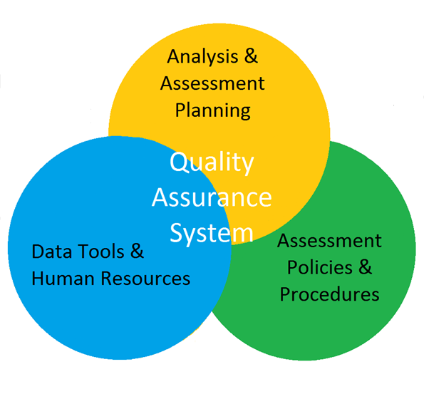
Quality Assurance System: Components/Structure
NAU QAS Resources: https://nau.edu/Provost/PEP/Quality-Assurance-System/
Notes:
– Quality Assurance System: Mechanisms (i.e., structures, policies, procedures, and resources) that an educator preparation provider (EPP) has established to promote, monitor, evaluate, and enhance operational effectiveness and the quality of the educator preparation provider’s candidates, educators, curriculum, and other program requirements. (CAEP Accreditation Handbook, p. 186)

Slide 10
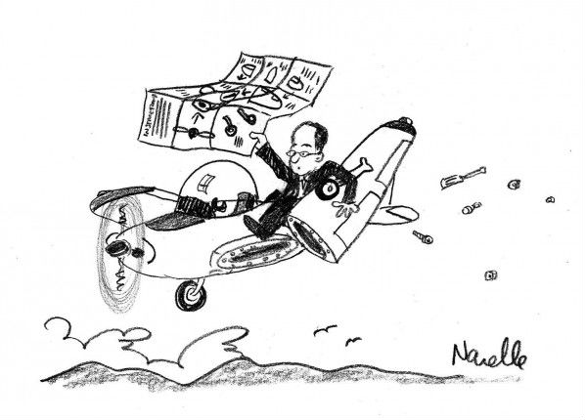
Developing a Quality Assurance System
The wonders of inflight construction…
[Credit: Eugene Kim & Brian Narelle, http://eekim.com/eekim/]
Notes:
Prioritizing work...
Based on the due date of your CAEP Self-Study Report, does your institution have sources of evidence (or a plan, if allowed) for all standards and components, especially required ones? Will your institution have enough data (3 cycles)?
During the high level needs analysis, what do you identify as the most significant gap(s)?
Are the data being collected valid and reliable?
We will be recommending a sequential approach to this work, but recognized that based on where you are in the state program review or CAEP accreditation process or already recognized priorities at your campus, you might need to work on components simultaneously or prioritize work for one component over the approach we are recommending. Overall, the strategies and approaches we are recommending should be adapted to your context.

Slide 11
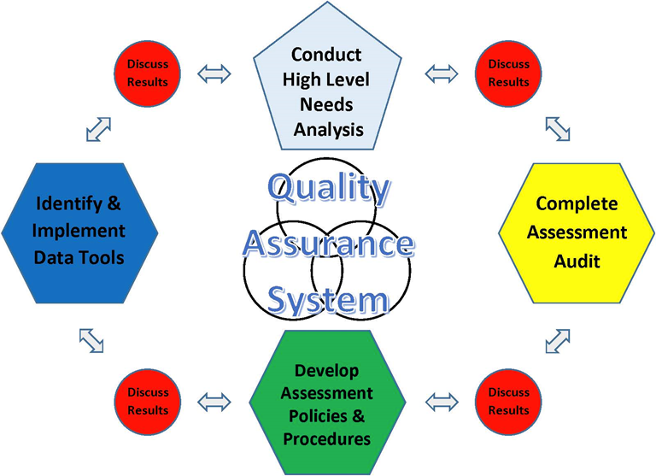
Quality Assurance System: Strategies

Slide 12
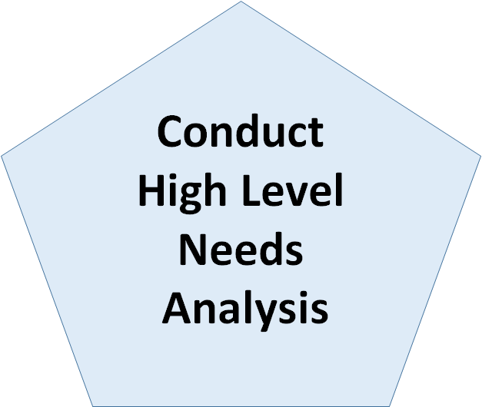
Strategy: High Level Needs Analysis
Purpose: Document strengths and issues related to your current quality assurance system that will assist with prioritizing work
Examples:
At NAU, this first strategy was conducted by Assistant Vice Provost of NAU Professional Education Programs.
Work provided necessary information for prioritizing work and developing a vision for the Quality Assurance System.
NAU was collecting data well but needed to improve the systematic reporting and access to data
We also recognized we needed to improve the quality of assessment instruments

Slide 13
Activity: High Level Needs Analysis
Ideas:
How have you or could you gather this high level needs analysis data on your campus?
Are there other initial approaches your campus took to develop a quality assurance system?
Who could implement this strategy on your campus?
Notes:
Activity (partner-share/large-group share):
How have you or could you gather this high level needs analysis data on your campus?
Who did/could you talk to on your campus?
What documentation did/could you review?
Are there other initial approaches your campus took to develop a quality assurance system?
Who could implement this strategy on your campus?
Reference - QAS: Guiding Questions for Strategies handout
With one or two partners sitting next to you, please take a 5 minutes to discuss these three questions. We will ask for highlights from your discussions to be shared with the whole group.
How have you or could you gather this high level needs analysis data on your campus?
Large meeting with stakeholders, find a leader/point person who could take on work; Early Instrument Review (CAEP) could help target efforts; local program assessments alignment to CAEP/SPA/discipline-specific Standards; CAEP Site Reviewer Rubric (in CAEP March 2016 Accreditation Handbook) as a resource for strengths and gaps in assessment system
Are there other initial approaches your campus took to develop a quality assurance system?
Integrate institutional values into CAEP Standards to encourage accreditation work; unified data structure with support from faculty and graduate assistants to aggregate and report data
Who could implement this strategy on your campus?
Experts or leaders with backgrounds in research and methodology; appraisal and assessment; statistics; people with strong interpersonal communication skills (to liaise with faculty); institutional or EPP leader to communicate consistently; balance with people who are working students

Slide 14
Developing A Quality Assurance System: Who is on Your Team?
Notes:
NAU Professional Education Programs utilized CAEP Standards to…
Strengthen connections and leverage the expertise of campus departments including Information Technology Services, Enterprise Reporting, E-Learning Center, Vice Provost for Academic Affairs Business & Process Analysis Team, Director of Special Projects and Administration and Compliance Director, Office of Institutional Planning & Analysis, Enrollment Management and Student Affairs, Extended Campuses, Graduate College, Campus Academic Advising, Student Academic Success & Retention, College of Education Research Center, College of Education Test Preparation Center, Office of Curriculum, Learning Design, & Academic Assessment, University Registrar, Financial Aid, Government Affairs, Development
Strengthen connections with stakeholders through development of intentional partnerships to increase opportunities for candidates to work with diverse students and work in high need schools and districts

Slide 15
Developing A Quality Assurance System
Questions/Issues/Ideas
Notes:
Brainstorm --- This is a three part workshop and we would like to address your questions to the greatest extent possible. Given the overview provided regarding what is a quality assurance system and the initial discussion regarding the model we will be discussing, we would like to take the last few minutes of this first session to find out what questions or issues you are trying to address at your campus in relation to developing a quality assurance system.
You can share your questions/issues/ideas with us by raising your hand and we will be taking notes. You can also write down your ideas on the sticky notes provided on the tables and post them on the large Questions/Issues/Ideas chart at the back of the room as you exit.

Slide 16
Developing a Quality Assurance System & Examining the Validity and Reliability of Performance Assessments (Part 2 of 3)
Kathy Bohan, EdD
Associate Dean, College of Education
Cynthia Conn, PhD
Assistant Vice Provost, Professional Education Programs
Sue Pieper, PhD
Assessment Coordinator, Office of Curriculum, Learning Design, & Academic Assessment

Slide 17
Big Ideas from Part I
A Quality Assurance System is like an umbrella. It’s overarching components—analysis & assessment planning, assessment policies & procedures, and data tools and human resources—ensure that a provider is meeting all CAEP standards and continuously improving.

Slide 18
Workshop Part 2 objectives
Discuss three additional strategies for developing a comprehensive Quality Assurance System (CAEP Standard 5.1)
Completing an assessment audit
Identifying and implementing data tools
Developing policies and procedures
Notes:
Part 2 Objectives

Slide 19
Quality Assurance System Strategies
Notes:
Review of QAS System-Transition to Assessment Audit

Slide 20
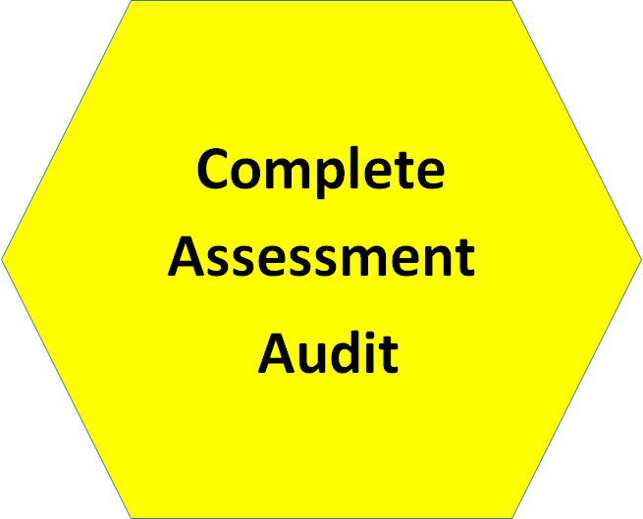
Strategy: Assessment Audit
Purpose:
Develop a detailed listing of current assessment instruments;
Document alignment to CAEP Standards, quality of the instruments, and implementation schedule; and
Set goals and timelines based on audit
Assessment Audit Template
Notes:
The next strategy we would like to discuss in our Quality Assurance System is to conduct a detailed audit of the assessments as they align to the CAEP standards, consider the purpose, value, and quality of the instruments, and consider the strengths and gaps. Then prioritize efforts and set timelines for documenting validity arguments for the instruments, verifying reliability, and determining how to use the data to inform continuous improvement.
A common misconception is that validity is about the tests or measures. If the measure is determined to be “valid” then any data obtained from the measure must be valid. However, evidence of validity must relate to the purpose and use of data, as well as confidence in the data. CAEP Standard 5.1 asks the provider to maintain a quality assurance system comprised of valid data from multiple measures” and 5.2 the QAS “relies on relevant, verifiable, representative, cumulative, and actionable measures, and produces empirical evidence that interpretations of data are valid and consistent.”
The purpose of the Assessment Audit is to provide evidence demonstrating the provider has measures that “monitor candidate progress, completer achievements, and operational effectiveness aligned with all CAEP standards.”
Use audit to first think about who your audience (end-user) is, and then what evidence do you need to communicate results with the various stakeholders.
For example: EPP leadership team, college leadership, faculty (development, implementation, use), staff, University Supervisors (training and feedback), P-12 administrators, assessment experts, state board of education directors

Slide 21
Strategy: Assessment Audit
Conduct detailed audit of current assessments aligned to CAEP Standards
Assessment Audit Template
A. Standard Component | B. Evidence/ Assessment Instrument | C. Schedule | D. Use of Data | E. Validity/ Reliability Evidence | F. Applicable CAEP Assessment Review Criteria
CAEP # | Name or assessment | -Implementation -Reporting -Review -Administrations | Purpose | When used? Who uses? How train? (inter-rater agreement, calibration) What does assessment measure? | CAEP Evidence Framework for EPP-Created Assessments (CAEPnet.org Accreditation Resources, Assessment)
Notes:
If you are the initial stages of writing the self-study or planning to submit to CAEP, this would be a first step. If you are entering the self-study process at a different stage (new staff, self-study due soon), conduct the audit to evaluate and set priorities. Outlines your QAS. This strategy goes a step further than the higher level analysis with delineating details for each assessment related to schedule, use, validity/reliability, and evidence of quality.
Show example audit for CAEP Standard 1.1: Handout
Template: fill out template to audit your current evidence for each of the CAEP Standards (Column A). If you have gaps, this will identify where those gaps are.
What assessments or evidence will you be using (column B)?
How, who, and when will you collect data for various purposes (implementation, reporting, review schedule, administrations)-Column C
How do you plan to use the data (Purpose, Column D)
What is your evidence of validity and reliability? (Column E)
Does assessment meet Sufficient Level or Above? (Column F; see CAEP Website, Accreditation Resources, Assessments)

Slide 22
Assessment Audit Example
CAEP Standard #1.1:
Candidate Knowledge, Skills, & Professional Dispositions
QAS Resource:
https://nau.edu/Provost/PEP/Quality-Assurance-System/
Notes:
Show sample Assessment Audit with CAEP standard 1.1: on screen and refer to Handout
Standard: Understanding of 10 InTASC standards. assessment instrument is Licensure Exams
Implementation: data are managed externally since published instrument
Data extracted by our NAU PEP staff each Sept 1 to add to report templates for SPA or EPP level analysis
Reviewed formally even years for programs/ odd years at EPP level
Administrations: # administrations in reporting cycle
Use of Data: subscale analysis informs for TPC candidate support
Validity/Reliability: proprietary evidence from manual and annual training w/ certificate of competence required for each university supervisor
CAEP Review Criteria: disaggregated by licensure area, at least 2 cycles of data reported; provides evidence or each candidate’s knowledge,
Other examples that came from our audit:
Teacher candidate evaluation OR student teaching evaluation:
We were using several different, locally developed teacher candidate observation/evaluation instrument. A goal was to identify one instrument better aligned to how we wanted to use the data, to look at how well our candidates are prepared to enter the teaching profession, but also to look at disaggregated data to drill down into specific knowledge, skills and dispositions strengths and areas needing improvement.
For this, a representative committee of faculty, university supervisors, and staff reviewed several options and selected a proprietary (nationally standardized) measure to adapt and use across our programs.
Another example is NAU’s EPP-created assessment, the Candidate Work Sample (aligns to CAEP 1.2 measuring P-12 students’ progress; implemented in student teaching, reported each semester; assessment development, review, revisions, and validity/reliability has evolved in the past 4 years; the purpose of the assessment is to provide evidence of impact on student learning (reported as Assessment 5 for SPAs, and 1.2 for CAEP Unit level; the Evidence Framework along with the NAU developed VIP framework (Part 3 of this presentation) will explain this in greater detail)—discussed in greater detail in Part 3
The assessment audit and periodic review (addressed later in the policies and procedures section-Part 3) has led to continuous improvements to improve validity, reliability, confidence in results, and use of results to inform the programs.

Slide 23
Assessment Audit Activity
Small group or pairs:
Identify an assessment you are using at your institution,
Select the aligned CAEP standard,
Using the Assessment Audit Template, fill in the columns to evaluate the assessment schedule, use, validity, reliability, and quality of the assessment
Notes:
Approximately 10-15 minutes; regroup into teams or with partner(s) who may be addressing similar needs with program review

Slide 24
Quality Assurance System Strategies
Notes:
Transition to Data Tools

Slide 25
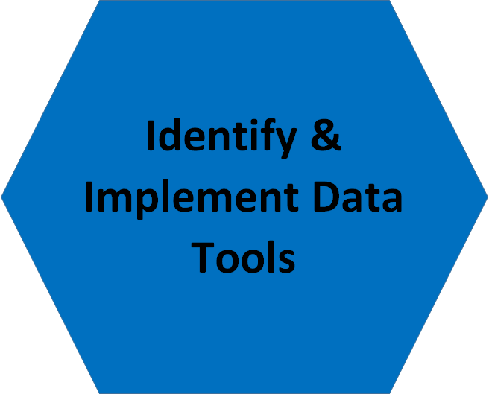
Strategy: Identify & Implement Data Tools and Human Resources
Purpose: To identify the data tool functions that need to be present to have systematic collection, reporting, and use of data for self-study, and the human resources to support the QAS
Data Tools:
Types of Data Collection (e.g., rubric or survey tools)
Collection, analysis, and reporting tools (data collection tools, data management, data analysis software, collaborative editing tools, institution supported sources, archive systems)
Human Resources:
Personnel (expertise, skills, priorities)
End Users: who reviews, interprets,
uses data?
Notes:
Vision: Reporting and use of data were seen as the most important functions that we needed to address in relation to our quality assurance system; Performance data integrated with demographic data; university-supported tools; led to the use of an online collaborative space for faculty (e.g., SharePoint); lead to readily accessible source of data to contribute to grant writing, media releases, talking points to university leadership and other stakeholders, research agendas
Provide the NAU example:
At NAU, we were seeking a quality assurance system that would include multiple data tools to address the complex and large-scale nature of our data:
For data collection, we integrated a rubric tool with a data management tool so we could analyze data by academic plan, campus location, etc.
For data reporting, we also integrated data collection tools with data reporting and archiving tools
The majority of our data tools do interface with each other to achieve a balance of data functions
Show data tool flowchart

Slide 26
Data Tools and Functions Self-Assessment
Data Tool | Data Tool Function | End User(s) | Sustainable and Efficient?
Name of Tool | What function is aligned with the data tool? (data collection, analysis, storage, collaboration, sharing/reporting) | Who will view and use the data? How will the data be accessed? How will data be stored? | Yes/ No
Sustainable, Efficient, Accessible, Useful
Notes:
Examples of data tool functions we’re currently using:
Electronically collecting rubric and survey data; qualitative data (notes from stakeholder meetings, Partnership meetings, faculty meetings)
Reporting and archiving data (Self-Study, Assessment Office, SPA, Provost/Associate Provost/Deans, ADE, Stakeholder)
Transitioning to university-supported tools (locally maintained to NAU supported systems, software, analyses supports (university and college level)
Connecting to university demographic data (data systems, revisions to add needed fields to extract data)
Enhancing access to data and instruments for a variety of audiences (e.g., faculty, teachers, university leadership, P12 partners, state politicians and agencies, general public)
Using self-study to respond to grants, develop research agendas, and promote programs (media, news/events, flyers, information presentations)
Question: Who do you need on the team to support the use of the data tools and functions? data management support staff, e-learning designers, assessment developers, institutional data analysts, faculty and staff with assessment expertise; data analysts, research/statistics experts, graduate assistants with backgrounds in assessment and statistical analyses

Slide 27
Data Tools Activity
Activity: In small group, talk about some of the data tools and resources you are using in your EPP, and identify any gaps in relation to data functions in your quality assurance system.
Data collection (surveys, rubrics, interviews)
Data analyses
Interpretation
Storage
Reporting
Access
Collaboration
Human resources
Institutional supports
Notes:
Activity: Consider the various ways you collect, analyze, interpret, report, and share evidence to inform continuous improvement
What is working well for you? Where are there gaps? What are potential solutions?
How might you use the data tools and human resources self-assessment? Who will be involved in the discussion? What changes do you anticipate or hope to achieve?

Slide 28
Quality Assurance System Strategies
Notes:
The next strategy: Develop assessment policies and procedures

Slide 29
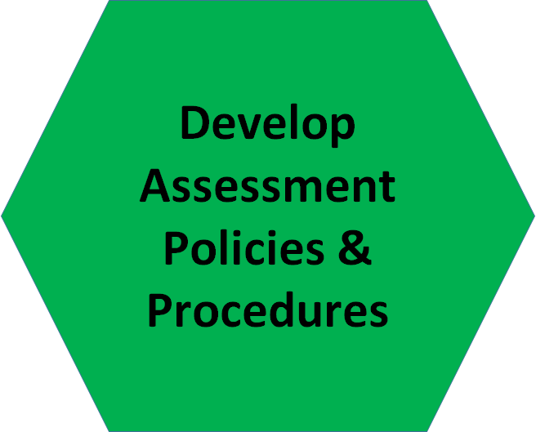
Strategy: Assessment Policies & Procedures
Purpose: To develop a useful, efficient and sustainable Quality Assurance System
Examples:
Align systematic reporting with University and State reporting requirements
Policies & Procedures for Program Level Assessment Reporting (developed in collaboration with NAU’s assessment office)
Biennial Reporting Chart with expectations
Maintain and update Self-Study and SPA report files to eliminate duplicate work
Develop a Master Assessment Plan and Calendar for EPP level assessments
Notes:
Show policies and procedures portal on NAU PEP site and QAS website with Examples from our experience: https://nau.edu/Provost/PEP/Quality-Assurance-System/
Also: Data Tool FLowChart
Discussed, proposed, and drafted policy and procedures for reporting that met university, state, and SPA expectations with minimal duplication (OCLDAA, SPA, ADE)
Developed templates for faculty/staff to use for SPA and Self-Study reporting; duplicate each reporting cycle and archive, store, to maintain a record
Developed template for biennial reporting to institutions assessment office that is efficient and aligned with CAEP and SPA (and State Certification Unit)
Show example files for Master Assessment Plan and Calendar and Biennial Reporting Chart with expectations
guided decision to use a proprietary student teaching evaluation (too many variations across programs, challenges with establishing validity and reliability on numerous EPP-created tools, challenges with collecting and extracting data,
Efficiencies with sharing data resulted in selecting SharePoint (Other tools not available at the time)
Discussions with upper administration about more sophisticated tools that are university supported for rubric data extraction (BbLearn Rubric with bridge software (Informatica), Collecting and managing other student data (SalesForce), having a survey tool with advanced functions (Qualtrics), Reporting official data (Business Objects and other institutional reporting tools and procedures, sharing through SharePoint and website; formal reporting to CAEP, NAU Assessment office, ADE (Title II)

Slide 30
Examples
Policies & Procedures
https://nau.edu/Provost/PEP/Quality-Assurance-System/
Example Policy link:
https://nau.edu/uploadedFiles/Administrative/Provost/PeuHome/Forms/Example%20Policy%20and%20Procedures%20for%20Systematic%20Review%20of%20Assessment%20Data.pdf
Biennial Reporting Template
Purpose:
Instructions:
Contacts and program details:
Context:
List of Assessments:
Relationship to Standards:
Evidence for meeting standards (each assessment):
Use of Assessment Results:
Action Plan:
Notes:
The Policy and Procedures Strategy focuses on efficient, systematic ways to guide faculty and staff with managing the QAS. The links on this slide will take you to the NAU Professional Education Programs website, Quality Assurance System resources. At our institution, the Office of Curriculum, Learning Design, and Academic Assessment requires all of the university’s programs to submit annual Program Level Assessment Reporting and Review through our college curriculum and assessment committees. Since most or our programs are nationally recognized by a Specialized Professional Association (SPA), we worked with the university office to submit a report that aligns with our CAEP and SPA process, but also meets the requirements for the university. The example policy at this link details that CAEP accredited programs will complete a Biennial Report in the fall of even years, and during the spring of odd years, the C & A committee will review the Use of Assessment Results and Action Plan sections and provide feedback to the program faculty (continuous improvement checks/balances).
The left side of this slide outlines the components to the Biennial Reporting Template. As a reminder, you can find this template on the NAU PEP Quality Assurance System website: https://nau.edu/Provost/PEP/Quality-Assurance-System/

Slide 31
SPA Report Policies and Procedures
Master SPA Section IV Assessment File Template
Master Template includes the required components for program level reports
Template and Archived documents are maintained on a SharePoint site; faculty and staff can access w/ authentication;
Templates are stored on the SharePoint site for easy reference;
For the next reporting cycle, NAU PEP staff update the template with data charts, and any revised assignment directions or rubrics;
faculty can then efficiently update the (a) assessment description, (b) standards alignment, (c) data analysis and (d) interpretation sections;
SPA reports submitted through AIMS.caepnet.org are also archived on the SharePoint drive
Notes:
Another example: Development and use of Master SPA Template with policies and procedures aligned to CAEP

Slide 32
Example: EPP Level Assessment Plan and Master Calendar
CAEP Standard | Evidence & Tools | Type of Data | Admin. Schedule | Report Schedule | Use of Data | Review Usefulness of Tool
1.1 know InTASC Standards | Student Teaching Eval (proprietary) Tools: BbLearn Rubric, Business Objects, SharePoint | InTASC categories | Mid-term & final each term | Fall, even years-program level Fall, odd years.-EPP wide | Program review (SPA A4) EPP Review (CAEP 1.1) Stakeholder meetings | AY 17-18, committee review options to continue or prepare RFP for another tool
http://caepnet.org/standards/introduction
Notes:
The CAEP EPP Master Assessment Plan & Calendar lists the CAEP Standards, and then asks for the various columns to be summarized for each standard. Additional rows should be added for standards that have several types of evidence (assessments, surveys, interviews). The calendar provides a comprehensive view of the EPP assessment plan and implementation timelines. The slide provides an abbreviated snapshot of the actual document. The template can be found on the NAU PEP QAS website. The url takes you to the CAEP Standards on the CAEPnet.org website.
This procedural tool focuses on the timelines, reporting, and intended use of the assessment results. Who uses the data? How often is it disseminated? in what ways? How does this inform continuous improvement?

Slide 33
Policies and Procedures Activity
Discussion
How might you use the Policy and Procedure strategies to develop a useful, efficient and sustainable Quality Assurance System for your EPP?
Master Assessment Plan and Calendar
Policy and Procedures Template
Biennial Report Template
SPA Templates
Notes:
Discussion reflecting on P&P strategies

Slide 34
CAEP Self-Study Report
Iterative process...
Used assessment audit, data tools, & policies/procedures to guide what we needed for evidence;
Formed CAEP Self-Study Writing Committees;
Used evidence file templates available on QAS Resource website;
EPP level faculty meeting held on biennial basis to formally review data;
utilized “speed sharing” and “deep discussion” technique to share, analyze, and interpret data
Re-reviewed assessment instruments (high level needs analysis strategy) to consider options for streamlining data collection;
Submitted Self-Study and held Site Visit;
Now conducting assessment audit with advanced programs to identify existing data and gaps related to CAEP standards approved in June 2016
Notes:
Our experience and application of strategies for preparing our CAEP Self-Study and Site Visit.

Slide 35
Developing a Quality Assurance System & Examining the Validity and Reliability of Performance Assessments (Part 3 of 3)
Sue Pieper, PhD
Assessment Coordinator, Office of Curriculum, Learning Design, & Academic Assessment
Kathy Bohan, EdD
Associate Dean, College of Education
Cynthia Conn, PhD
Assistant Vice Provost, Professional Education Programs

Slide 36
Big Ideas from Parts 1 & 2
A Quality Assurance System is like an umbrella. It’s overarching components—analysis & assessment planning, assessment policies & procedures, and data tools and human resources—ensure that a provider is meeting all CAEP standards and continuously improving.
The first step for implementing a Quality Assurance System is typically conducting a high-level needs analysis, followed by completing an assessment audit, developing assessment policies and procedures, and identifying and implementing data tools. Depending on your institutional context, your first step may vary.

Slide 37
Workshop Objectives
Objectives
Explore a model for examining the validity of the interpretations and use of performance assessment data: the Validity Inquiry Process (VIP) Model
Practice using the VIP Model instruments
Discuss the implementation of the VIP Model at NAU
Discuss strategies for implementing calibration trainings and determining inter-rater agreement
Discuss strategies for encouraging inter-rater agreement at NAU

Slide 38
Exploring the Validity Inquiry Process (VIP) Model

Slide 39
Introduction to Validity Inquiry Process Model and Relation to CAEP
Standard 5:
Provider Quality Assurance and Continuous Improvement
Quality and Strategic Evaluation
5.2 The provider’s quality assurance system relies on relevant, verifiable, representative, cumulative and actionable measures, and produces empirical evidence that interpretations of data are valid and consistent.

Slide 40
Purpose of the Validity Inquiry Process (VIP) Model
Purpose
The purpose of the Validity Inquiry Process (VIP) Model instruments is to assist in examining and gathering evidence to build a validity argument for the interpretation and use of data from locally or faculty developed performance assessment instruments.

Slide 41
The Approach
Theory to Practice
Utilized the existing validity and performance assessment literature to develop practical guidelines and instruments for examining performance assessment in relation to validity criteria (Kane, 2013; Linn, Baker, & Dunbar, 1991; Messick, 1994)
Qualitative and Reflective
Process and instruments guide the review and facilitate discussion regarding performance assessments and rubrics
Efficient
Some steps require documenting foundational information, one provides a survey completed by students, and the other steps involve faculty discussion and review

Slide 42
Validity Inquiry Process (VIP) Model Criteria
Performance Assessment Validity Criteria
Domain coverage
Content quality
Cognitive complexity
Meaningfulness
Generalizability
Consequences
Fairness
Cost and Efficiency
(Linn, Baker, & Dunbar, 1991; Messick, 1994)

Slide 43
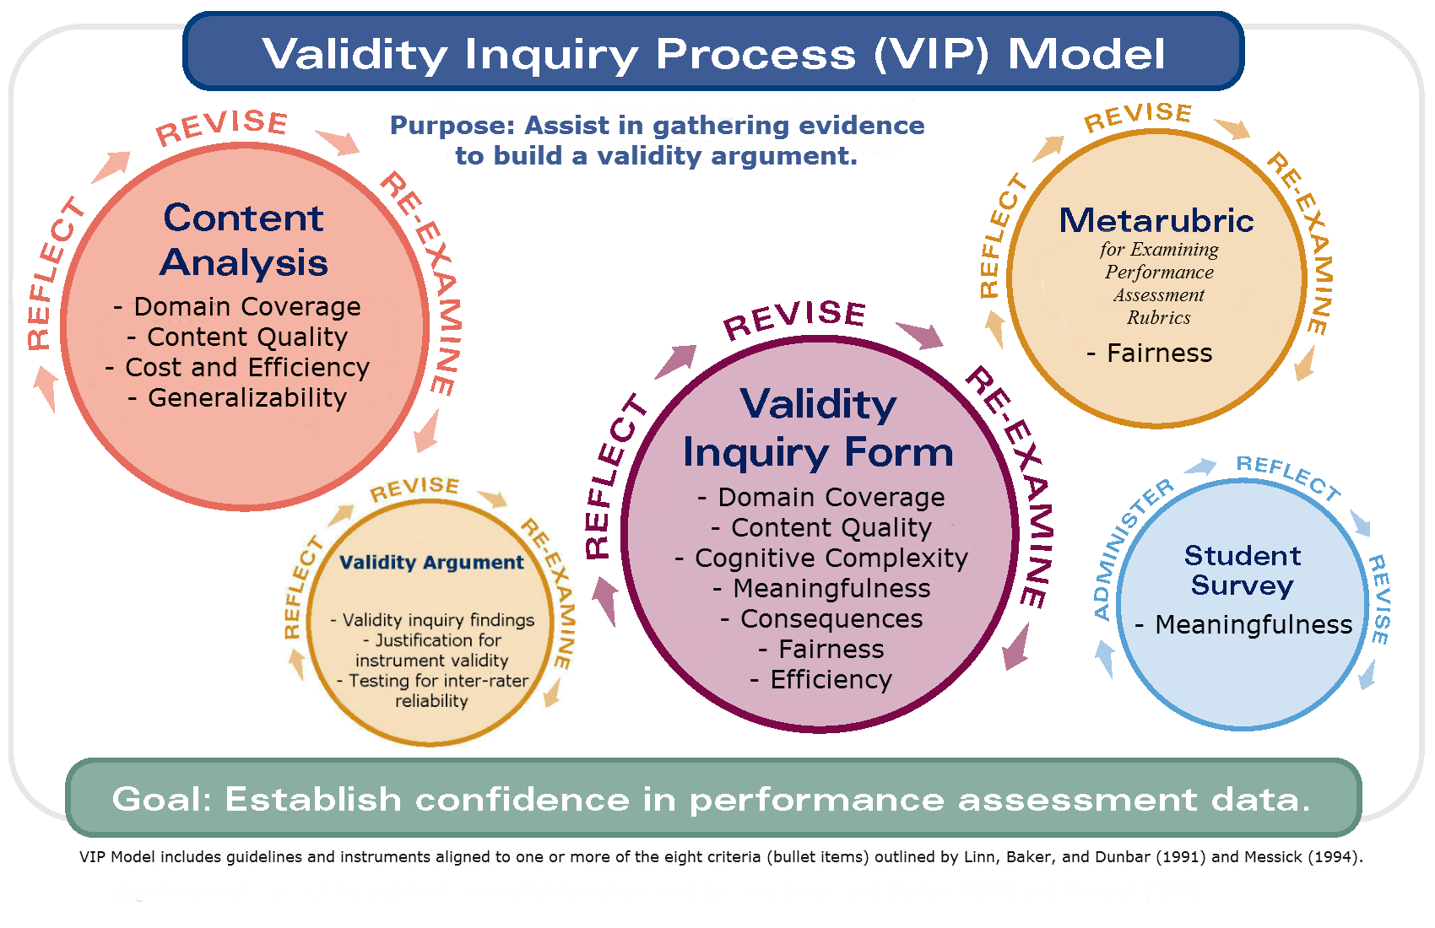
Validity Inquiry Process (VIP) Model

Slide 44
Using the VIP Model Instruments
Using the VIP Model Instruments

Slide 45
Validity Inquiry Process (VIP) Model
Notes:
The purpose of practicing with using the various VIP model instruments is to model the VIP process: “train the trainer.”

Slide 46
Activity #1: Using the Validity Inquiry Form
Discuss in small groups the stated purpose of this performance assessment and if it is an effective purpose statement.
Purpose of Curriculum and Assessment Presentation Signature Assignment
The purpose of this assignment is to demonstrate successful attainment of the course learning outcomes aligned with the National Association for the Education of Young Children (NAEYC) standards.

Slide 47
Activity #1: Question Prompts to Promote Deep Discussion
Why are you asking candidates to prepare and deliver a curriculum and assessment presentation? Why is it important?
How does this assignment apply to candidates’ future professional practice?
How does this assignment fit with the rest of your course?
How does this assignment fit with the rest of your program curriculum?

Slide 48
Activity #2: Using the Validity Inquiry Form
Discuss in small groups question 3 on the Validity Inquiry Form and how you would rate the assignment.
Cognitive Complexity, Q3: Analyze performance assessment using the Rigor/Relevance Framework (see http://www.leadered.com/our-philosophy/rigor-relevance-framework.php) to provide evidence of cognitive complexity:
Identify the quadrant that the assessment falls into and provide a justification for this determination.

Slide 49
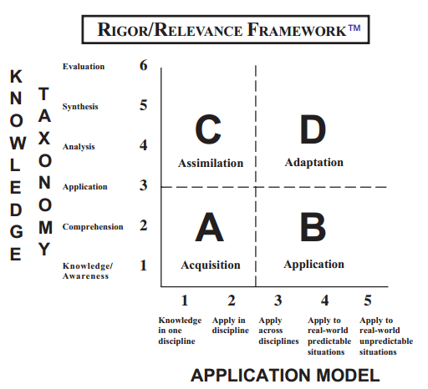
Activity #2: Using the Validity Inquiry Form
Cognitive Complexity
Daggett, W.R. (2014). Rigor/relevance framework®: A guide to focusing resources to increase student performance. International Center for Leadership in Education. Retrieved from http://www.leadered.com/our-philosophy/rigor-relevance-framework.php
Notes:
This is just one possible model of cognition. Other possible models include Bloom et al. (1956), Biggs & Collis (1982), Anderson et al. (2001), and Fink (2003).

Slide 50
Activity #2: Question Prompts to Promote Deep Discussion
Using the Rigor/Relevance Framework®
What quadrant did the assessment fall into and why?
How did your group establish consensus on the quadrant determination?

Slide 51
Validity Inquiry Process (VIP) Model
Notes:
The purpose of practicing with using the various VIP model instruments is to model the VIP process: “train the trainer.”

Slide 52
Activity #3: Using the Metarubric
Discuss in small groups questions 2 and 8 on the Metarubric:
Criteria: Q2: Does each rubric criterion align directly with the assignment instructions? (Pieper, 2012)
Descriptions: Q8: “Are the descriptions clear and different from each other?” (Stevens & Levi, 2005, p. 94)

Slide 53
Validity Inquiry Process (VIP) Model
Notes:
Show example Validity Argument document on screen.
The purpose of practicing with using the various VIP model instruments is to model the VIP process: “train the trainer.”

Slide 54
Using the VIP Model Instruments
Implementing the VIP Model at NAU
Notes:
Note: The following three slides are available for reference and review outside of the workshop.

Slide 55
Implementing Validity Inquiry Process Model
Pre-Meeting Timeline
Identified target programs and faculty developed performance assessments (1 semester in advance)
Identified lead faculty member(s) for each performance assessment (1 month in advance)
Provided brief announcement and description at department faculty meeting (1 month in advance)
Associate Dean scheduled meeting with lead faculty including (at least 2 to 3 weeks in advance):
Introduction letter describing purpose (CAEP Standard 5.2) and what to expect (sample letter available through website)
Attached copy of Validity Inquiry Form and Metarubric
Verified most recent copy of performance assessment to be reviewed
Requested preliminary review of Validity Inquiry Form and Metarubric prior to the meeting

Slide 56
Performance Assessment Review Meeting
Logistics for Meeting
Individual review meetings were scheduled for 2 hours
Skype was utilized for connecting with faculty at statewide campuses
Participants included 2 to 3 lead faculty members, facilitators (Associate Dean & Assessment Coordinator), and a part-time employee or Graduate Assistant to take notes

Slide 57
Feedback on Meeting and Overview of Next Steps
Post-Meeting Follow-up
Notes from meetings were consolidated
Assessment Coordinator developed a one page document outlining:
Who participated
Strengths
Areas for improvement
Next steps (see http:// Strengths and Next Steps Document)
Initial follow-up documentation was utilized to develop Validity Argument (CAEP Evidence Guide, 2015)
“To what extent does the evaluation measure what it claims to measure? (construct validity)”
“Are the right attributes being measured in the right balance? (content validity)”
“Is a measure of subjectively viewed as being important and relevant? (face validity)”
Documentation for CAEP Standard 5

Slide 58
Documentation for CAEP Standard 5
CAEP Standard 5.2 Evidence File
Creation of bundled pdf file with validity inquiry and metarubric forms
Cover sheet to pdf should contain validity argument and information regarding experts involved in review process
Store files in web-based, collaborative program for easy access by leadership, faculty, site visit team members

Slide 59
strategies for implementing calibration trainings and determining inter-rater Agreement
Strategies for
Implementing Calibration Trainings &
Determining Inter-Rater Agreement

Slide 60
Definitions
Definitions
Calibration training is intended to educate raters on how to interpret criteria and descriptions of the evaluation instrument as well as potential sources of error to support consistent, fair and objective scoring.
Inter-Rater Agreement is the degree to which two or more evaluators using the same rating scale give the same rating to an identical observable situation (e.g., a lesson, a video, or a set of documents). (Graham, Milanowski, & Miller, 2012)
Notes:
Calibration training and inter-rater agreement address issues of reliability and enhance confidence in the data collected.
Purpose: Improve and provide evidence of consistency in data collection to enhance confidence in use of results.

Slide 61
Calibration Strategies
Calibration Strategies
Select performance assessment artifacts (remove identifying information) that can serve as a model and that an expert panel agrees on the evaluation scores
Request raters to review and score the example artifacts
Calculate percentages of agreement and utilize results to focus discussion
Discuss:
Criteria with lowest agreement among raters to improve consistency of interpretation including:
Requesting evaluators to cite evidence from artifact that support their rating
Resolve differences
Potential sources of rater error
Request evaluators score another artifact and calculate agreement

Slide 62
Factors that affect Inter-Rater Agreement
Discussion regarding common types of rater errors:
Leniency errors
Generosity errors
Severity errors
Central tendency errors
Halo effect bias
Contamination effect bias
Similar-to-me bias
First-impression bias
Contrast effect bias
Rater drift
(Suskie, 2009)
Notes:
If faculty are scoring many samples of student work, rescore the first few samples after they finish to guard against rater drift.
If faculty are scoring large numbers of papers, periodically schedule a refresher scoring practice session in which they all compare their scores and discuss and resolve their differences. (Suskie, 2009)

Slide 63
Calculating Inter-rater Agreement
Percentage of Absolute Agreement
Calculate number of times raters agree on a rating.
Divide by total number of ratings.
This measure can vary between 0 and 100%.
Values between 75% and 90% demonstrate an acceptable level of agreement.
Example:
Raters scoring 200 student assignments agreed on the ratings of 160 of the assignments. 160 divided by 200 equals 80%. This is an acceptable level of agreement. (Graham, Milanowski, & Miller, 2012)

Slide 64
Inter-Rater Agreement
Summary of Inter-Rater Agreement Data
Summary of University Supervisor Agreements
Number of score pair agreements | 36 | Number of raters | 47
% Score pair agreement | 76.60%
Average % Perfect Agreement | 38.52%
Average % Adjacent Agreement | 46.47%
Overall Average Agreement (Adjacent + Perfect) | 84.99%

Slide 65
Activity #4: Implementing Calibration Strategies
Discuss with a partner a particular inter-rater agreement strategy that you might be able to implement at your own institution.
What would be the benefits of implementing such a strategy?
What challenges do you anticipate?
What do you need to do to get started?

Slide 66
Resources & Contact Information
Website: https://nau.edu/Provost/PEP/Quality-Assurance-System/
Contact Information:
Cynthia Conn, PhD
Assistant Vice Provost, Professional Education Programs
Associate Professor & Associate Dean, College of Education
Cynthia.Conn@nau.edu
Kathy Bohan, EdD
Associate Dean, College of Education
Kathy.Bohan@nau.edu
Sue Pieper, PhD
Assessment Coordinator, Office of Curriculum, Learning Design, & Academic Assessment
Sue.Pieper@nau.edu

Slide 67
Definitions
Performance Assessment
An assessment tool that requires test takers to perform—develop a product or demonstrate a process—so that the observer can assign a score or value to that performance. A science project, an essay, a persuasive speech, a mathematics problem solution, and a woodworking project are examples. (See also authentic assessment.)
Validity
The degree to which the evidence obtained through validation supports the score interpretations and uses to be made of the scores from a certain test administered to a certain person or group on a specific occasion. Sometimes the evidence shows why competing interpretations or uses are inappropriate, or less appropriate, than the proposed ones.
Reliability
Scores that are highly reliable are accurate, reproducible, and consistent from one testing occasion to another. That is, if the testing process were repeated with a group of test takers, essentially the same results would be obtained.
National Council on Measurement in Education. (2014). Glossary of important assessment and measurement terms. Retrieved from: http://ncme.org/resource-center/glossary/)

Slide 68
References
Center for Innovative Teaching & Learning. (2005). Norming sessions ensure consistent paper grading in large course. Retrieved from http://citl.indiana.edu/consultations/teaching_writing/normingArticle.php
Daggett, W.R. (2014). Rigor/relevance framework®: A guide to focusing resources to increase student performance. International Center for Leadership in Education. Retrieved from http://www.leadered.com/our-philosophy/rigor-relevance-framework.php
Gall, M. D., Borg, W. R., & Gall, J. P. (1996). Educational research: An introduction (6th Edition). White Plains, NY: Longman Publishers.
Kane, M. (2013). The argument-based approach to validation. School Psychology Review, 42(4), 448-457.
Linn, R. L., Baker, E. L., & Dunbar, S. B. (1991). Complex, performance-based assessment: Expectations and validation criteria. Educational Researcher, 20(8), 15-21.
Messick, S. (1994). The interplay of evidence and consequences in the validation of performance assessments. Educational Researcher, 23(2), 13-23.
Pieper, S. (2012, May 21). Evaluating descriptive rubrics checklist. Retrieved from http://www2.nau.edu/~d-elearn/events/tracks.php?EVENT_ID=165
Stevens, D. D., & Levi, A. J. (2005). Introduction to rubrics: An assessment tool to save grading time, convey effective feedback and promote student learning. Sterling, VA: Stylus Publishing, LLC.
Suskie, L. (2004). Assessing student learning: A common sense guide. Bolton, MA: Anker Publishing Company, Inc.
Graham, M., Milanowski, A., & Miller J. (2012). Measuring and promoting inter-rater agreement of teacher and principal performance ratings. Retrieved from http://files.eric.ed.gov/fulltext/ED532068.pdf.

